Slide 1
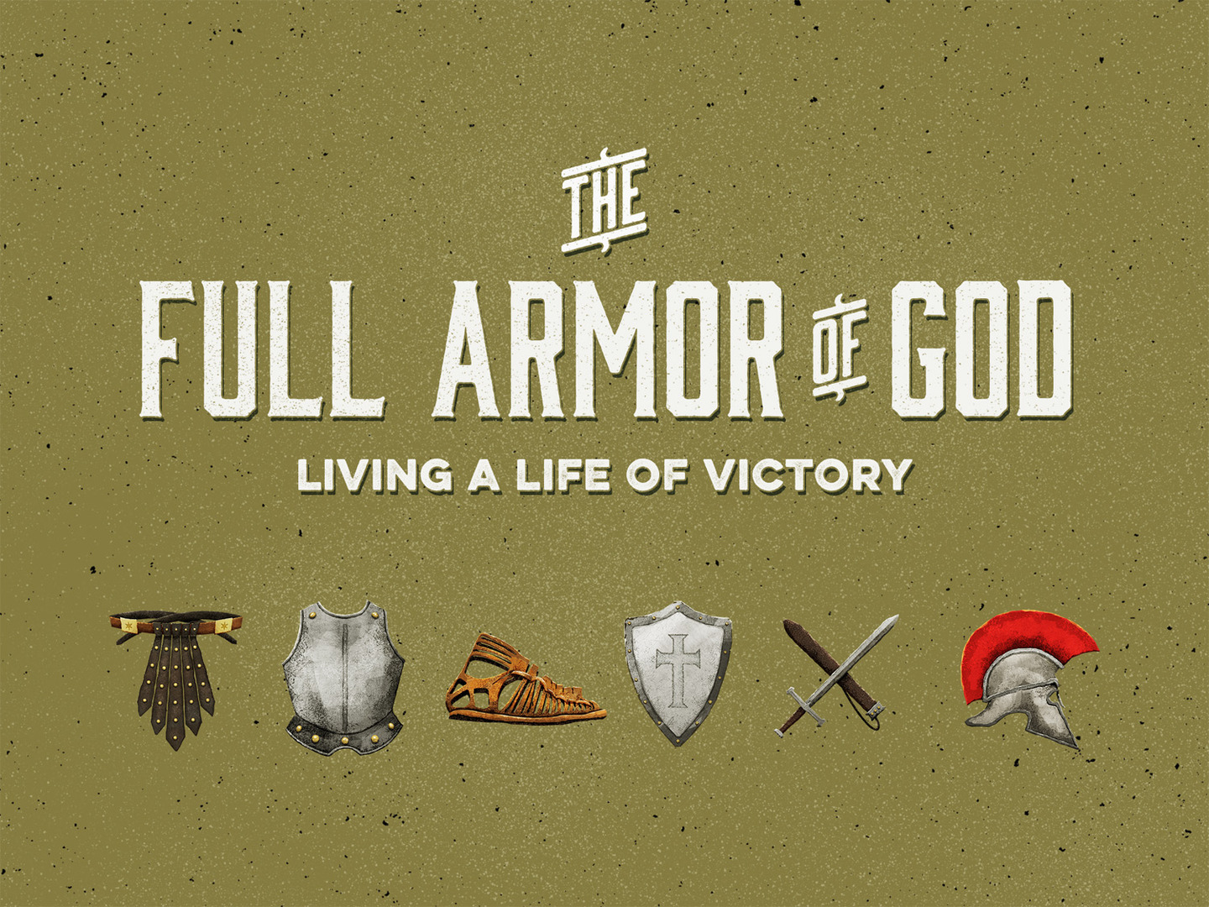

Slide 2
Be Strong in the Lord: 6.10
Strength is found when we “put on the armor of God.”

Slide 3
Put on “the Whole Armor”: 6.11, 13
Every piece!
If you join this fight, the equipment isn’t optional!

Slide 4
Take a Stand: 6.11, 13-14
Don’t surrender! Withstand! Resist! James 4.7
The devil will scheme against us to attack us: Eph. 4.27
“To be forewarned about the nature of his wiles is to be forearmed against them.”

Slide 5
Understand the nature of this battle: 6.12
Spiritual battle: John 18.36; 2 Cor. 10.4; 1 Tim. 1.18; 2 Tim. 2.3; 4.7
We Must Know How to Navigate the War Zone: Eph. 2.2, 10; 4.1, 17; 5.2, 8, 15

Slide 6
Recognize your enemy: 6.11-12
If we do not recognize the enemy, how can we fight him? Eph. 2.2; 2 Cor. 4.4; 1 John 5.19; Matt. 12.30; Phil. 3.18
He is a wolf in sheep’s clothing: Acts 20.29-31
He can appear as an angel of light: 2 Cor. 11.13-15

Slide 7
Do not to fight alone: 6.12, 18-19
This is why we need to be strong in the Lord; this is why we need the armor.
We are not alone on this spiritual battlefield: cf. 1 Peter 5.8-9; 1 Cor. 10.13

Slide 8
Our Armor Must Be Put on Properly
With prayer: 6.18

