Slide 1
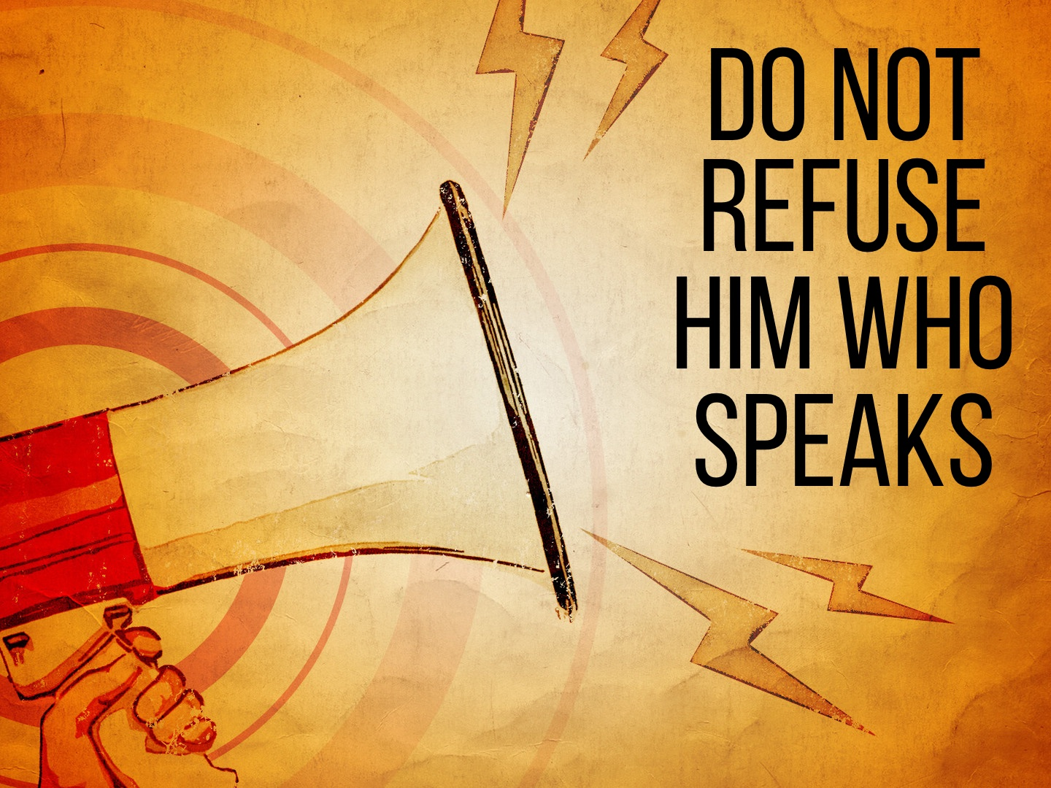

Slide 2
HOW PEOPLE REFUSE HIM
Some people refuse to listen: Matt. 13.9, 15; Zech. 7.8-12; Acts 2.37; 7.57; Acts 28.24-28
Some listen with no intention of obeying:
Luke 6.46; Matt. 19.16-22
Some reject those who preach the truth:
Luke 10.16; 2 Tim. 4.2-4; 1 Thess. 2.13

Slide 3
WHY PEOPLE REFUSE HIM
Heb. 3.12-13; 2 Thess. 2.10
Some trust in their own righteousness rather
than the righteousness of God: Rom. 10.1-3
Some love the praise of men more than the
praise of God: John 12.42-43; 2 Tim. 3.4; 4.10
Some trust in their own wisdom rather
than the wisdom of God: 1 Cor. 1.18, 22
Some trust the future: Acts 24.25

Slide 4
THE DANGER OF REFUSING HIM
Those who disobeyed Moses faced physical death without mercy: Heb. 2.1-3; 3.7-19; 10.28
It is a far more dangerous thing to disobey Jesus: Heb. 2.2-3; 10.29-31; 12.25-29
Notes:
Sermon idea from Bob Myhan

