Slide 1
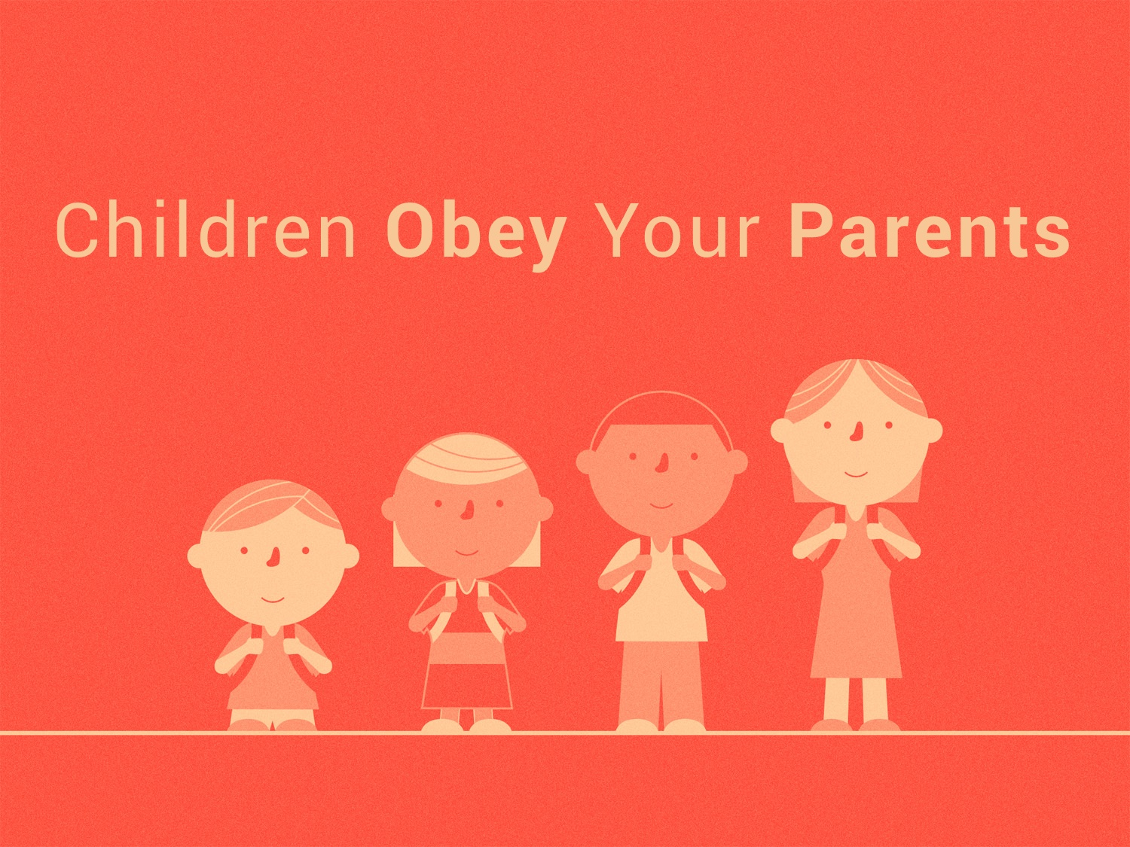

Slide 2
Children OBEY Your Parents in the LORD
Without DISAGREEMENT:
  Whether you AGREE or not.
  Whether you get SOMETHING out of it or not.
  Whether they are PRESENT or not.
  Whether the parents are FAITHFUL to God or not.

Slide 3
Children OBEY Your Parents in the LORD
CONDITIONALLY: cf. Col. 3.20; Acts 5.29
  Whatever we obey must “PLEASE the Lord”
For This Is RIGHT: cf. Col. 3.20
  If it is right to obey, it is WRONG to disobey: Rom. 1.30, 2 Tim. 3.2; 1 Tim. 1.9; 3.4, 12; Titus 1.6; Prov. 20.11
When you obey your parents, you’re obeying GOD.

Slide 4
Children HONOR Your Parents
by giving them your BEST.
by RESPECTING them.
by APPRECIATING them. cf. Mark 7.9-13; 1 Tim. 5.3-8, 16
to be BLESSED with a promise: cf. Exo. 20.12; 21.15, 17; Deut. 5.16; 21.18-21; 27.16; Rom. 1.30, 32

Slide 5
Children LISTEN to Your Parents
To learn God’s INSTRUCTIONS: Prov. 6.20-22; 23.22-25
To gain WISDOM from above: Prov. 15.20; 17.25; 19.26; 30.17
To REMEMBER your Creator: Eccl. 12.1

