Slide 1
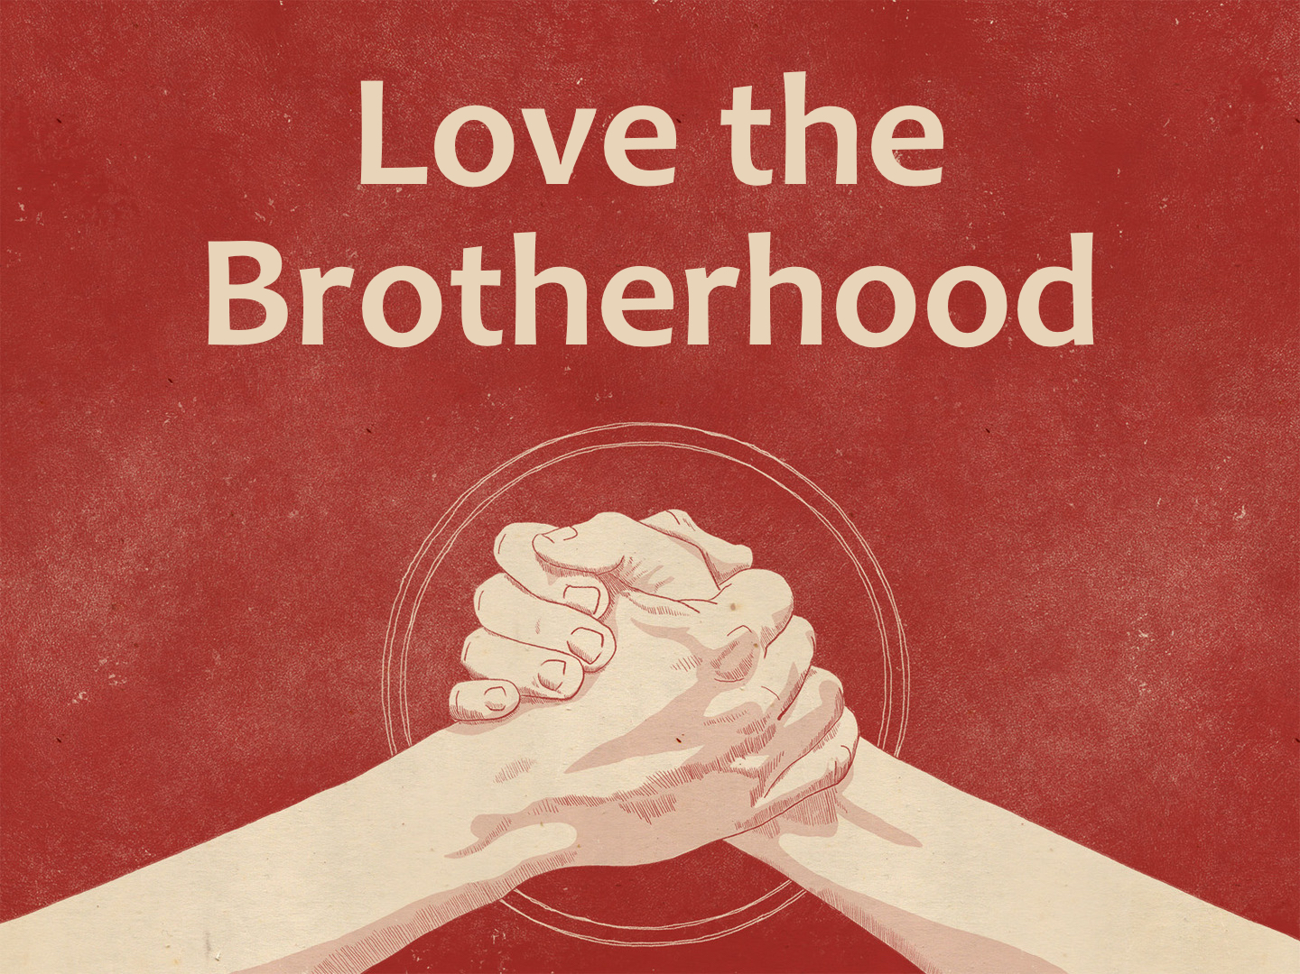

Slide 2
We Must Love the Brotherhood
Honor all people. Love the brotherhood. Fear God. Honor the king.
1 Peter 2.17

Slide 3
We Must Love the Brotherhood
Love one another with brotherly affection...
Romans 12.10

Slide 4
We Must Love the Brotherhood
We know that we have passed from death to life, because we love the brethren. He who does not love his brother abides in death.
1 John 3.14

Slide 5
We Must Love the Brotherhood
But concerning brotherly love you have no need that I should write to you, for you yourselves are taught by God to love one another; and indeed you do so toward all the brethren who are in all Macedonia. But we urge you, brethren, that you increase more and more…
1 Thessalonians 4.9-10

Slide 6
We Must Love the Brotherhood
We are a spiritual family: Matt. 12.46-50
We are beloved brethren, beloved of God: Heb. 2.11; Rom. 1.7; Phil. 4.1; 1 Thess. 1.4

Slide 7
We Must Love the Brotherhood
We share in blessings and sufferings: Rom. 16; Jude 3; 1 Cor. 3.9; Eph. 2.19; 3.6; 1 Peter 5.9
We must treat our brethren properly: Gen. 13.8; Gal. 5.13-15; Col. 3.12-14; Phil. 2.4; Rom. 14.19

Slide 8
We Must Love the Brotherhood
Do we love the brethren no matter their looks, social standing, gender, etc.?
  Do we treat each other like we dearly love each other?

Slide 9
We Must Love the Brotherhood
  Do we strive to develop a strong love for the brethren?
  Do we seek for peace and unity? Eph. 4

Slide 10
  Behold, how good and how pleasant it is
  For brethren to dwell together in unity!
  Psalm 133.1

