Slide 1
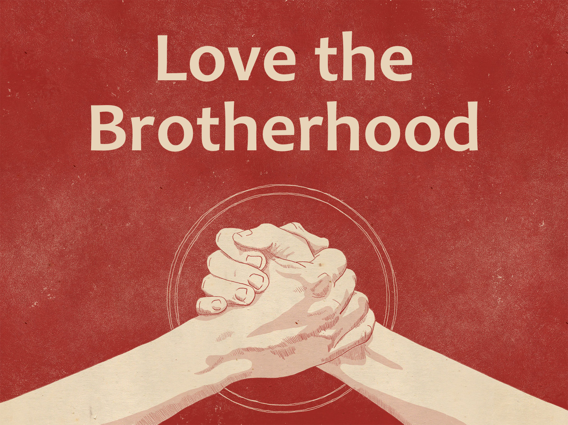

Slide 2
We Must Love the Brotherhood
Honor all people. Love the brotherhood. Fear God. Honor the king.
1 Peter 2.17

Slide 3
We Must Love the Brotherhood
We know that we have passed from death to life, because we love the brethren. He who does not love his brother abides in death.
1 John 3.14; 4.7-8, 20-21

Slide 4
We Must Love the Brotherhood
We are a spiritual family.
We are beloved brethren, beloved of God.
We share in blessings and sufferings.
We must treat our brethren properly.
John 13.34-35

Slide 5
We Must Love the Brotherhood
Do we love the brethren no matter their looks, social standing, gender, background, etc.?
  Do we strive to develop a strong love for the brethren?
  Do we seek for peace and unity? Eph. 4

Slide 6
Avoid the False Brethren
False brethren: Gal. 2.4-5; Acts 15.1-2, 5
False brethren upset the faith of some brethren: 2 Tim. 2.18; 2 Cor. 11.26
False brethren must be rebuked and silenced: Titus 1.9-13; 3.10; Rom. 16.17-18

Slide 7
Teach the Ignorant Brethren
Purpose of teaching and studying is to replace ignorance with knowledge: cf. 1 Cor. 12.1; 1 Thess. 4.13; Rom. 6.1-3; 7.1
Be gentle with the ignorant. Teach them patiently.

Slide 8
Encourage the Weak Brethren
Weak in personal conscience toward allowable things: Rom. 14.13, 15, 19-20; 15.1-2; 1 Cor. 8.7-13
Weak because of disobedience: 1 Cor. 11.30; Gal. 6.1-2; James 5.19-20

Slide 9
Encourage the Weak Brethren
Comfort and support the weak: 1 Thess. 5.11, 14; cf. 4.13-18
Admonish the idle (warn the unruly): 1 Thess. 4.11-12; 2 Thess. 3.6-12

Slide 10
Imitate the Faithful Brethren
Reputation for faithfulness: Col. 1.2-5; 4.7-9
Rooted and established in Christ: Col. 2.6-7; 1.9-12; Eph. 6.10; 1 John 2.14
Imitate these brethren: 1 Cor. 11.1; Heb. 6.12; 13.7

Slide 11
  Behold, how good and how pleasant it is
  For brethren to dwell together in unity!
  Psalm 133.1

