Slide 2
What good is religion or faith that does not modify behavior?
Religion is vain if there is no self-examination with a desire for application and self-improvement.

Slide 3
2.1
"The faith" Acts 6.7; 13.8; Rom. 1.5; 10.8; 1 Cor. 16.13; Gal. 1.11, 23; Col. 1.23; Jude 3
"The faith" is parallel to James 1.25; 2.12

Slide 4
2.1
Impartiality is a characteristic of God: Luke 20.21; Acts 10.34; 11.17; Rom. 2.10-11; 15.5-7; Gal. 2.6; 3.28; Eph. 6.9; Col. 3.25; 1 Tim. 5.21; 1 Peter 1.17
Impartiality is forbidden in the O.T.: Lev. 19.15; Deut. 1.17; Job 34.19
Impartiality is forbidden in "the faith" (it's contrary to, or incompatible with): 1 John 4.20

Slide 5
2.1
It is a bad reflection upon our Lord, the Lord of Glory.
We are to imitate Christ and God: Luke 6.40; Eph. 5.1
If we show partiality as Christians, we leave the impression that Jesus Himself is partial (prejudiced, biased, racist).

Slide 6
2.2-3
Assembly: or synagogue/place of worship/a collecting or gathering (can be used for a Jewish congregation or group meeting for worship): cf. Matt. 4.23
Synagogue was a material building: Luke 7.5; Matt. 6.5; 23.6; cf. James 2.3; Acts 9.2; 22.19; 26.11
Most likely these were visitors: cf. 1 Cor. 14.23
Contextually, favoritism was shown between the rich and the poor. However, favoritism was and can be shown in many ways.

Slide 7
What good is religion or faith that does not modify behavior?
Religion is vain if there is no self-examination with a desire for application and self-improvement.

Slide 8
2.4-5
James reasons socially, logically and morally: 4-13
They made distinctions
They judged with evil thoughts
They dishonored the poor: 6
They did not demonstrate love: 8
Judging with evil thoughts is contrary to righteous judging: John 7.24; Matt. 15.19

Slide 9
2.4-5
"Chosen”: Luke 7.22; 1 Cor. 1.26-29; cf. Eph. 1.4; 1 Peter 2.9
“poor in the world”: poverty is only in this world, but we can still be rich (in faith) with God’s grace and blessings: Eph. 1.3; Rev. 2.9

Slide 10
2.6-7
“Dishonored the poor man”: To treat shamefully and insult
"Oppress": dominate, exercise power over, exploit, etc.
We are to honor all men: 1 Peter 2.17
We are all made in the image of God: James 3.9
God honors the poor: Psalm 68.10; 69.33; Prov. 14.21

Slide 11
2.8
“royal”: of or belong to a king, kingly, royal; metaph. principal, chief (Thayer)
It is a law that governs or includes all other laws concerning how we treat others: Matt. 22.39-40
It sums up every command which applies between us and others: Rom. 13.9-10; Gal. 5.14

Slide 12
2.9-11
Partiality violates the law, therefore it's sinful: 1 John 3.4
Showing favoritism is "evil judging," "committing sin," "transgression,” and hatred, etc.
One is not guilty of murder if he didn't commit it, but the guilt of being a "law breaker" is on him regardless of what part he broke.
Notice: Partiality makes one just as guilty as the murderer or the adulterer: cf. 10-11 (One sin is as bad as another where God is concerned.)

Slide 13
2.12
Make this a habit!
Law of liberty: Cf. James 1.25
The law of liberty is the gospel message: John 8.31-32
Judged: cf. 2 Cor. 5.10; John 12.48

Slide 14
2.13
If the law of liberty has taught us anything it has taught mercy, and mercy should teach us to value all human beings equally: Matt. 5.7; 6.14-15; 25.40, etc.
Mercy is in opposition to partiality.
Dishonoring the poor is not showing mercy.
Those who despise the poor, certain races, etc. can expect to receive no mercy at the judgment! We cannot afford to face a judgment where there is no mercy!

Slide 15
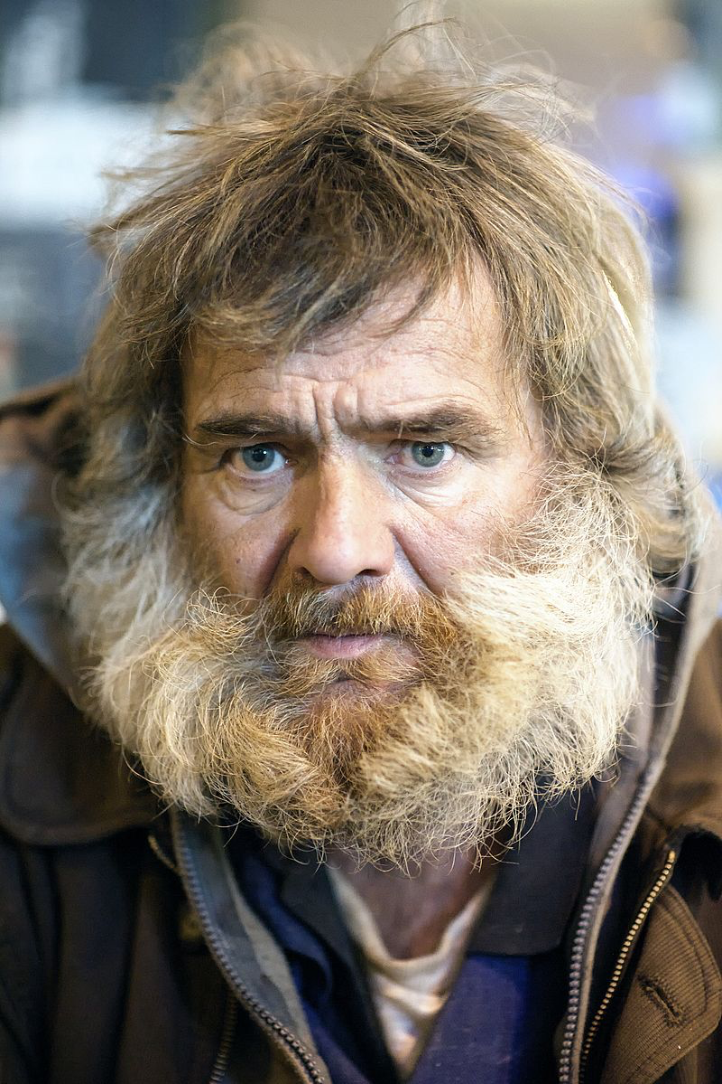
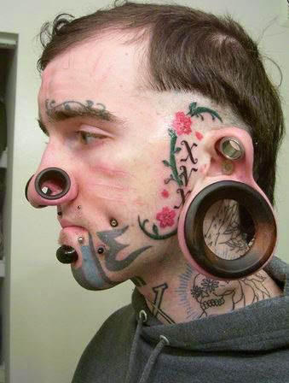
Which man needs the gospel?

Slide 16
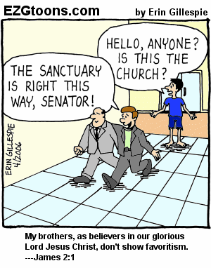

Slide 17
If we make Scripture our standard (12), then love will be our practice (8) and mercy will be the result (13).

Slide 18
Does Paul Contradict James Concerning Faith & Works?

Slide 19
The Contrast in Romans Is Between:
An active faith in Jesus: 1.5; 6.16-18; 16.25
Is not based on sinless perfection
Is dependent upon God’s mercy
A system of “works” demanding strict obedience (sinlessness) to law of Moses.

Slide 20
Paul and James Agree
Paul discusses:
James discusses:
Justification by (obedient) faith without LOM/circumcision: Rom.1.5; 6.17-18; 16.25
Faith working by love: Gal. 5.6
The worthless nature of faith without works
Justification by works (obedient faith): James 2.14-24
The faith which works by love
The worthless nature of faith without works

Slide 21
Paul and James Agree
Paul discusses:
James discusses:
Faith and works (strict obedience to the law of Moses / boastful works)
He does not exclude obedience when speaking of faith: 2 Thess. 1.7-9; Phil. 2.12, etc.
He never says “faith only”
Faith and works (obedience)
He is not talking about works of human merit or observing the Law of Moses. He is talking about requirements from God.

Slide 22
2.14
“Someone says he has faith”: James gives the acid test. Prove it!
There’s a faith that saves and a faith that does not save.
Without works his faith is vain. His religion is vain.

Slide 23
2.15-17
James continues his discussion on the poor and ties it to faith: cf. James 1.27; 2.1-13
A dismissal of all responsibility from the “I have faith” members. Cf. James 1.23, 25
Faith without works is dead. It’s inactive: 1 John 3.16-18

Slide 24
2.18
This challenges the “faith without works” person to demonstrate their professed faith.
Hint: it can’t be done.
It is like that of the demons: cf. v19

Slide 25
2.19-20
One God: cf. Deut. 6.4
“you do well” yet, believing a sound doctrine isn’t enough. Why? The demons believe that too!
We must practice what we believe!
The foolish man lacks truth and reason.

Slide 27
2.21-22
Works:
Not works of human invention or merit
Not works of LOM
Works of obedience: “when he offered up…”
Becuase he obeyed God his faith was completed/perfected.
THEREFORE: An incomplete/imperfect faith is a faith that lacks obedience.

Slide 28
2.23
Both James and Paul appeal to the same quotation to prove their point: Gen. 15.6
Friend: 2 Chron. 20.7; Isaiah 41.8; John 15.14

Slide 29
2.24
“works”, again, is defined by context as obedience.
The only time in Scripture “faith alone” is used and yet it’s “not by faith alone”
Side note: The word alone excludes everything else.

Slide 30
2.25
Rahab was an immoral gentile (prostitute): Josh. 2.1-22; 6.22-25; Heb. 11.31
Notice that she was a sinner justified by works!
Her faith in God would have been empty if she hadn’t risked everything to help the messengers.

Slide 31
2.25
Notice how James uses an illustration of a rich man (Abraham) and a poor woman (Rahab).
Both must demonstrate their faith.
Both are accepted by God: no partially!

Slide 32
2.26
Faith by itself is a like a dead body.
If our faith ceases to be active, we are spiritually dead.

Slide 33
Summary
Faith alone does not profit: 2.14
Faith alone will not save: 2.14
Faith alone is dead: 2.17, 20, 26
Faith alone cannot be shown: 2.18
Faith alone is possessed by demons: 2.19
Faith alone is incomplete: 2.22
Faith alone will not justify: 2.24

