Slide 1
DILIGENCE

Slide 2
Diligence
Diligence:
John 9:4-5 - night is coming, when no one can work.
Gal. 6:9-10 - while we have opportunity,
Eph. 5:15-16 - making the most of your time,
Diligently seek unity
Rom. 12:3-13
Eph. 4:1-3
1 Thess. 5:11-13

Slide 3
Diligently work for God’s approval
2 Tim. 2:15
Diligently improve ourselves
2 Pet. 1:5-15
Diligence and Faithfulness
Heb. 4:10-11
Rev. 2:10
Heb. 6:11-12
2 Pet. 3:14

Slide 4
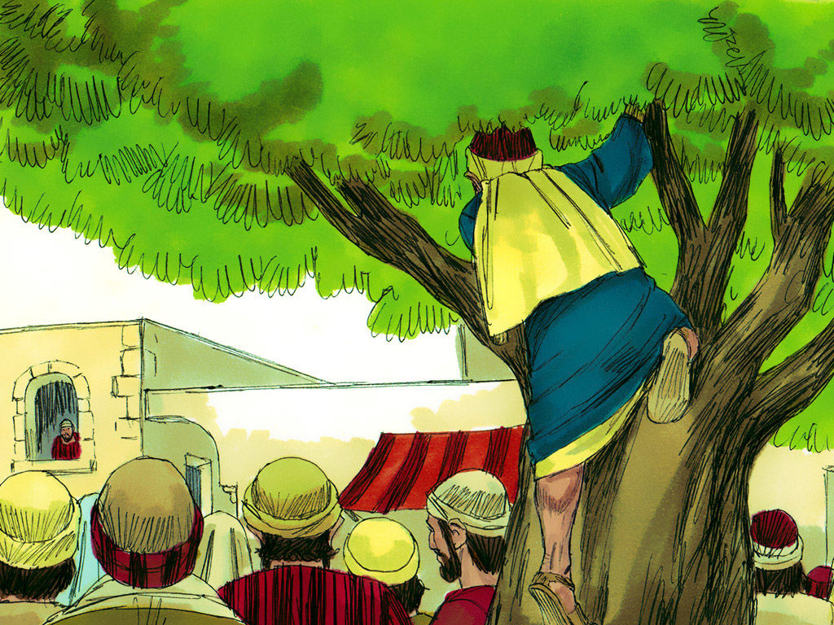
Make haste to come to Jesus – NOW!
Luke 19:5-6

