Slide 1
The art of grafting
4-2-23

Slide 2
Grafting
Romans 11:17-23
Ephesians 2:11-13

Slide 3
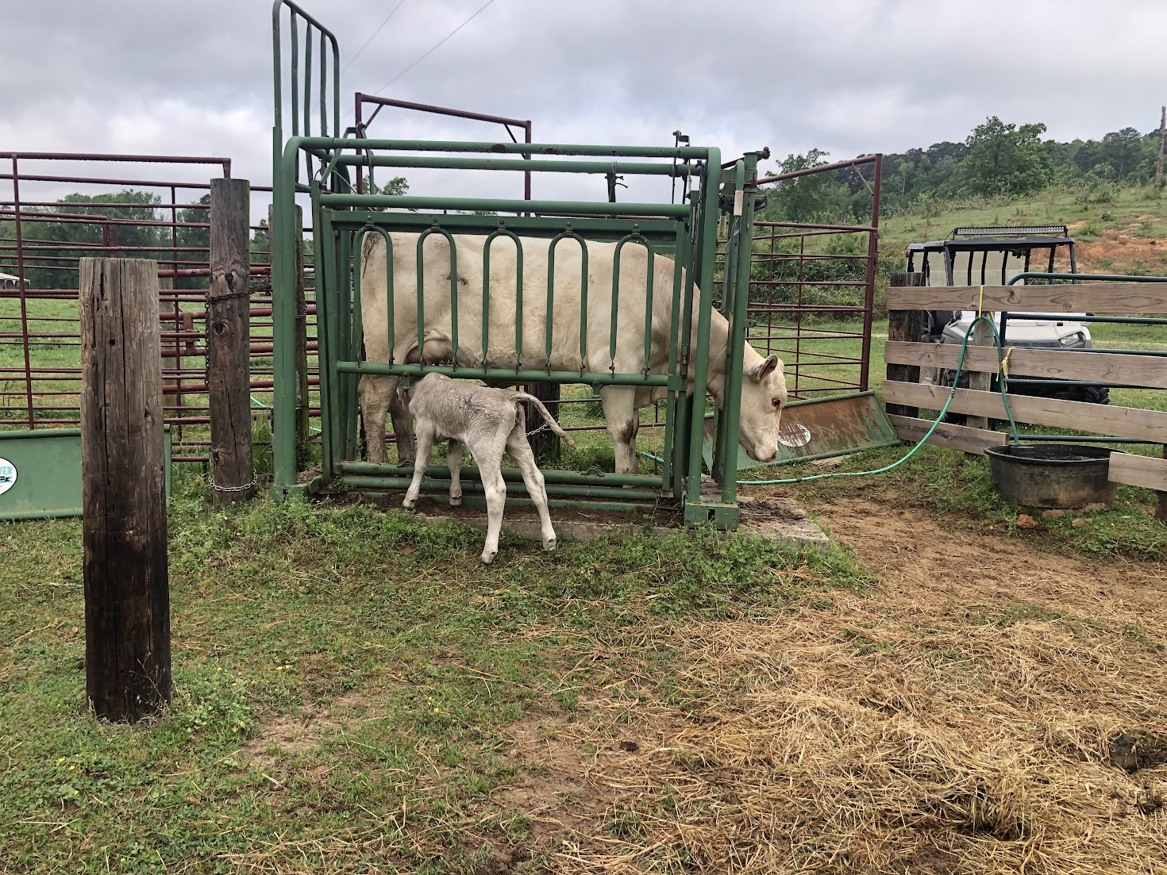
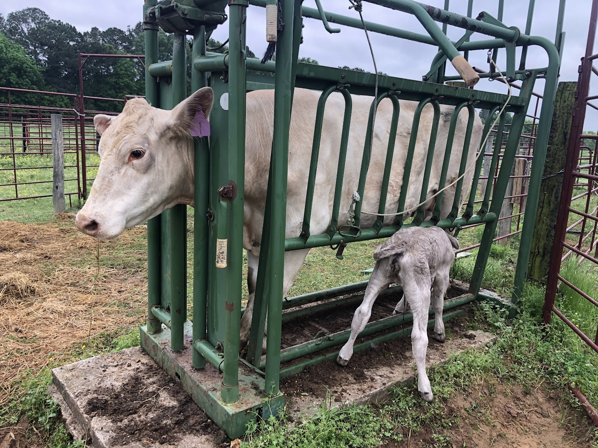

Slide 4
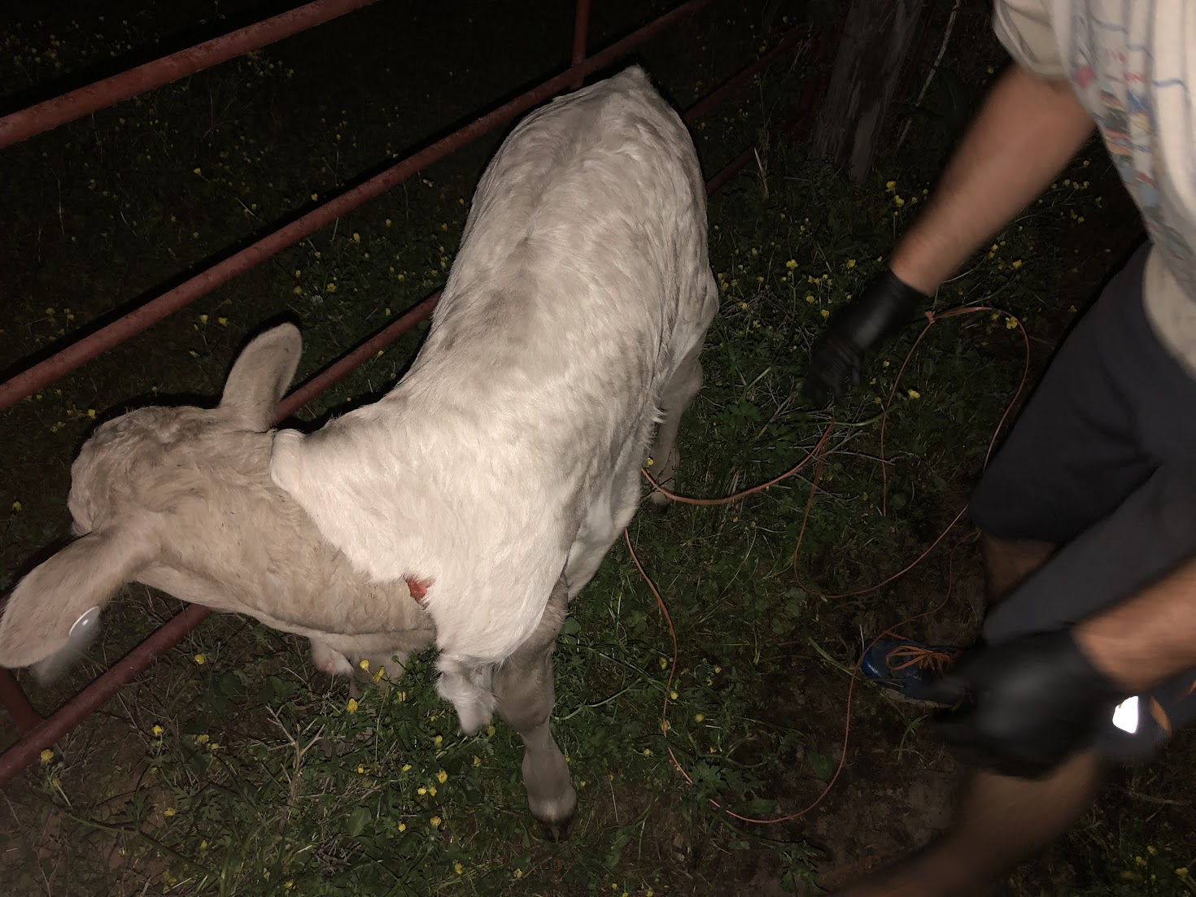

Slide 5
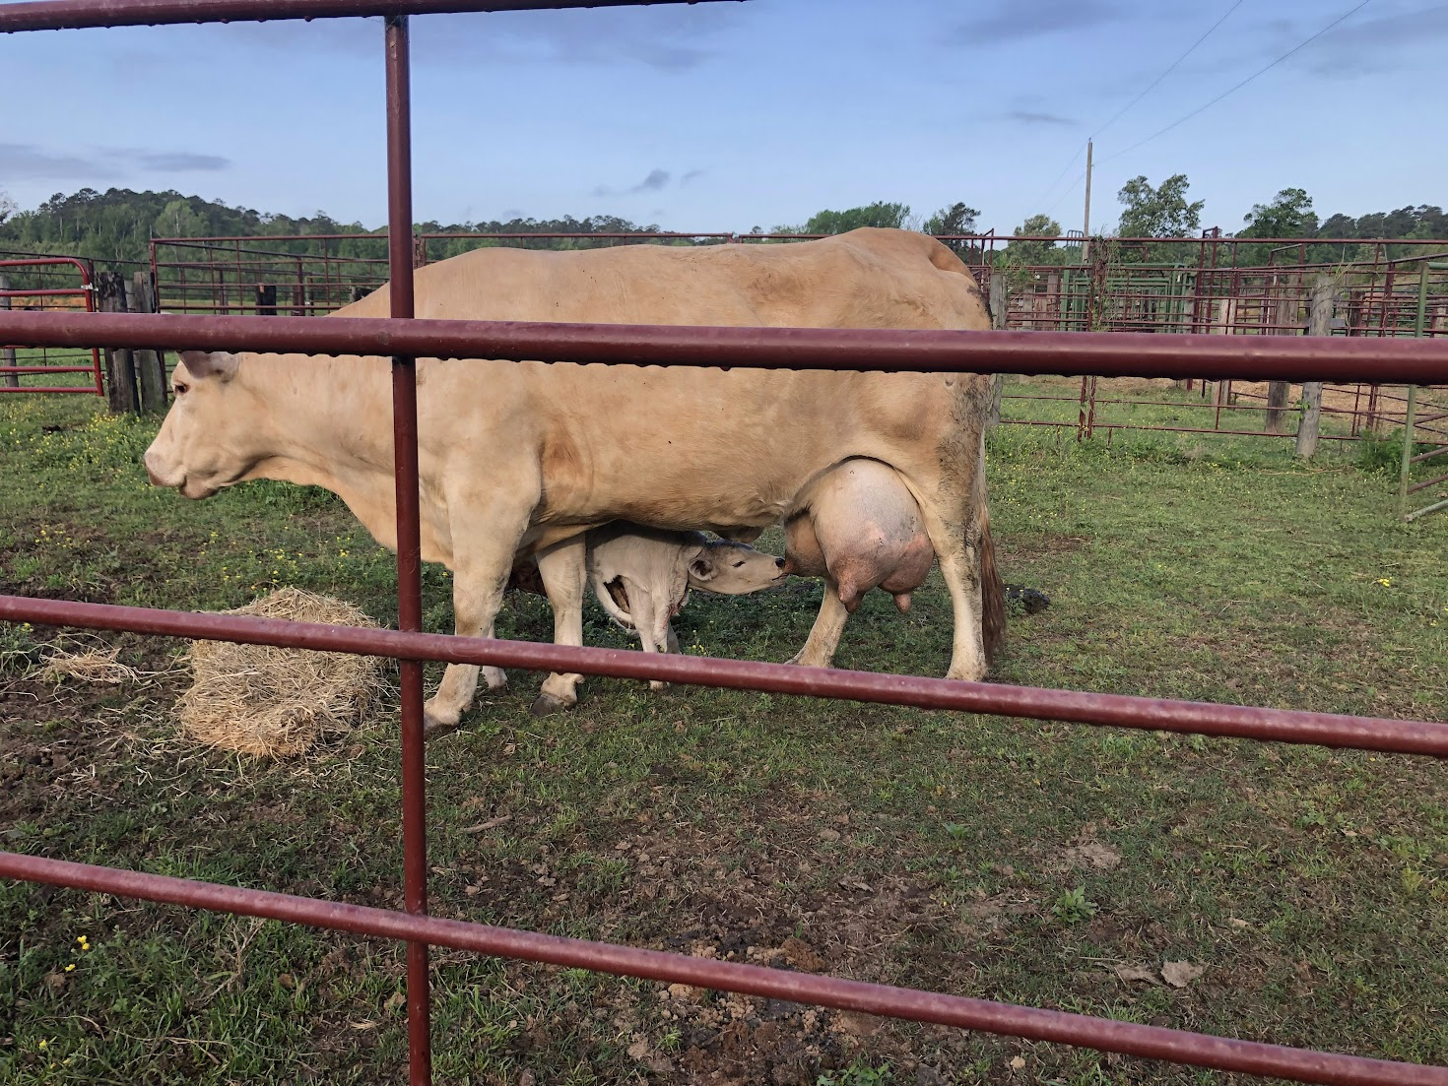
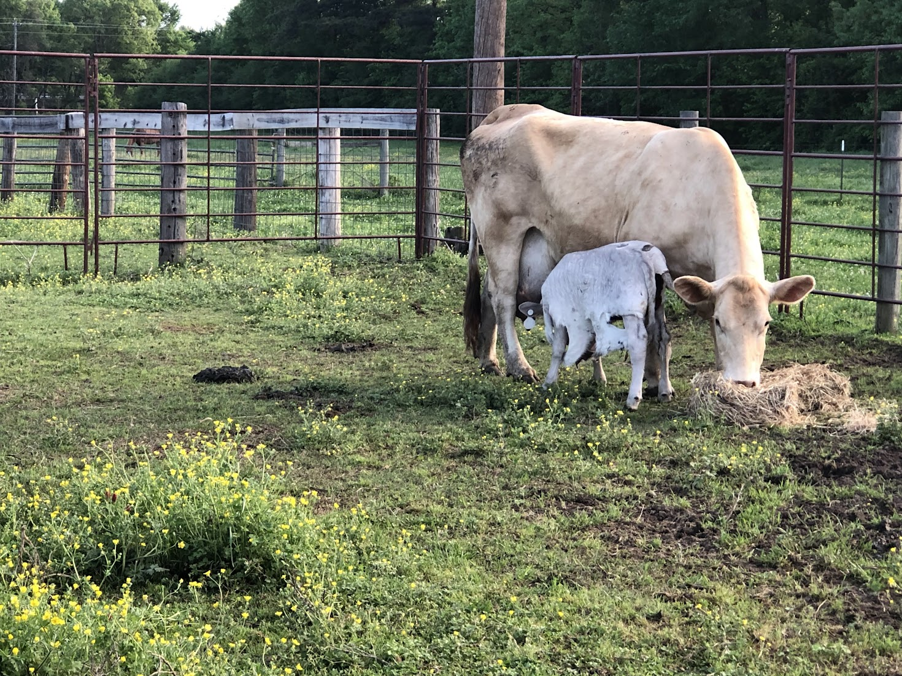
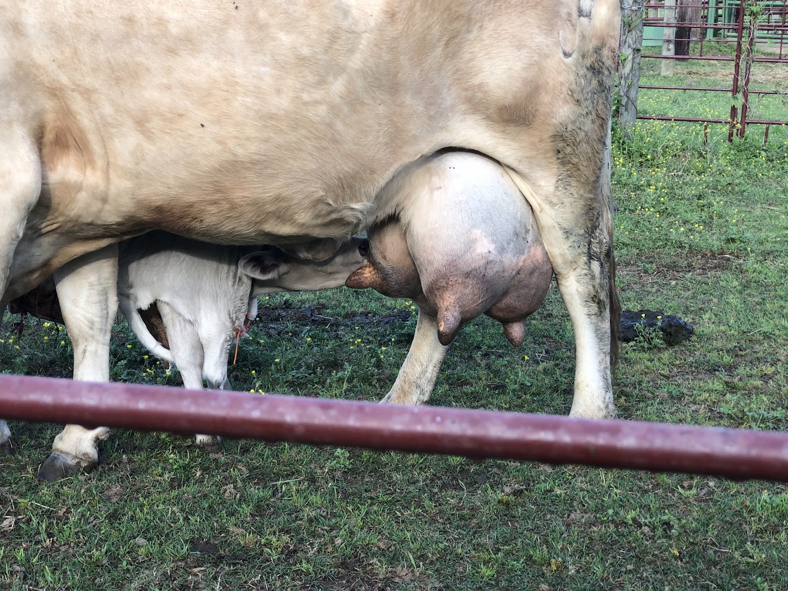

Slide 6
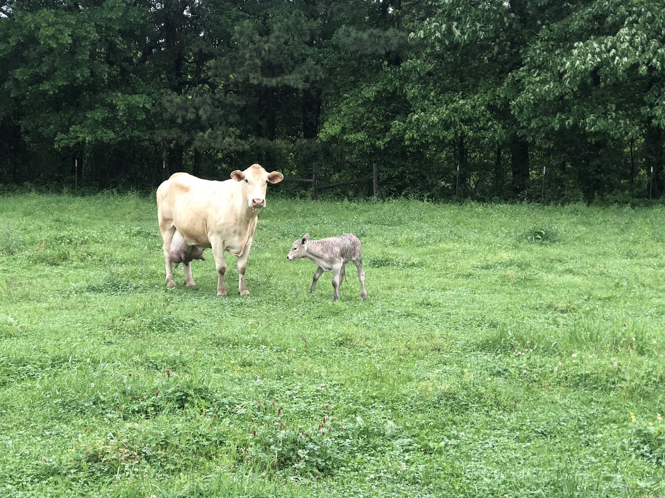
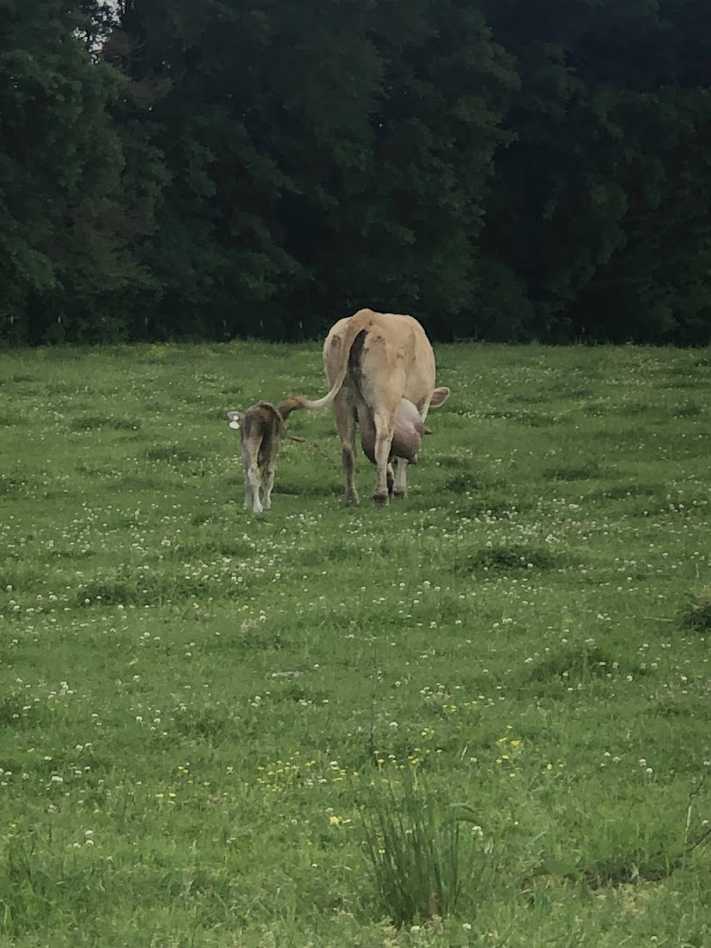

Slide 7
4 truths of grafting
4-2-23

Slide 8
The covering is greater than the covered
Exodus 12:3-7
Exodus 12:12-13
1 Chronicles 29:11
Yours, O Lord, is the greatness and the power and the glory and the victory and the majesty, for all that is in the heavens and in the earth is yours. Yours is the kingdom, O Lord, and you are exalted as the head above all.

Slide 9
The covering covered completely
Leviticus 13-14
Leviticus 13:45-46
Mark 1:40-44

Slide 10
The covered must change allegiance
2 Corinthians 5:14-17
Philippians 3:17-4:1
Ephesians 4:17-24

Slide 11
Death covered life, but life was not lost
Galatians 2:20-21
*2 Timothy 1:8-13
1 Corinthians 15:24-26
Hebrews 2:14

