Slide 1
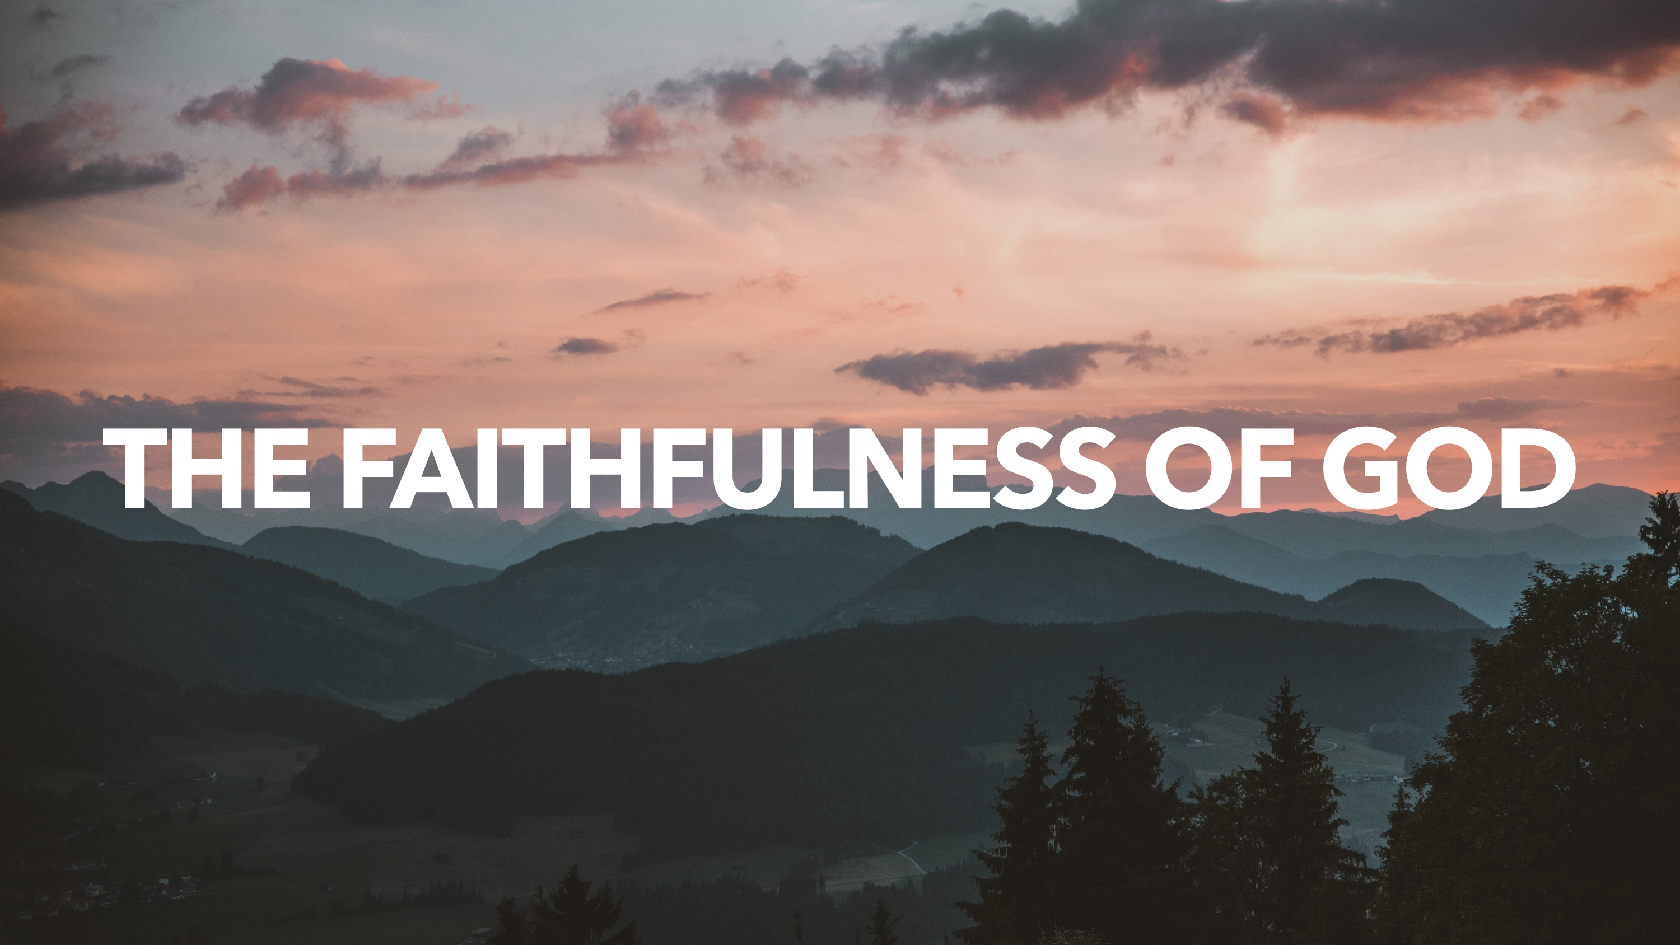

Slide 2
God’s faithfulness has always been under ATTACK and always will be.

Slide 3
God promised Abraham to bless the world through him, and throughout history, God DELIVERED and PROVIDED for His people so that He was loyal to His promises.
Despite the FAITHLESSNESS of God’s people, He remained faithful. And ultimately, God’s loyalty to His covenantal promises is KNOWN through Jesus Christ, who was loyal, and which brings about our loyalty.

Slide 4
What Does God’s Faithfulness Mean to Us?
We serve a TRUSTWORTHY God—fear and obey Him!
We can have CONFIDENCE in Him—we are not hopeless.
We have nothing to fear and no need for EMBARRASSMENT.
We are motivated by His promises to greater HOLINESS.
We can speak FREELY to our King and remind Him of His promises.

