Slide 1
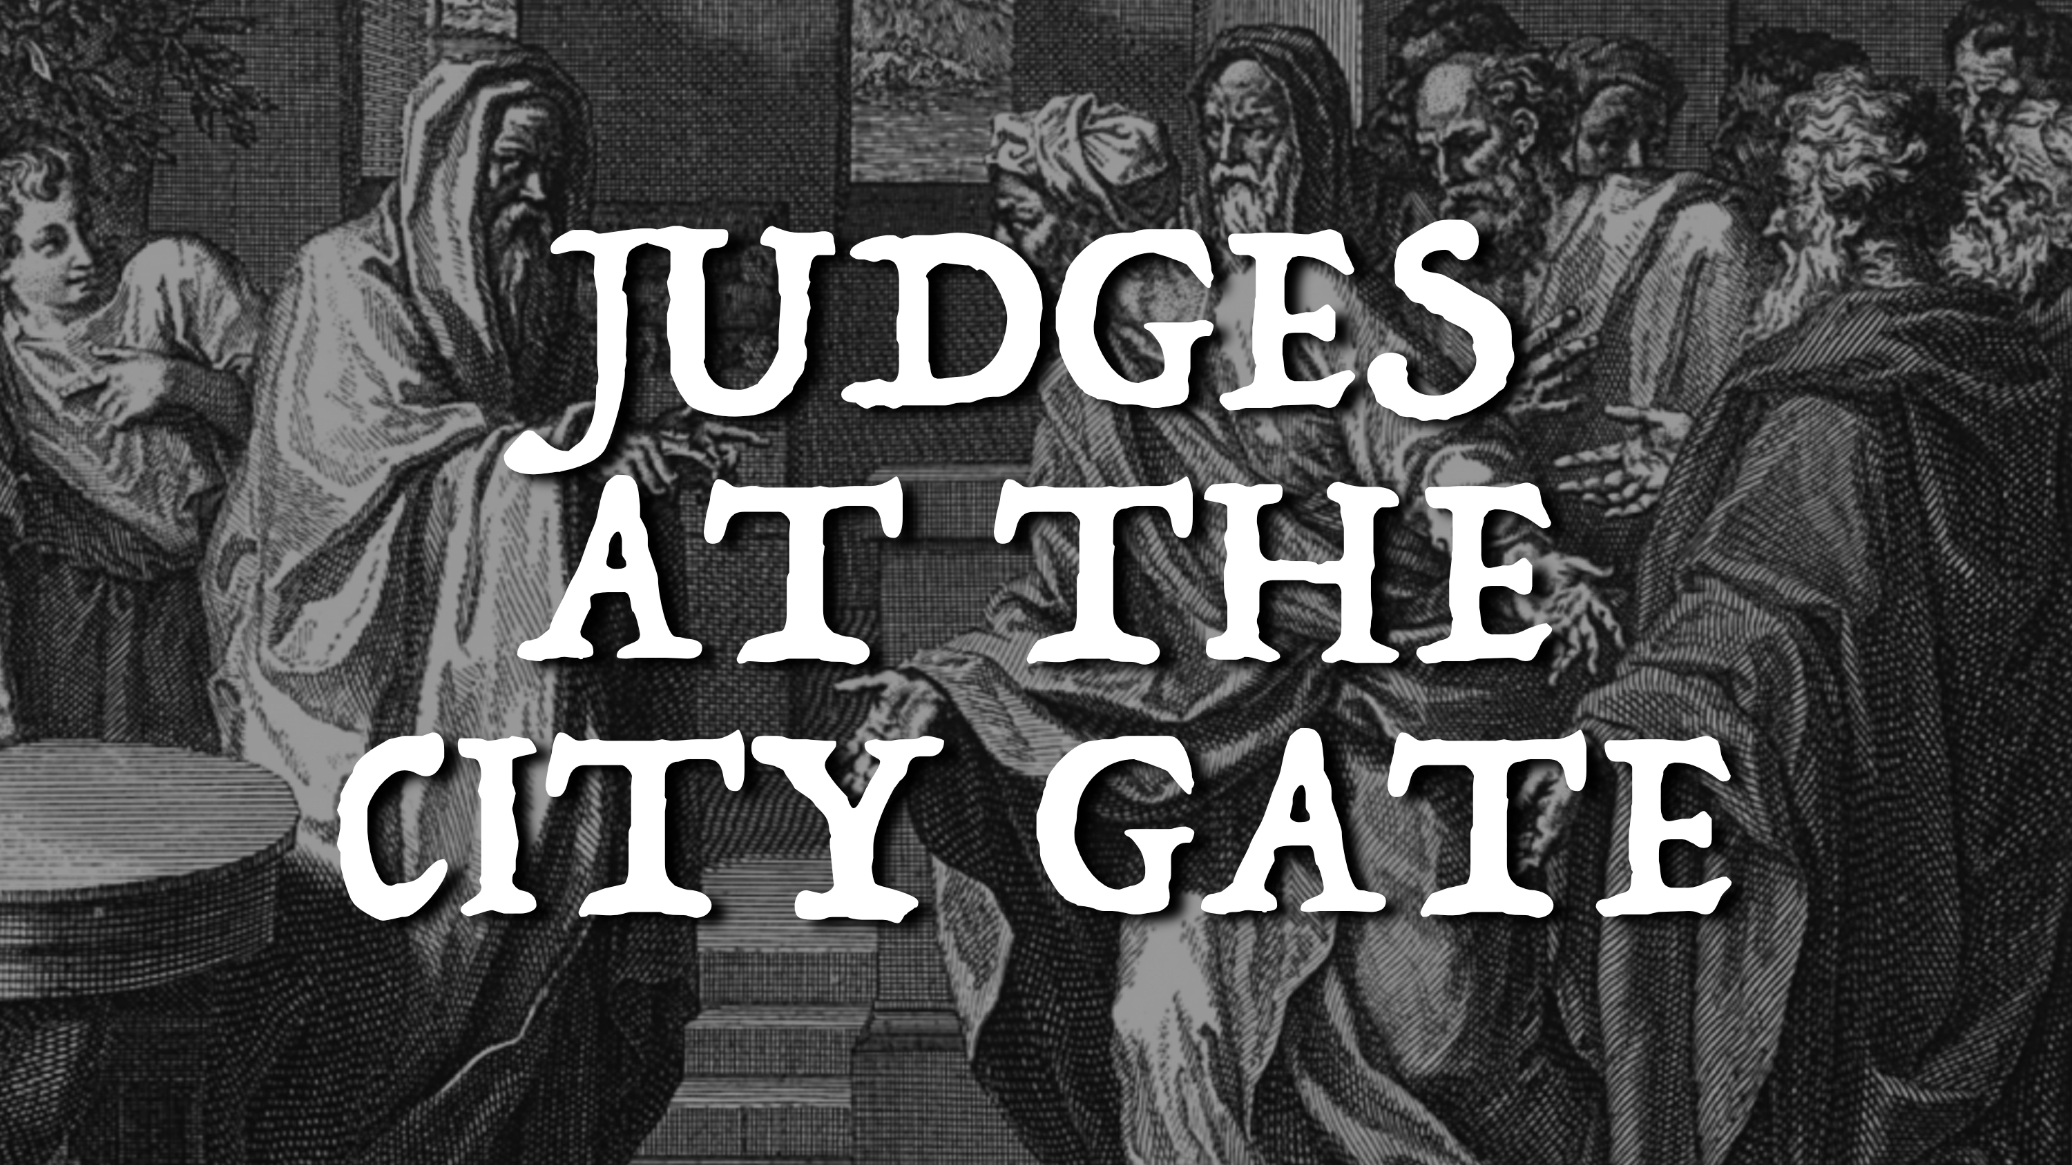

Slide 2
The Eldership in the Old Testament
They had to meet QUALIFICATIONS.
They served as REPRESENTATIVES of the community.
They were the TEACHERS of the law.
They were the JUDGES of all matters.
They were responsible for the community’s FAITHFULNESS.

Slide 3
The Eldership in the Gospel Accounts
They had a necessary PERSUASION over the community but abused their power.
They had the right (and responsibility) to challenge Jesus as the PROTECTORS of Israel but refused to examine His teachings honestly.
All these things culminated in the PERSECUTION of King Jesus rather than natural submission to His authority.

Slide 4
We must take the biblical commentary of failed leadership and learn from it. Our elders must “sit at the city gate,” watching over us and holding us accountable to the precepts of God as we mature in Christ.

