Slide 1
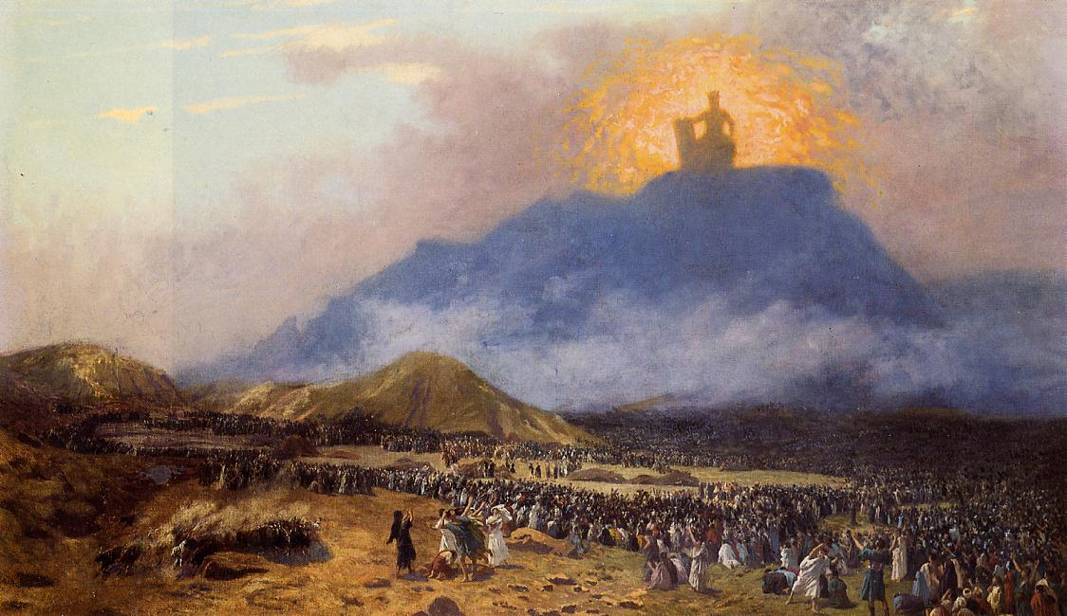
Biblical Curses

Slide 2
Curses are real
Not Just Hoodoo or Fiction!
Curses Fall on Real People
Curses Are the Opposite of Blessings – Gen 1.22,28; Gen 3.17-19

Slide 3
Man Sins god curses man Man withers and dies

Slide 4
Examples of Curses
Adam and Eve – Genesis 4.11-12
Mount Ebal and Gerizim – 28.15-26, 45
Jesus and the Fig Tree – Mark 11.21

Slide 5
Man Sins god curses man Man withers and dies

Slide 6
The Source of all curses
God

Slide 7
Numbers 22.6,18; 23.11-12

Slide 8
Curses today
Fall Upon Those Who Preach Falsehood – Galatians 1.6-10
Bring About Condemnation – 2 Peter 2.1-3
Punish the Self-Seeking – Romans 2.8

Slide 9
Avoiding Curses
By Studying God’s Word Daily – Joshua 1.8
By Preaching Truth – Matthew 28.18-20
By Living In Truth – 2 Timothy 2.15, 1 John 1.5-6

Slide 10
Blessings Curses Light Sin Life Death Rest Destruction

