Slide 1
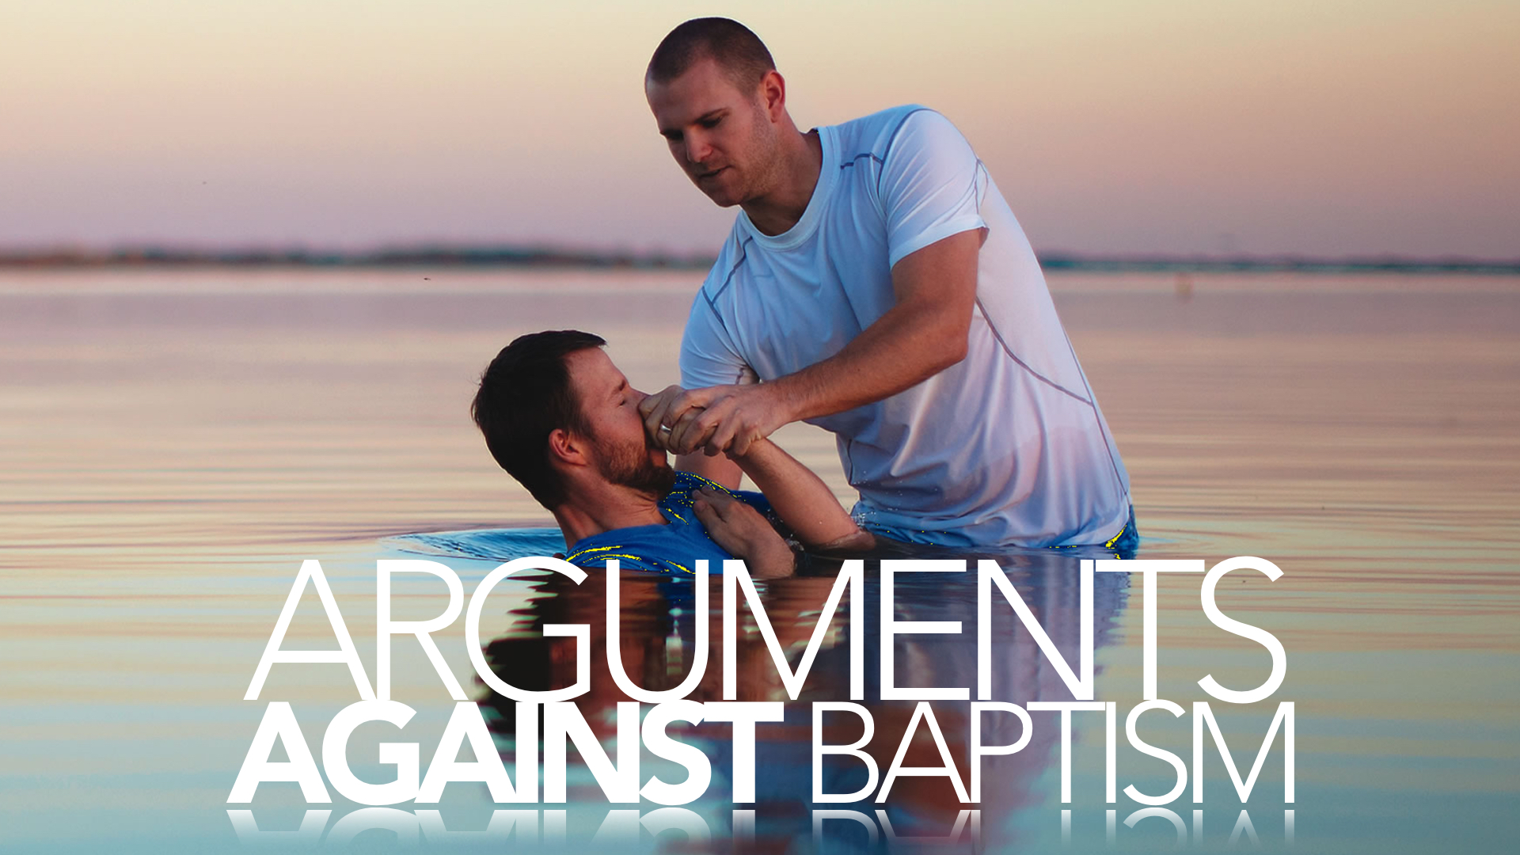

Slide 2
“the Bible does not teach baptismal regeneration”
“you’re not saved by water baptism”
“water baptism has nothing to do with salvation”
“when you get in the water and you go under the water you die to your old way of life, you’re buried with Christ in baptism, you’re raised to walk in newness of life”
“people who build a doctrine that says you have to be baptized in order to be saved”

Slide 3
“the Bible makes it clear that if we take this verse… ‘he who has believed and has baptized shall be saved’ the Bible assumes that if you really believed you’re going to be baptized and if you refuse to be baptized you probably never believed.”

Slide 4
“baptism is a work”

Slide 5
“for by grace you have been saved through faith not through baptism”

Slide 6
“he had prayed and received Christ”

Slide 7
“it’s what you do after you’re saved to show that you’re saved, but it doesn’t make you saved… baptism is something you do to show the world”

