Slide 1
Managing carbs
5.15.22

Slide 2
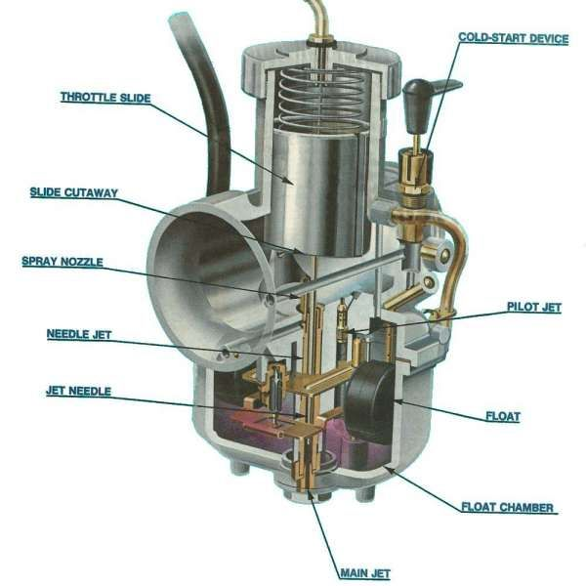

Slide 3
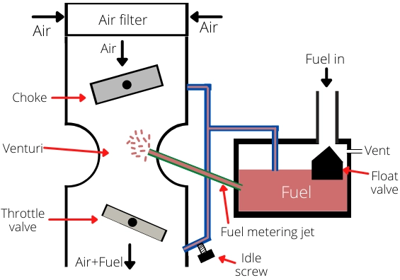

Slide 4
Intake issues
Philippians 4:6-9 Romans 12:1-2 James 1:19-21
-Matthew 2:37
And He said to him, you shall love the Lord your God with all your heart and with all your soul and with al your mind.
-Proverbs 4:23
Keep your heart with all vigilance, for from it flow the springs of life.
-Romans 8:6
For to set the mind on the flesh is death, but to set the mind on the Spirit is life and peace.

Slide 5
Adjustment issues
1 Corinthians 14:15 Philippians 2:1-8 2 Corinthians 10:3-6
-1 Peter 1:13
Therefore, preparing your minds for action, and being sober-minded, set your hope fully on he grace that will be brought to you at the revelation of Jesus Christ.
-Colossians 3:2
Set your mind on things that are above, not on things that are on earth.
-Romans 7:23
But I see in my members another law waging war against the law of my mind and making me captive to the law of sin that dwells in my members.

Slide 6
Replacement issues
Romans 8:1-8
There is therefore now no condemnation for those who are in Christ Jesus. For the law of the Spirit of life has set you free in Christ Jesus from the law of sin and death. For God has done what the law, weakened by the flesh, could not do. By sending His own Son in the likeness of sinful flesh and for sin, he condemned sin in the flesh, in order that the righteous requirement of the law might be fulfilled in us, who walk not according to the flesh but according to the Spirit. For those who live according to the flesh set their minds on the things of the flesh, but those who live according to the Spirit set their minds on the things of the Spirit. For to set the mind on the flesh is death, but to set the mind on the Spirit is life and peace. For the mind that is set on flesh is hostile to God, for it does not submit to God’s law; indeed, it cannot. Those who are in the flesh cannot please God.

Slide 7
I have found that trying to become more like Jesus yields far better results than trying to become a better me.

