Slide 1
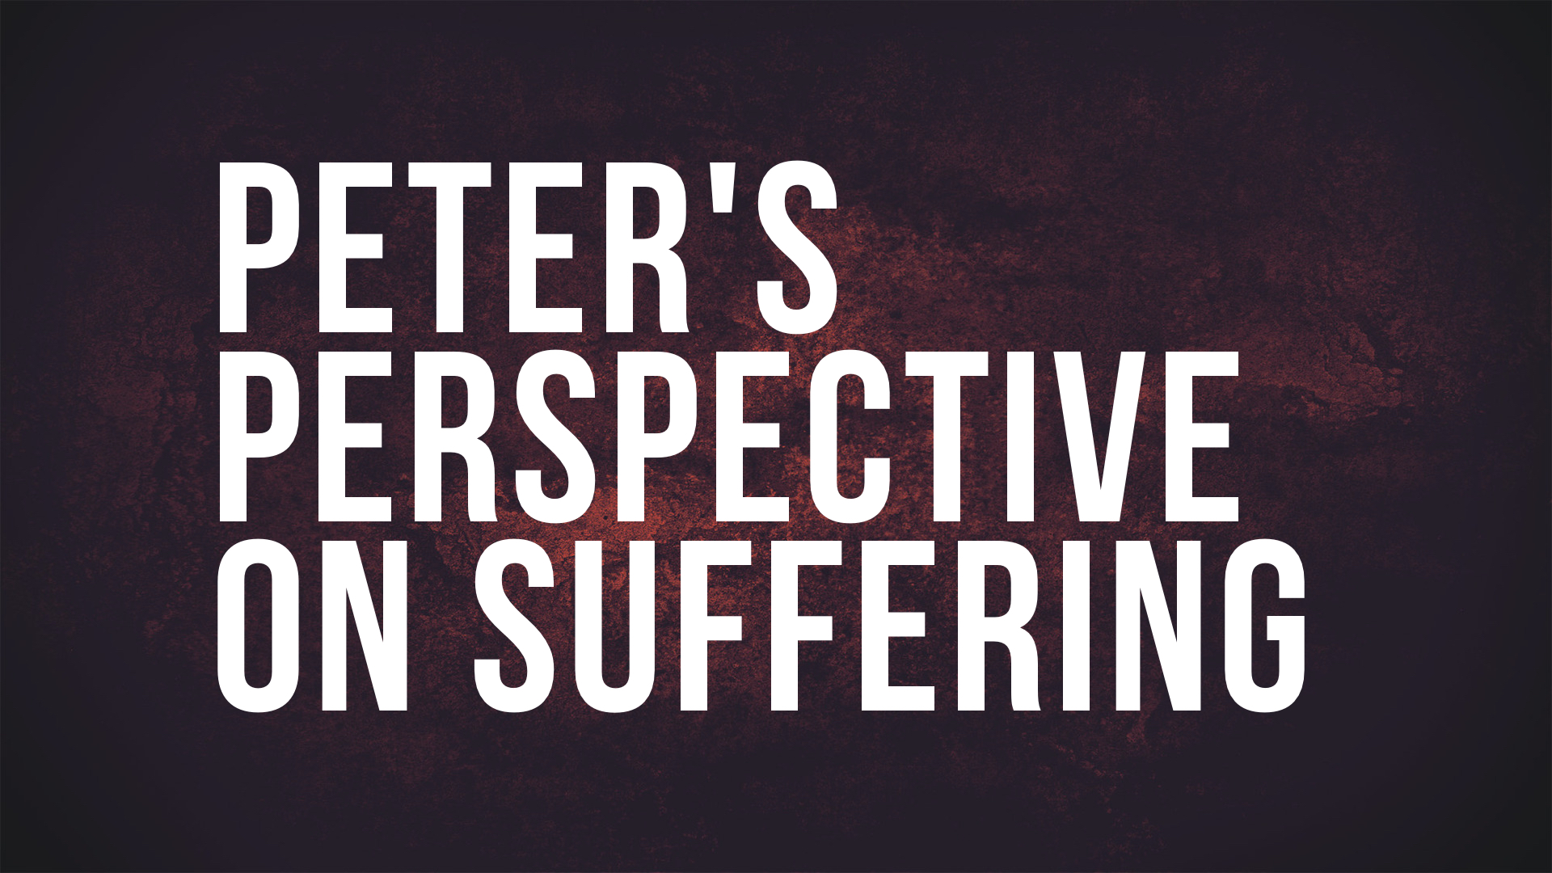

Slide 2
How Can We Have Peter’s Perspective?
1 Peter 1.6-9 — view suffering as an opportunity to prove your faith.
1 Peter 2.12, 20 — view suffering as an opportunity to glorify your Father.
1 Peter 2.21; 4.1, 13 — view suffering as an opportunity to identify with your Savior.

