Slide 2
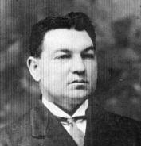
James Rowe
Born in England in 1865 and died in America in 1933.
“You Never Mentioned Him to Me” written in 1929.
Hymns for Worship #598

Slide 3
Verse 1
When in the better land before the bar we stand, How deeply grieved our souls will be; If any lost one there should cry in deep despair, “You never mentioned Him to me.”

Slide 4
Verse 2
O let us spread the word where'er it may be heard, Help groping souls the light to see, That yonder none may say, “You showed me not the way. You never mentioned Him to me.”

Slide 5
Verse 3
A few sweet words may guide a lost one to His side, Or turn sad eyes on Calvary; So work as days go by, that yonder none may cry, “You never mentioned Him to me.”

Slide 6
Chorus
“You never mentioned Him to me, You helped me not the light to see; You met me day by day and knew I was astray, Yet never mentioned Him to me.”

Slide 7
598 - You Never Mentioned HimTo Me - Title

Slide 8
598 - You Never Mentioned HimTo Me - 1.1

Slide 9
598 - You Never Mentioned HimTo Me - 1.2

Slide 10
598 - You Never Mentioned HimTo Me - 1.3

Slide 11
598 - You Never Mentioned HimTo Me - C.1

Slide 12
598 - You Never Mentioned HimTo Me - C.2

Slide 13
598 - You Never Mentioned HimTo Me - C.3
End of Verse 1

Slide 14
598 - You Never Mentioned HimTo Me - 2.1

Slide 15
598 - You Never Mentioned HimTo Me - 2.2

Slide 16
598 - You Never Mentioned HimTo Me - 2.3

Slide 17
598 - You Never Mentioned HimTo Me - C.1

Slide 18
598 - You Never Mentioned HimTo Me - C.2

Slide 19
598 - You Never Mentioned HimTo Me - C.3
End of Verse 2

Slide 20
598 - You Never Mentioned HimTo Me - 3.1

Slide 21
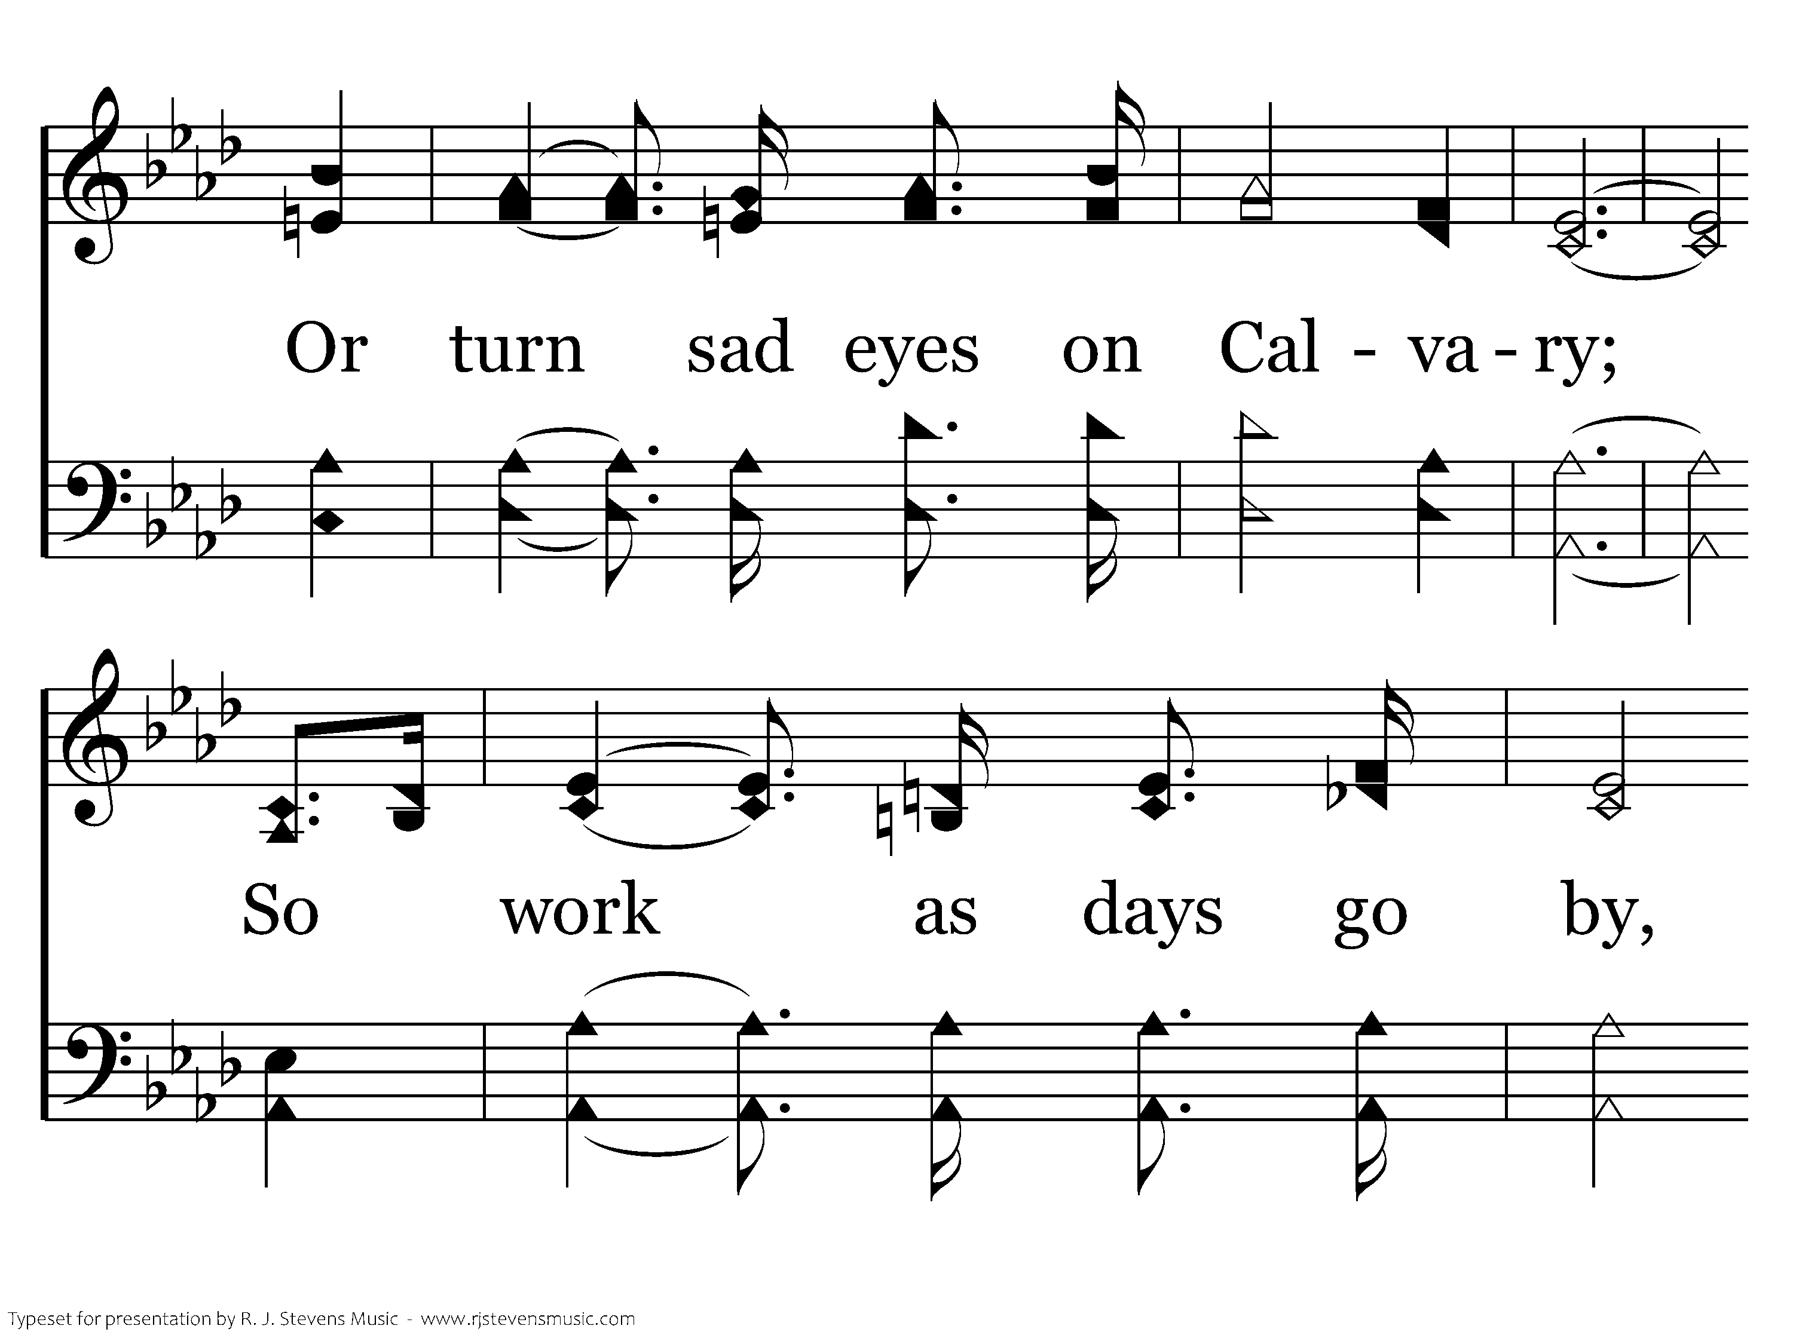
598 - You Never Mentioned HimTo Me - 3.2

Slide 22
598 - You Never Mentioned HimTo Me - 3.3

Slide 23
598 - You Never Mentioned HimTo Me - C.1

Slide 24
598 - You Never Mentioned HimTo Me - C.2

Slide 25
598 - You Never Mentioned HimTo Me - C.3
End of Song

