Slide 1
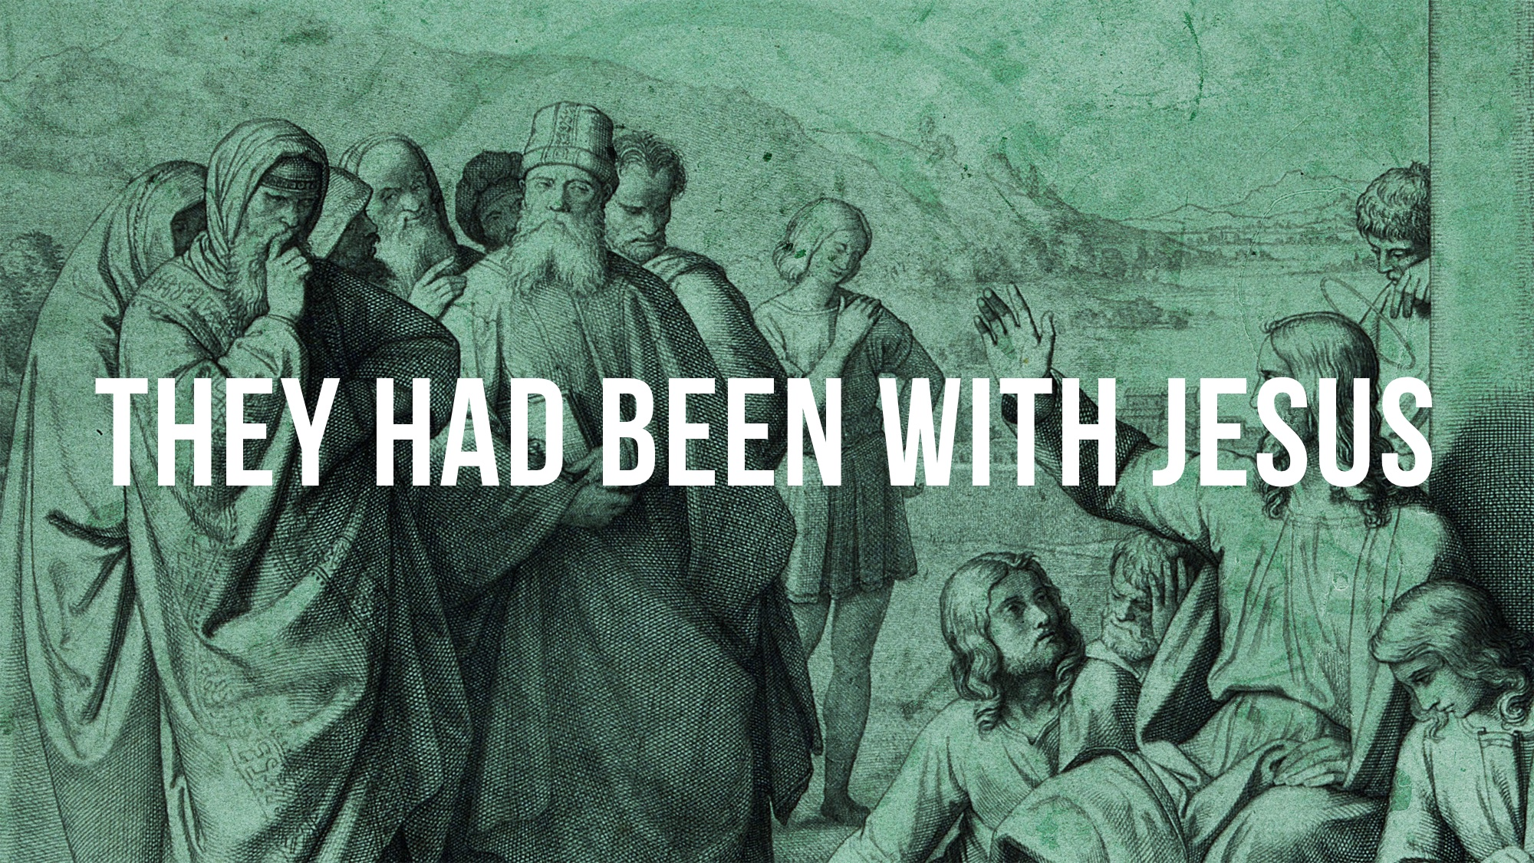

Slide 2
They Had Been with Jesus – Acts 4.13
They were trained by Jesus: to pray, to do good, to obey, and to teach.
They were driven by the resurrection.

Slide 3
Do people know that we have been “with Jesus”?

