Slide 1
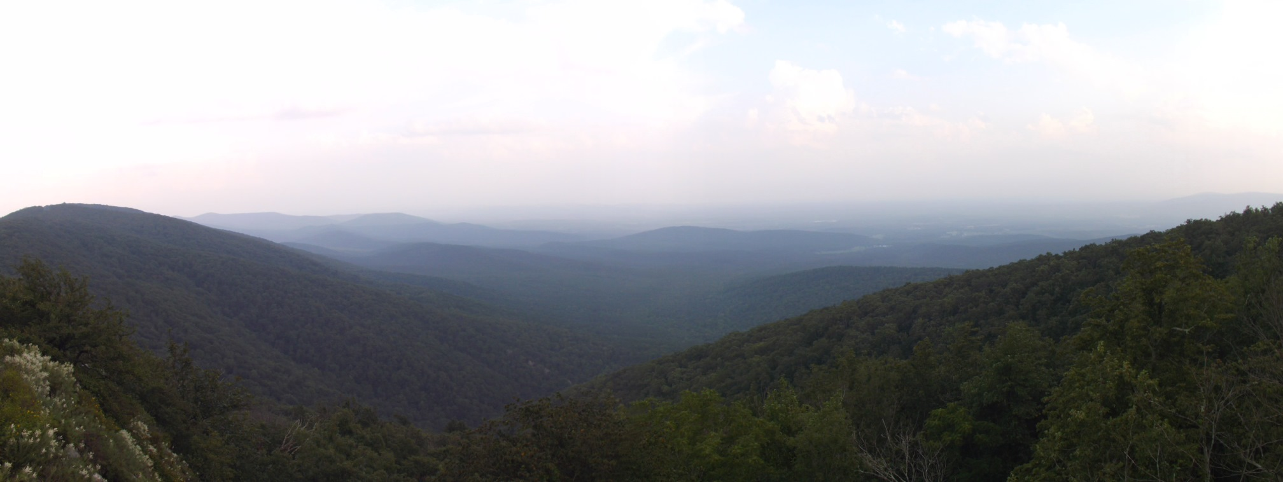
What I learned
on a Mountain
Luke 15:11-32

Slide 2
What I learned on a mountain
Luke 15:11-32
Be still and listen
Job 6:24 Psalm 46:1-7 Exodus 14:14 Proverbs 3:1-6
Your Heavenly Father is always waiting
Romans 8:31-39 Colossians 1:19-23 Matthew 10:29-31 Psalm 94:14
Don’t miss the big picture
James 1:22-27 1 John 2:1-6 2 Thessalonians 2:14-15 Isaiah 30:18

