Slide 1
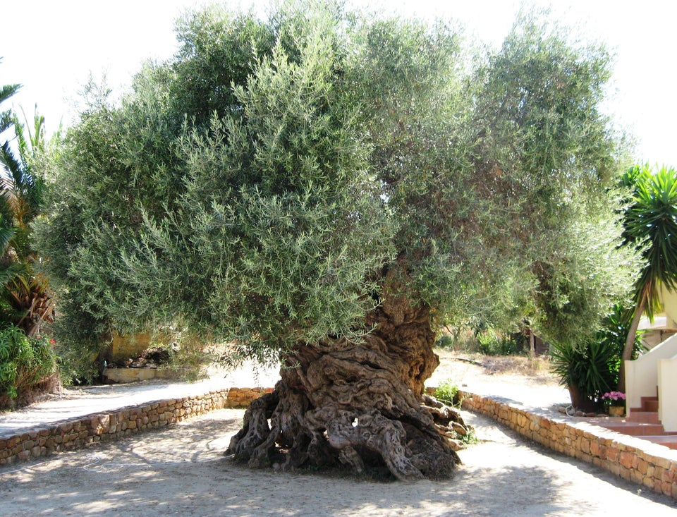
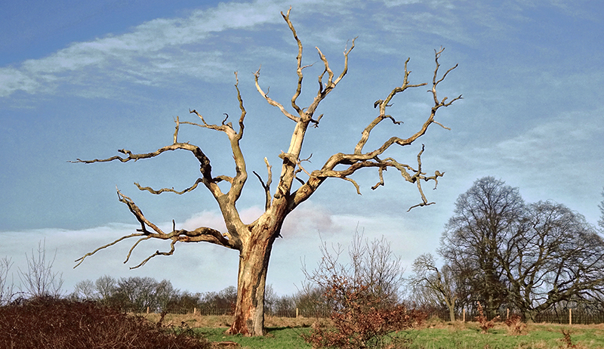
“Lord, Increase Our Faith.”

Slide 2
Increase Our Faith
Why?
1. It is PLEASING to God. Heb 11:1-3, 6
2. We are justified by FAITH and WORKS Rom. 3:28; Gal. 2:16; James 2:24
3. Faith leads to PERFECTION: Heb. 6:1
4. Faith produces WORKS: James 2:18
5. Jesus KNOWS our faith: Rev. 2:19

Slide 3
Realistically
1. We want to, we need to, we intend to – but we PROBABLY WON’T.
2. We say, “AMEN” and “GOOD LESSON”.
3. It is not easy to BREAK our CURRENT habits.
4. It is HARD to make NEW habits.
5. It is much easier to PLAN than to DO.

Slide 4
Anyway – here are a few things that will help us increase our faith:
1. Your Bible is your FRIEND!
2. God really does want us to PRAY.
3. TALK about your faith.

Slide 5
Increase Our Faith
Faith that isn’t USED will WITHER and DIE.
Faith that is used will GROW.
It’s OUR choice.
We WANT to.
We know we NEED to.
Decide now, while you agree, to DO.

