Slide 1
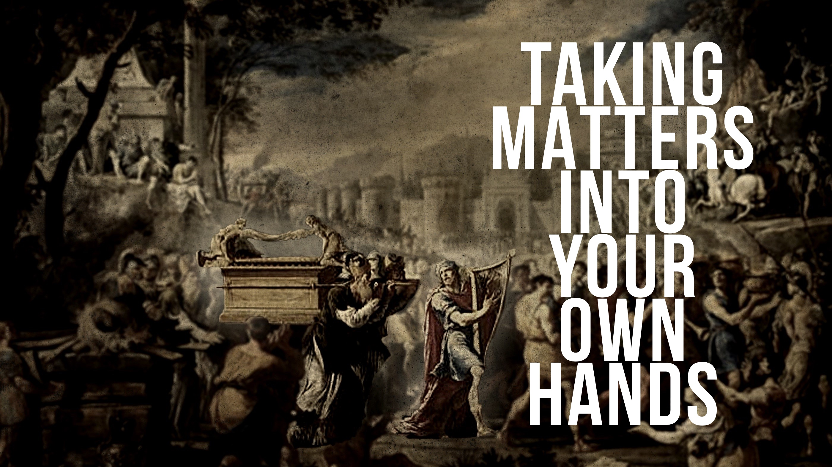

Slide 2
Why Did God Kill Uzzah?
They disobeyed His instructions for TRANSPORTING the ark.
They disobeyed His instructions by TOUCHING holy things.

Slide 3
When Do We Take Matters into Our Own Hands?
When CONVENTIONAL wisdom becomes the standard.
When the BEHAVIOR of others becomes the standard.
When “SILENCE is permissive” becomes the standard.
When GOOD intentions become the standard.
When FEELINGS become the standard.
When RELAXING God’s commands becomes the standard.

