Slide 1
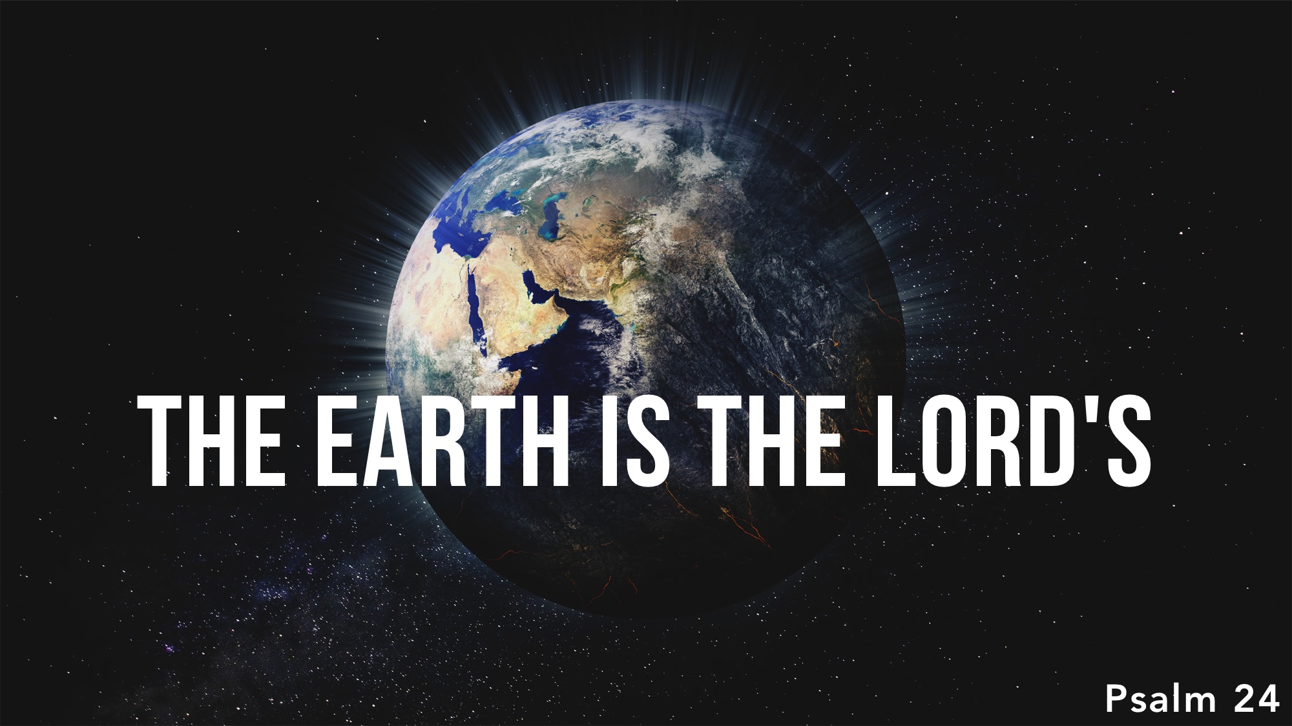

Slide 2
Since God is our maker – and owner of all things – we must humble ourselves and subject all things to His glory.

Slide 3
Only those with outward and inward conformity to godliness may approach the holy and awesome Jehovah.

Slide 4
Praise to the victorious King!

