Slide 1
HEBREWS 11

Slide 2
“FAITH IN THE UNSEEN”
“Now faith is the substance of things hoped for, the evidence of things not seen.” (Heb. 11:1)

Slide 3
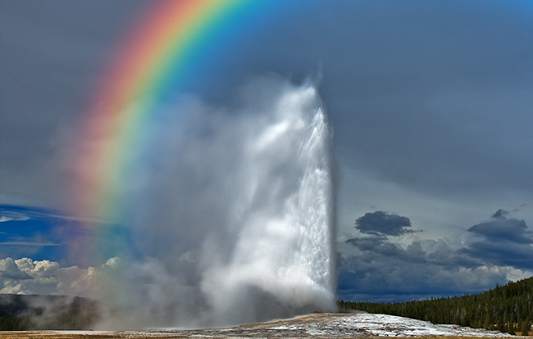
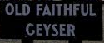

Slide 5
HEBREWS 11
CREATION vs. 3 (Gen. 1)
Hebrews 11:3
³ By faith we understand that the worlds were framed by the word of God, so that the things which are seen were not made of things which are visible.

Slide 6
HEBREWS 11:7
NOAH (Genesis 6:5-8, 11-14, 22; 7:1, 5)
⁷ By faith Noah, being divinely warned of things not yet seen, moved with godly fear, prepared an ark for the saving of his household, by which he condemned the world and became heir of the righteousness which is according to faith.

Slide 7
HEBREWS 11:8-10
ABRAHAM (Genesis 12:1-4)
⁸ By faith Abraham obeyed when he was called to go out to the place which he would receive as an inheritance. And he went out, not knowing where he was going. ⁹ By faith he dwelt in the land of promise as in a foreign country, dwelling in tents with Isaac and Jacob, the heirs with him of the same promise; ¹⁰ for he waited for the city which has foundations, whose builder and maker is God.

Slide 8
HEBREWS 11:11-12
SARAH (Genesis 17:15-17; 18:11-15)
¹¹ By faith Sarah herself also received strength to conceive seed, and she bore a child* when she was past the age, because she judged Him faithful who had promised. ¹² Therefore from one man, and him as good as dead, were born as many as the stars of the sky in multitude — innumerable as the sand which is by the seashore.

Slide 9
HEBREWS 11:17-19
ABRAHAM/ISAAC (Genesis 22:1-3)
17 By faith Abraham, when he was tested, offered up Isaac, and he who had received the promises offered up his only begotten son,
18 of whom it was said, "In Isaac your seed shall be called,"
19 concluding that God was able to raise him up, even from the dead, from which he also received him in a figurative sense.

Slide 10
HEBREWS 11:24-27
MOSES (Exodus 2)
²⁴ By faith Moses, when he became of age, refused to be called the son of Pharaoh's daughter, ²⁵ choosing rather to suffer affliction with the people of God than to enjoy the passing pleasures of sin, ²⁶ esteeming the reproach of Christ greater riches than the treasures in* Egypt; for he looked to the reward.
²⁷ By faith he forsook Egypt, not fearing the wrath of the king; for he endured as seeing Him who is invisible.

Slide 11
- NOAH
- ABRAHAM
- SARAH
- ISAAC
- MOSES
Hebrews 11:13-14
¹³ These all died in faith, not having received the promises, but having seen them afar off were assured of them,* embraced them and confessed that they were strangers and pilgrims on the earth. 14 For those who say such things declare plainly that they seek a homeland.

Slide 12
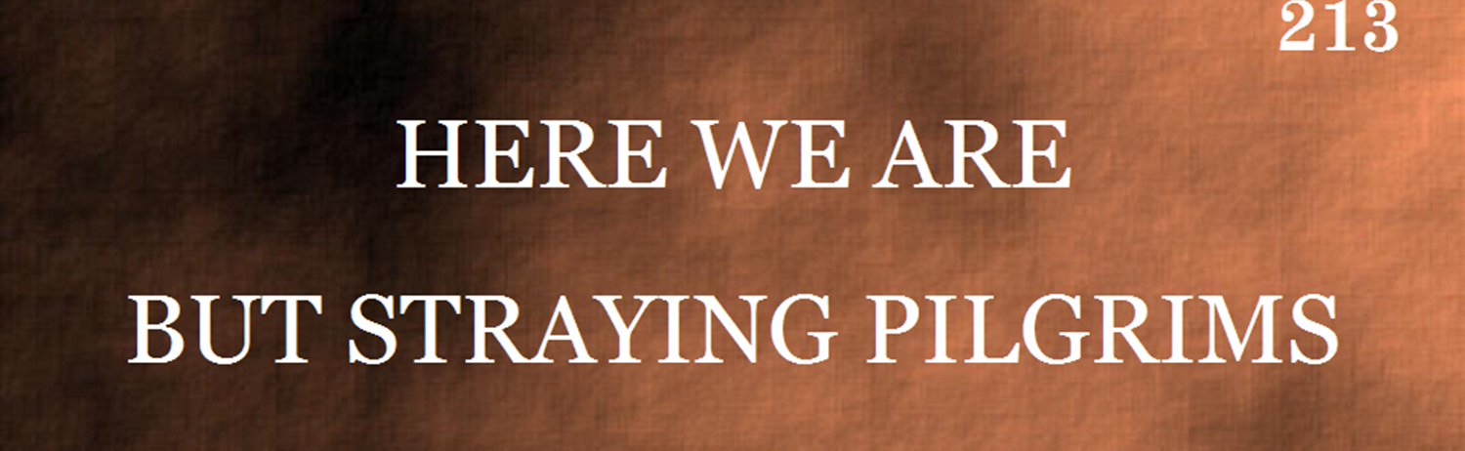

Medley: “Homeward Bound”

Slide 13
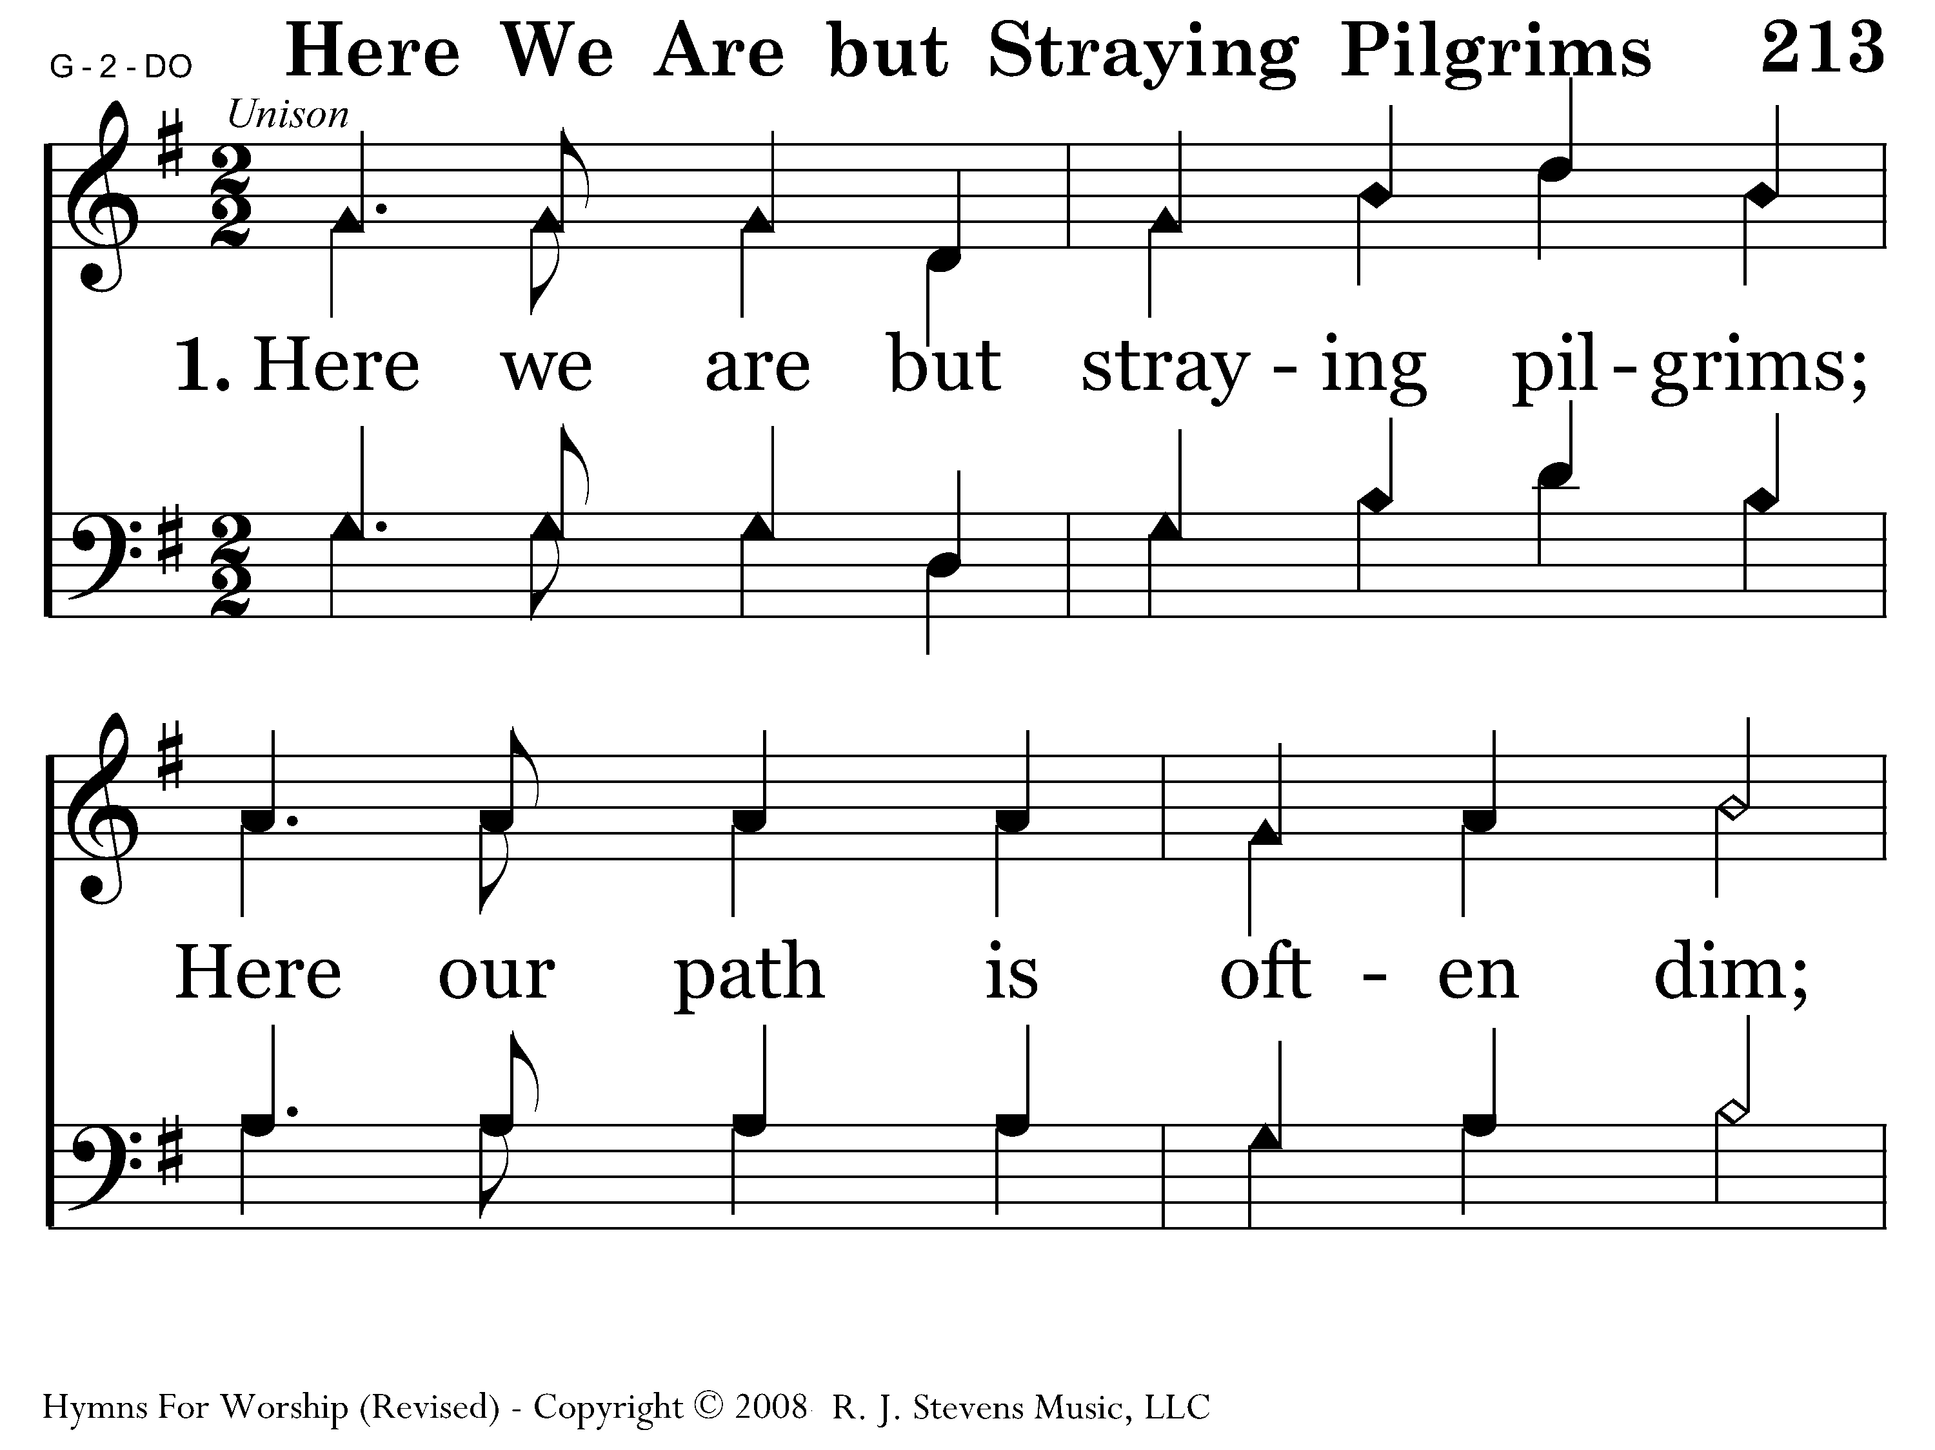
213 - Here We Are But Straying Pilgrims - 1.1

Slide 14
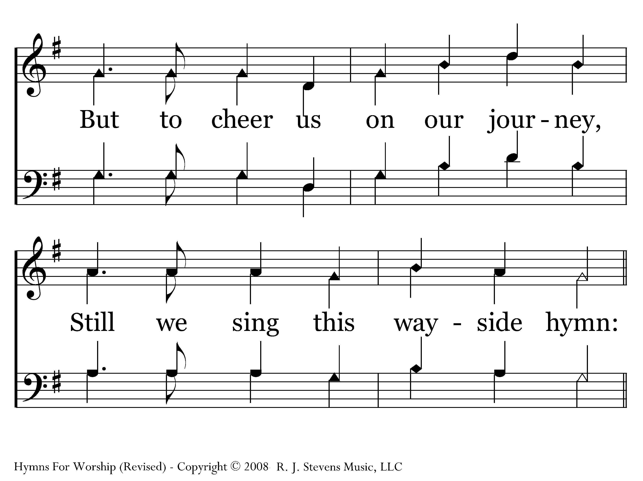
213 - Here We Are But Straying Pilgrims - 1.2

Slide 15
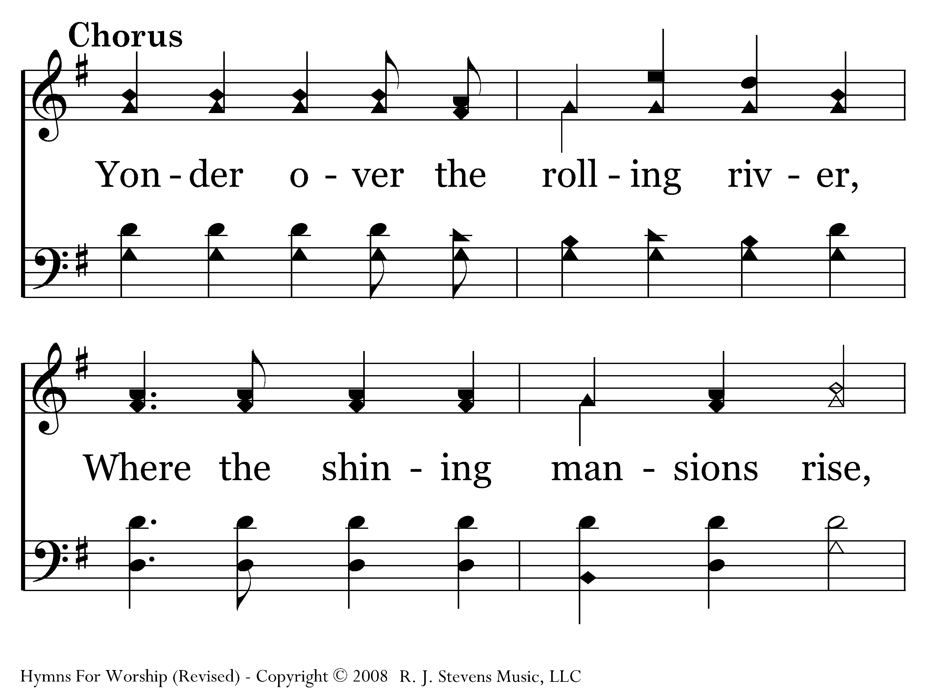
213 - Here We Are But Straying Pilgrims - C.1

Slide 16
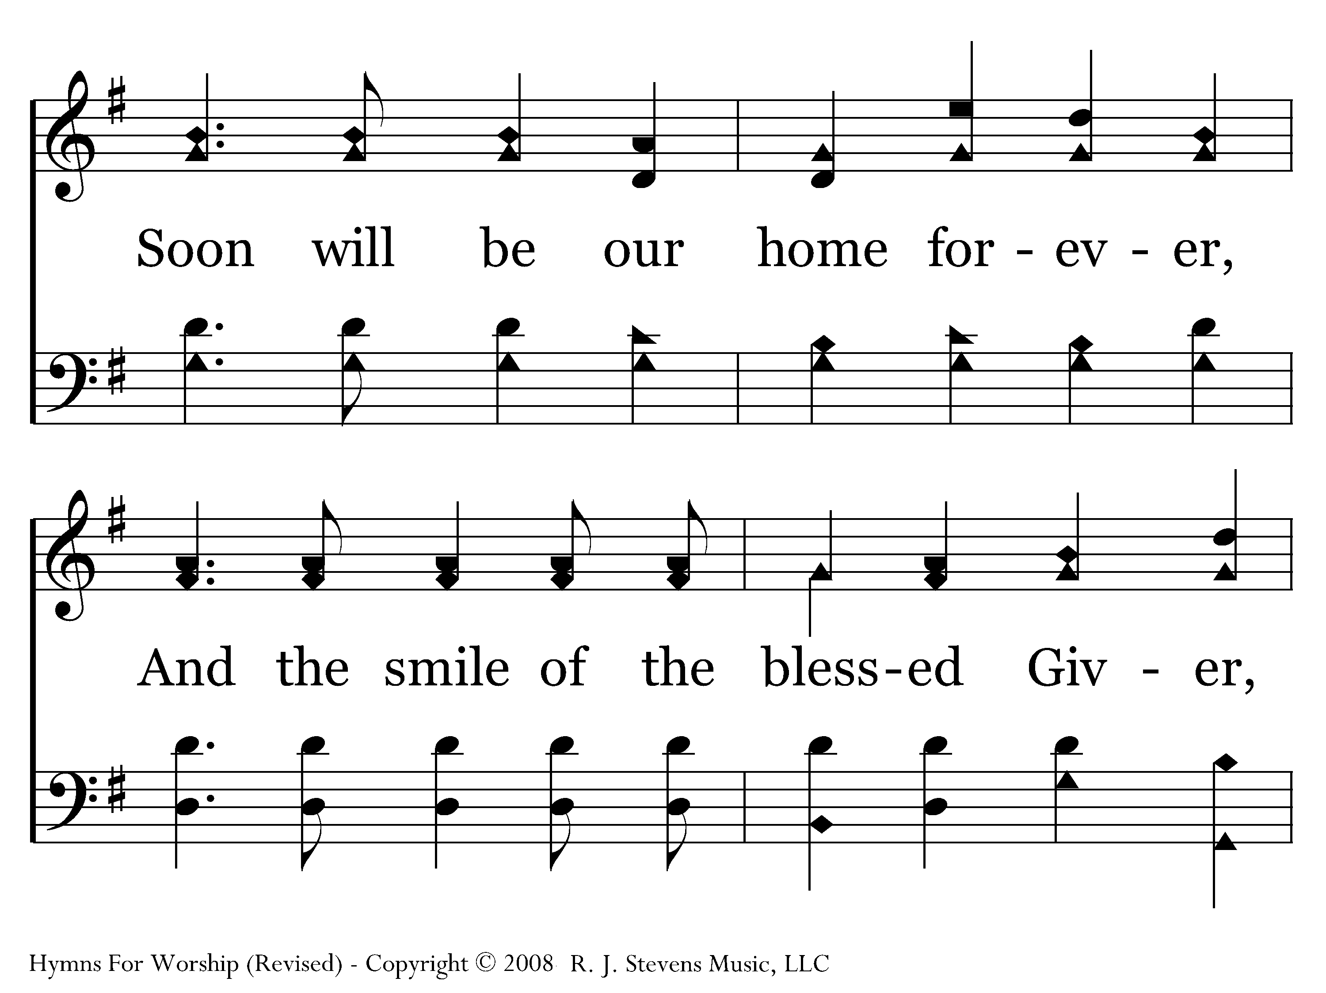
213 - Here We Are But Straying Pilgrims - C.2

Slide 17
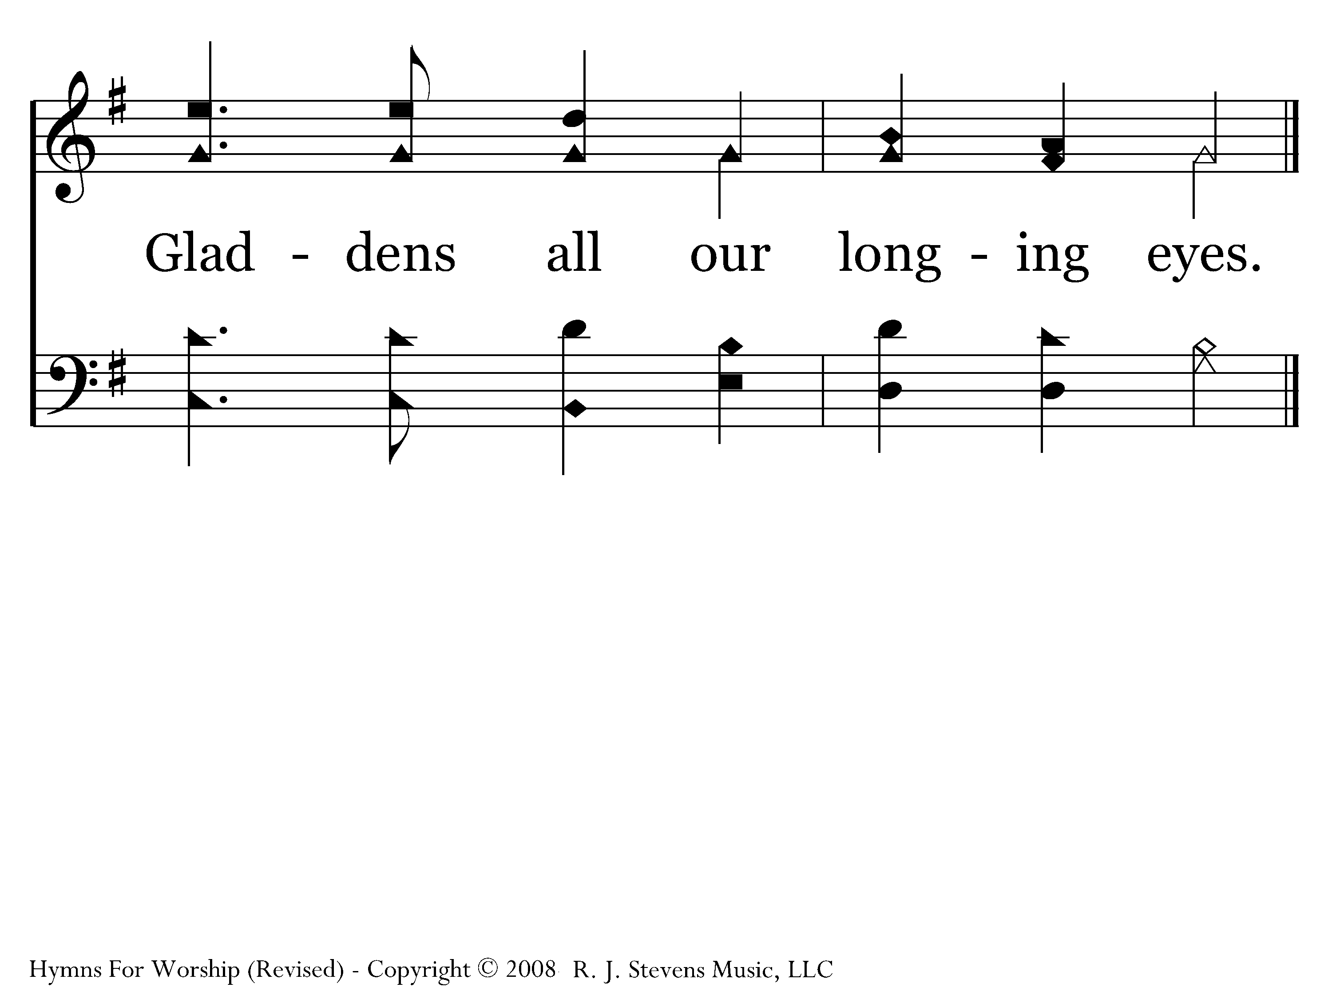
213 - Here We Are But Straying Pilgrims - C.3
Next Song: This World is Not My Home

Slide 18
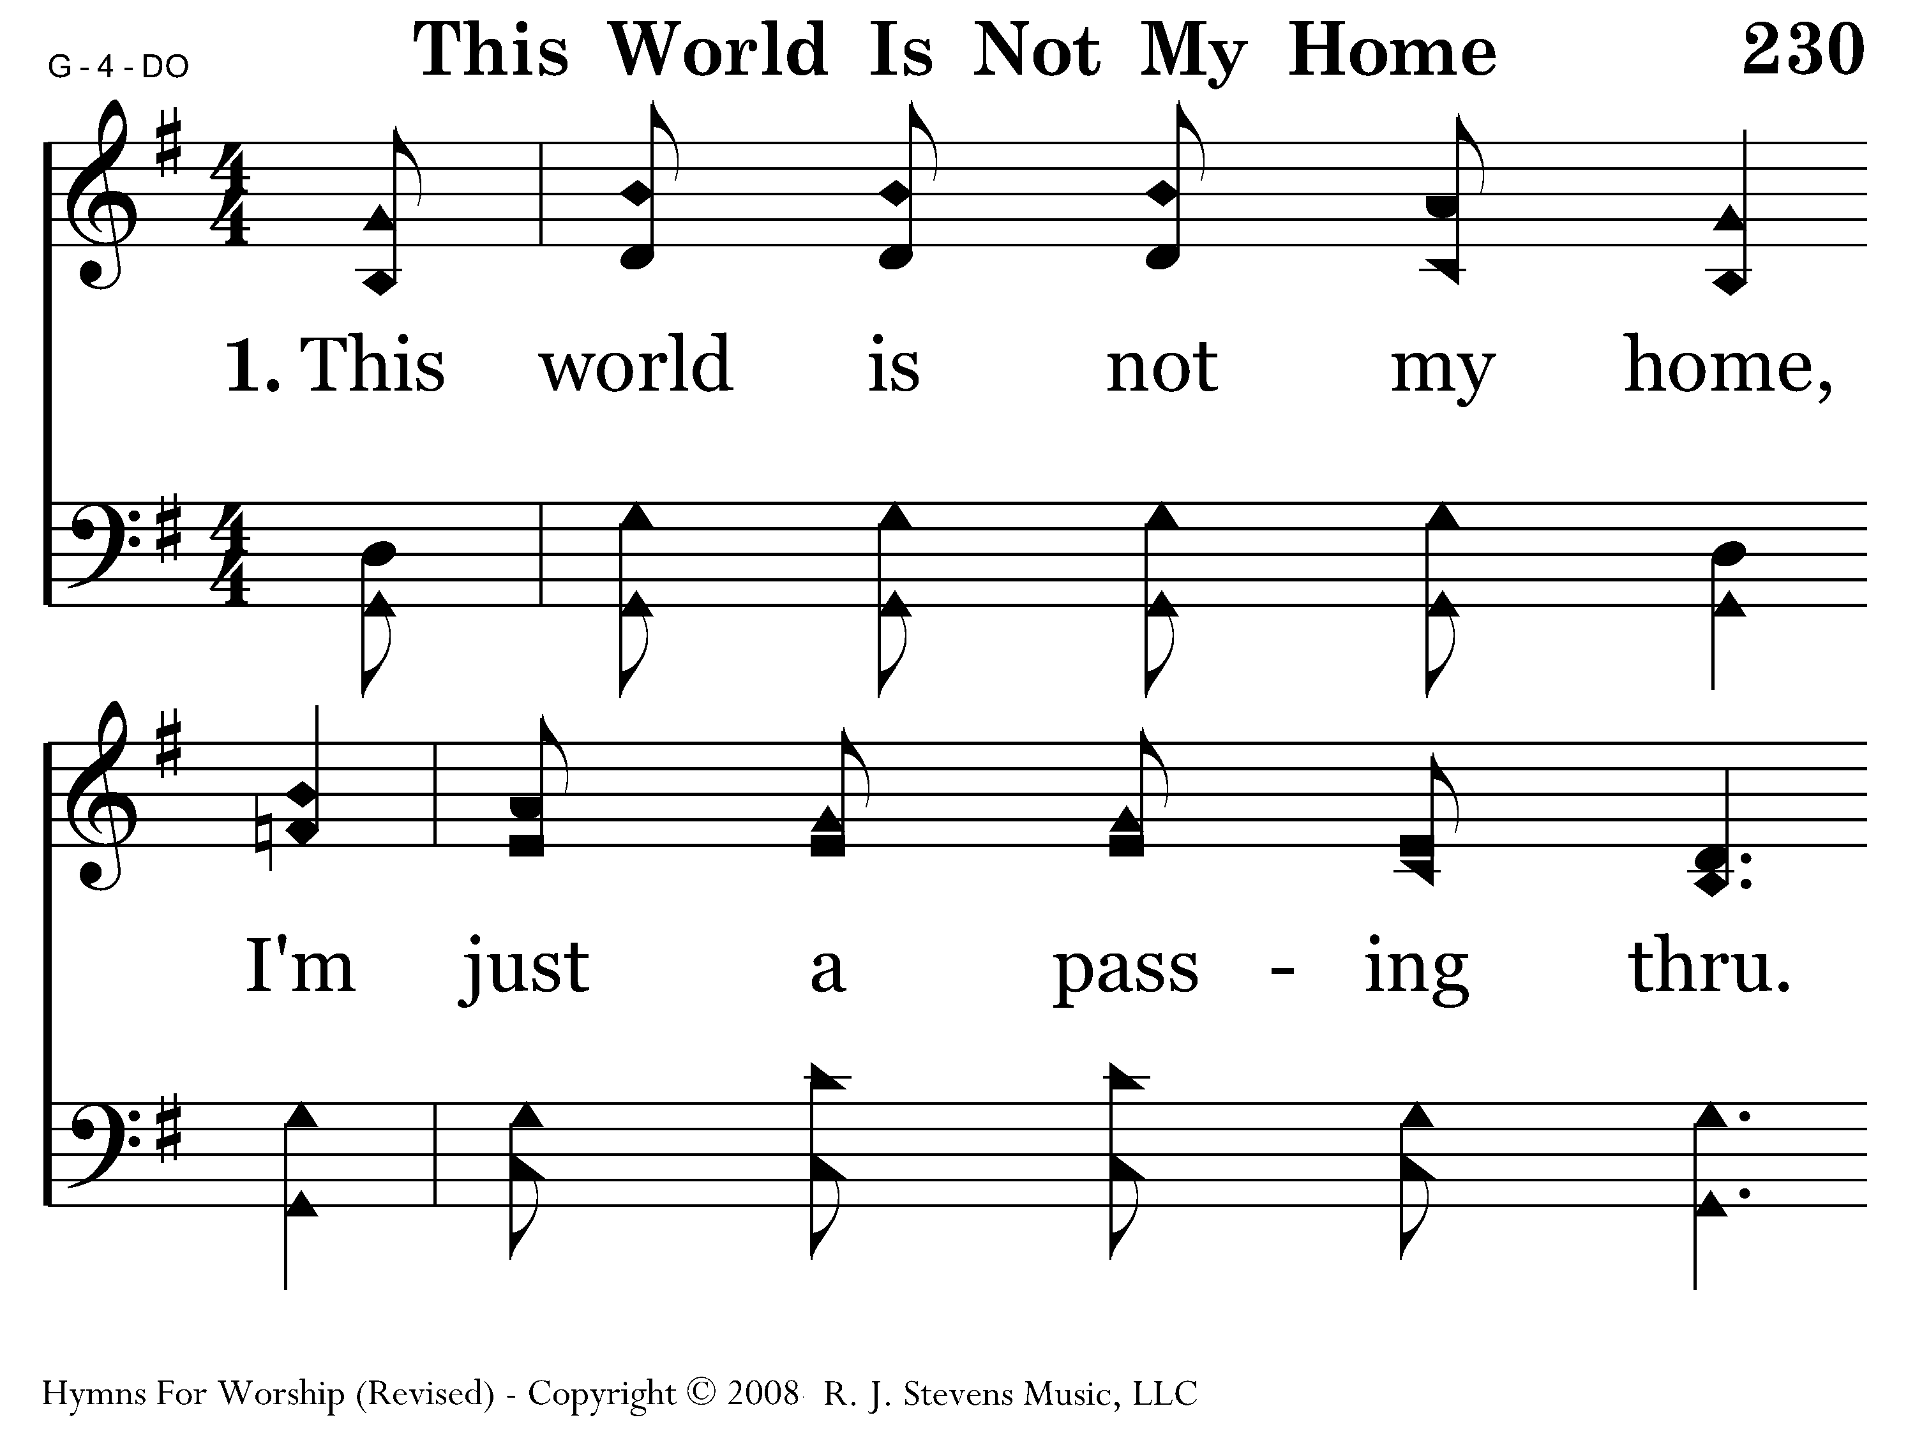
230 - This World Is Not My Home - 1.1

Slide 19
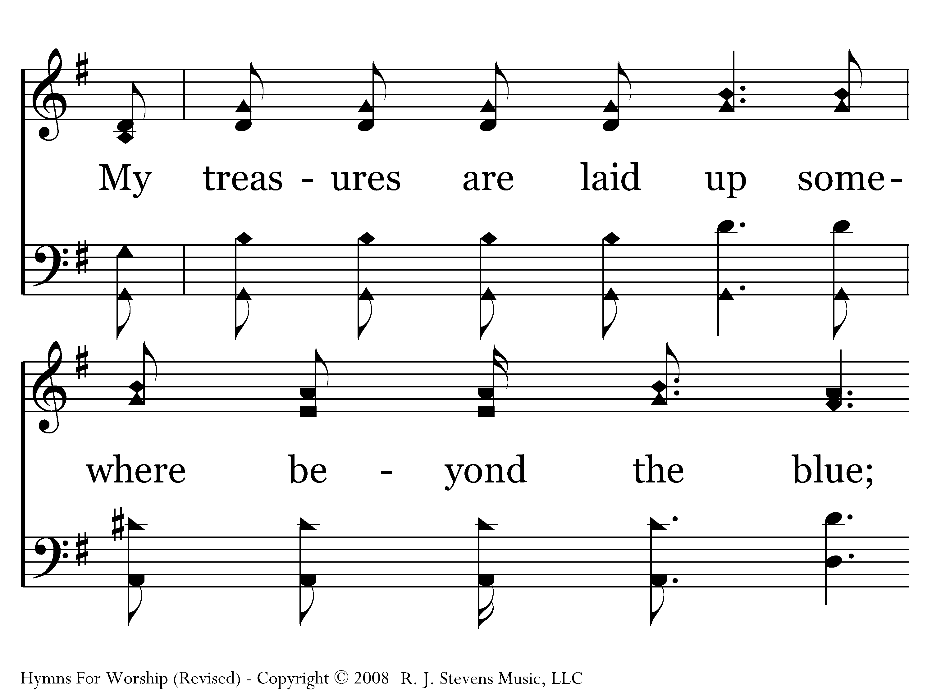
230 - This World Is Not My Home - 1.2

Slide 20
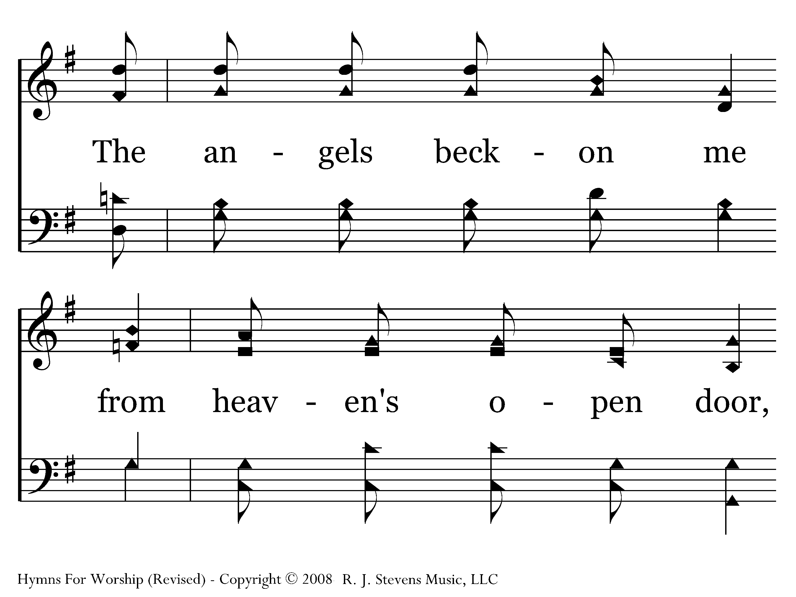
230 - This World Is Not My Home - 1.3

Slide 21
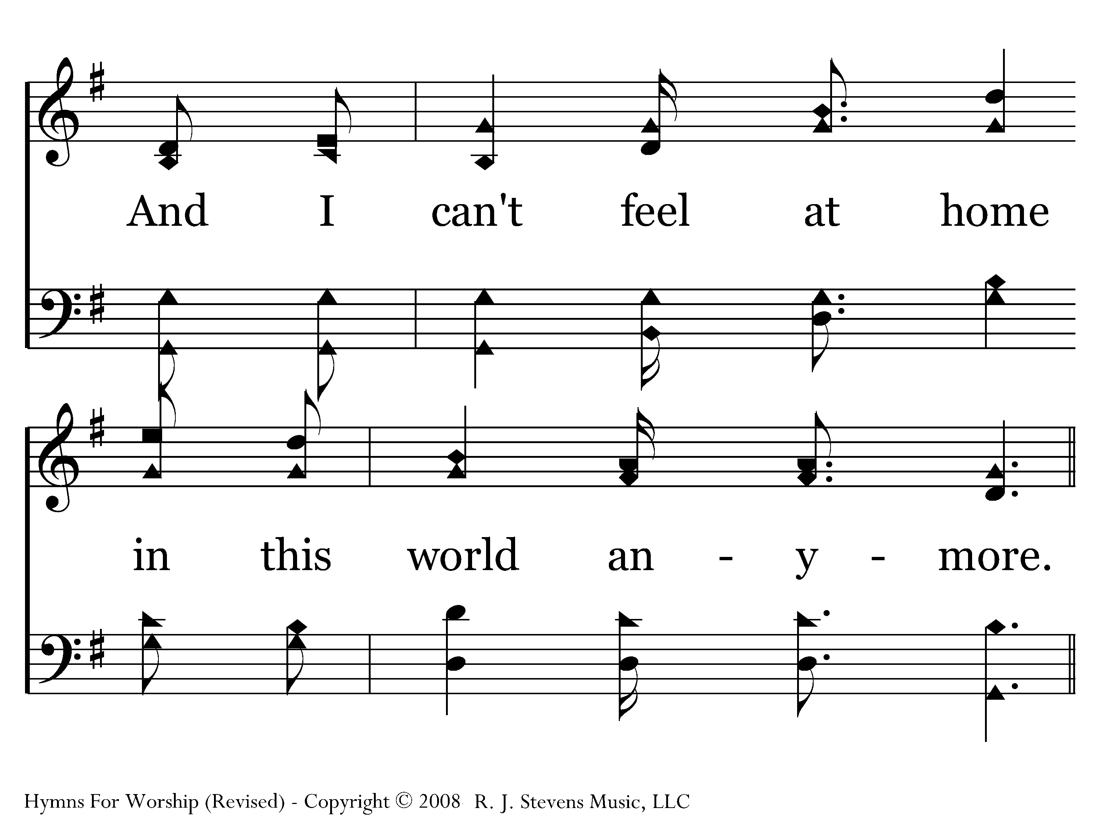
230 - This World Is Not My Home - 1.4

Slide 22
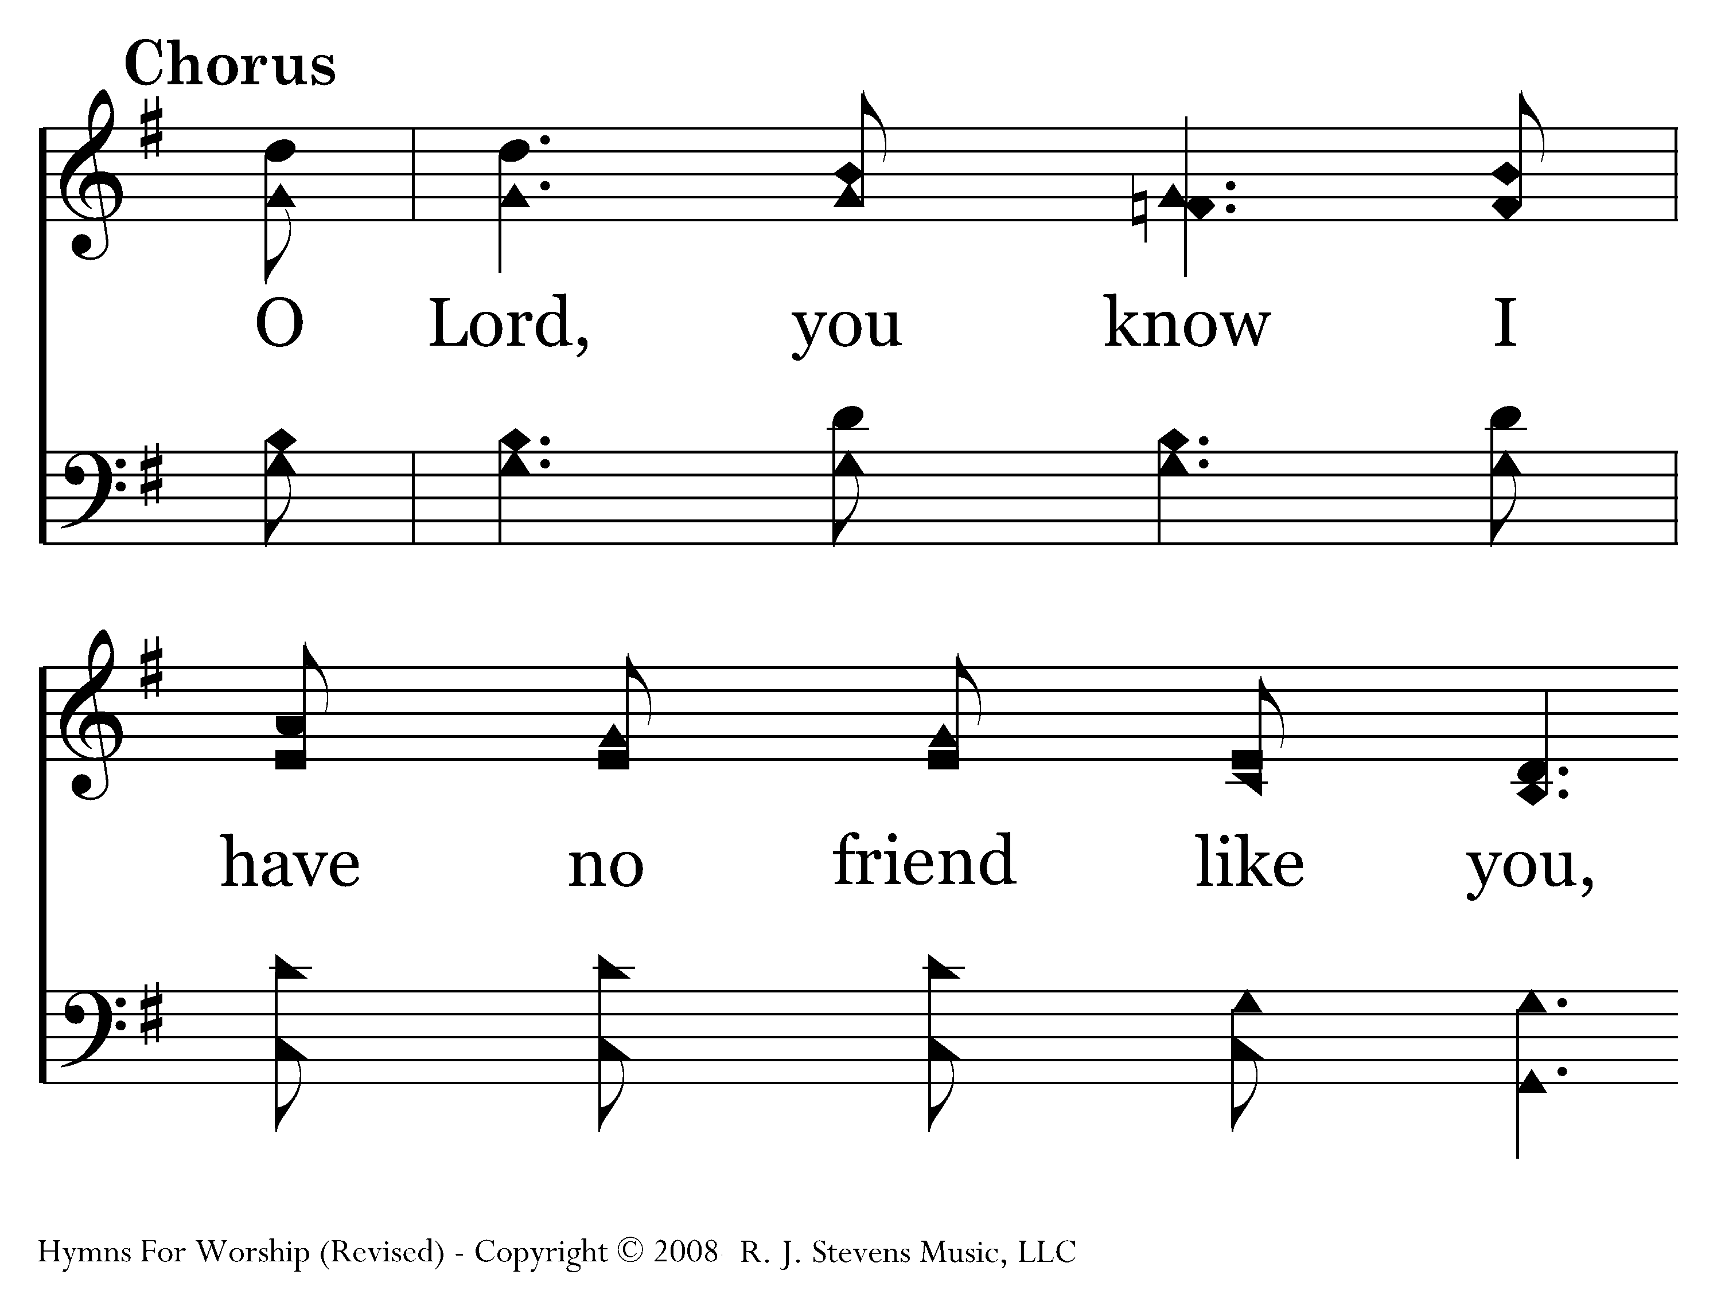
230 - This World Is Not My Home - C.1

Slide 23
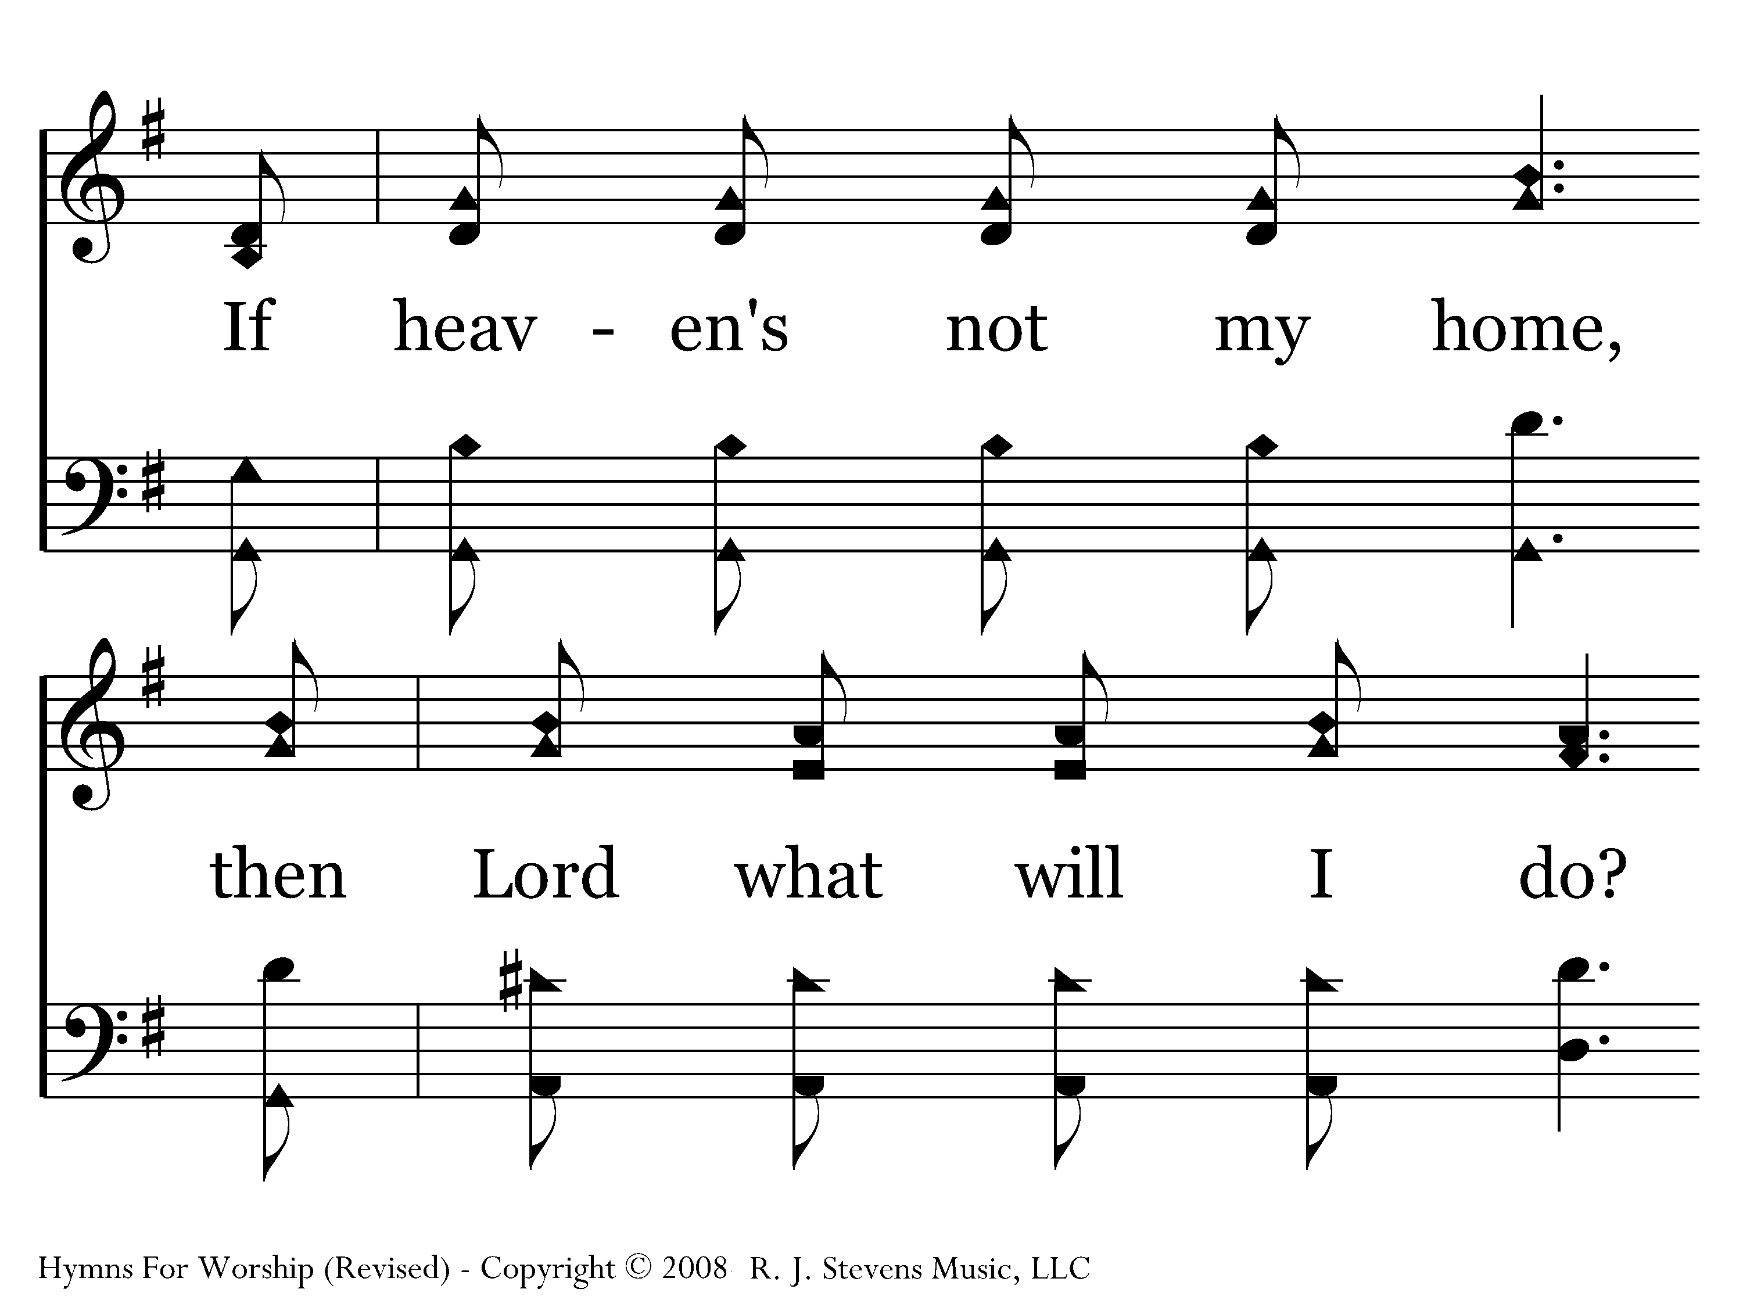
230 - This World Is Not My Home - C.2

Slide 24

230 - This World Is Not My Home - C.3

Slide 25
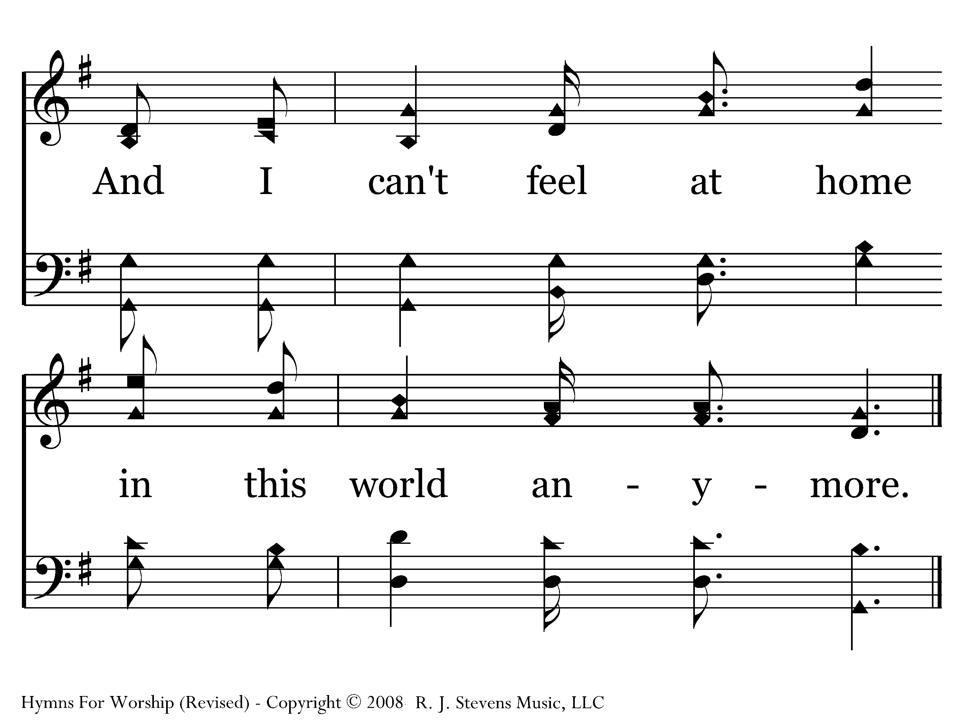
230 - This World Is Not My Home - C.4
End of Song

Slide 26
What Lessons are for Us?
Only the “unseen” things are eternal.
Develop a faith that simply says, “If God said it. I believe it! Period!!”
Trust God in the dark.
2 Corinthians 4:18
18 while we do not look at the things which are seen, but at the things which are not seen. For the things which are seen are temporary, but the things which are not seen are eternal.

Slide 27
What Lessons are for Us?
Only the “unseen” things are eternal.
Develop a faith that simply says, “If God said it.
I believe it! Period!!”

Slide 28
What Lessons are for Us?
Only the “unseen” things are eternal.
Develop a faith that simply says, “If God said it.
I believe it! Period!!”
Trust God in the dark.

Slide 29
Hebrews 11:6
6 But without faith it is impossible to please Him, for he who comes to God must believe that He is, and that He is a rewarder of those who diligently seek Him.
“FAITH IS THE ENERGY THAT DRIVES THE LIFE OF THE BELIEVER!”

Slide 30
“FAITH in the UNSEEN”
“Now faith is being sure of what we hope for and certain of what we do not see.” (Heb. 11:1)
S E E N
vs
U N S E E N
End of Life
D
E
A
T
H
HEAVEN
Today,
this Life
- Physical
- Temporal
or
LORD’S
RETURN
After-Life
HELL

