Slide 1
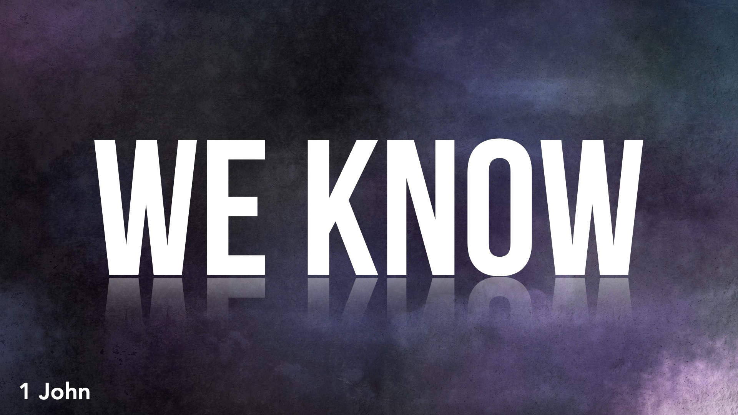

Slide 2
Are You Confident of Your Salvation?
We know we are right with God if we keep His commandments: 1 John 2.3-6; 3.19-24; 5.14-15, 18-20
We know we are ready for the judgment if we keep His commandments: 1 John 3.2-3
We know we retain eternal life if we keep His commandments: 1 John 3.14; 5.2

