Slide 1
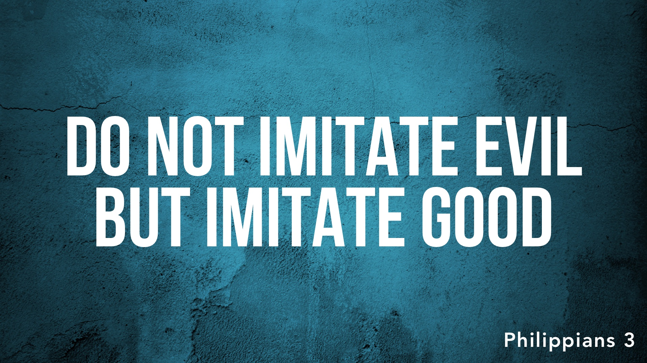

Slide 2
Those whom we imitate determine our view of the cross – boasters of the cross (Phil. 3.3; Gal. 6.14) or enemies of the cross.
Those whom we imitate determine our choices in this life – humble obedience (Phil. 2.12-13) or stubborn rebellion.
Those whom we imitate determine our outcome – citizenship in heaven (Heb. 13.7) or destruction.

