Slide 1
Fear, Obligation & Love
Psalm 25:14

Slide 2
Biblical “Fear” is defined as:
1. To be fearful or to be DREADFUL
This leads to being AFRAID of God.
2. To cause ASTONISHED and AWE.
This leads to feeling an OBLIGATED to God.
3. To inspire REVERENCE or GODLY FEAR.
This leads to LOVING God.
Fear, Obligation & Love

Slide 3
Fear: Old Testament Examples
Moses knew PHARAOH did not yet FEAR Jehovah. (Ex. 9:27-30)
At Mt. Sinai, God spoke to the people so they would FEAR Him all of their days. (Dt. 4:10)
The ISRAELITES were to teach their CHILDREN to fear JEHOVAH. (Dt. 6:1-2)
In Canaan, who was to fear God? YOU your SON and your GRANDSON. (Dt. 6:1-2)
Besides fearing Jehovah, Israel was to be OBLIGATED to Him and LOVE Him. (Dt. 10:12)

Slide 4
New Testament
The deaths of ANANIAS and SAPPHIRA created great FEAR over all.
After Saul’s conversion, the church went on in FEAR and COMFORT of the Holy Spirit.
Fear, Obligation & Love

Slide 5
Obligation:
An obligation is a DUTY, RESPONSIBILITY or COMPULSION.
Ananias was to tell Saul WHAT YOU MUST DO. (Acts 9:6)
The Pentecost believers asked, “WHAT SHALL WE DO”? (Acts 2:37)
Fear, Obligation & Love

Slide 6
Love:
Jesus said LOVE will motivate us to KEEP His COMMANDMENTS. (John 14:15)
If we love Jesus, we will keep His WORD. (John 14:23-24)
God’s commandments are not BURDENSOME. (1 John 5:3)
Walking according to God’s commandments is FEAR. (2 John 1:6)

Slide 7
Fear, Obligation AND Love:
If we know the fear of God, what will we do? PERSUADE MEN. (2 Cor. 5:11)
The fear of God will help us PERFECT HOLINESS. (2 Cor. 7:1)
Why should we be subject to one another? The FEAR of CHRIST. (Eph. 5:21)
Fear, Obligation & Love

Slide 8
After the Corinthians heeded Paul’s rebuke and changed, what did he say they had accomplished? (2 Cor. 7:11)
GODLEY SORROW
VINDICATION
INDIGNATION
FEAR
LONGING
ZEAL
AVENGING OF WRONG
INNOCENCE
Fear, Obligation & Love

Slide 9
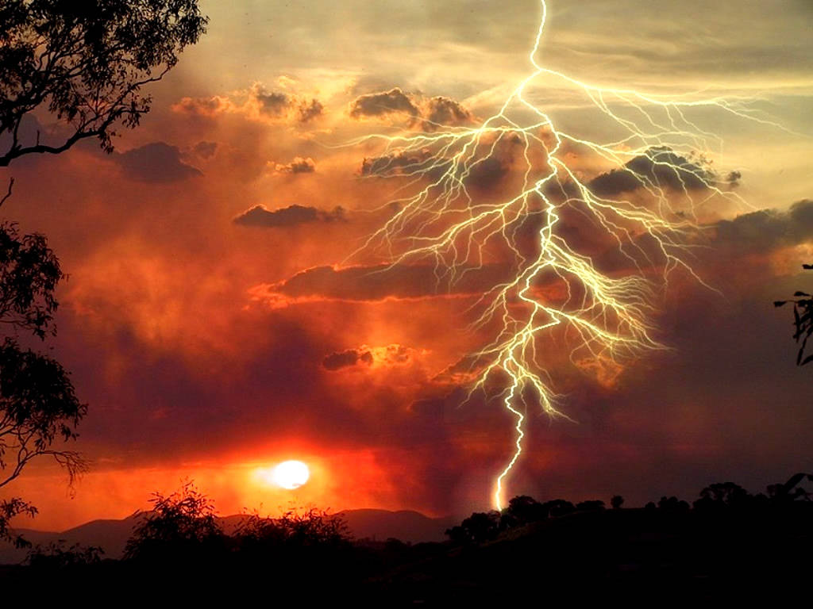
It is a terrifying thing to fall into the hands of the living God. Heb. 10:31

Slide 10
Fear, Obligation & Love
Psalm 25:14

