Slide 1
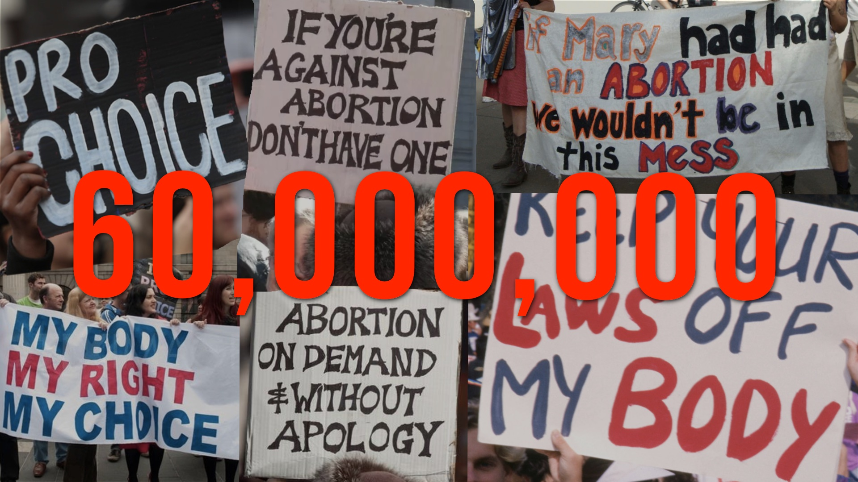

Slide 2
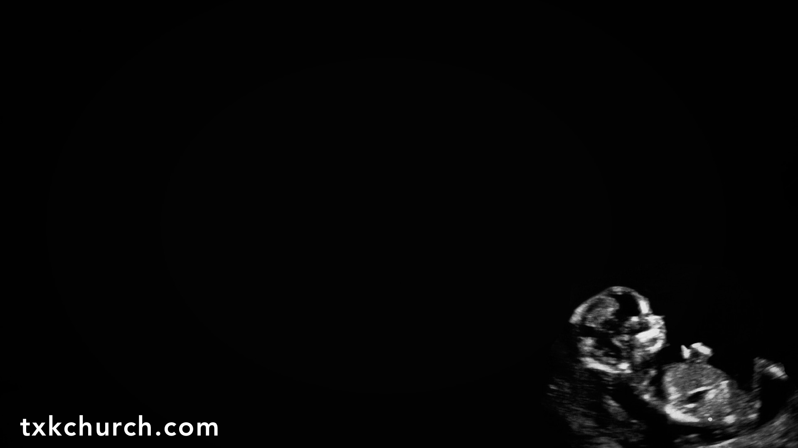
Why Are We Having This Conversation?
SUPPRESSED truth of the value of life.
SANCTITY of marriage is not recognized.
SEXUAL self-discipline is not practiced.
SELFISH elimination of consequences.
Ultimately, God is not FEARED.

Slide 3
Life Is PRECIOUS
Life has VALUE only when we accept the God of the Bible as the AUTHOR of life.
(Acts 17.24-29)

Slide 4
Life Is PRECIOUS
We are a SPECIAL creation, made in GOD’S IMAGE.
(Gen. 1.26-28; 9.6; Exo. 21.22-25, 28-32;
Num. 35.29-34; Prov. 6.16-17; James 3.9-10)

Slide 5
Life Is PRECIOUS
Those who murder their children are HEARTLESS and have a loss of NATURAL affection.
(Rom. 1.31; 1 Kings 3.16-27; Psalm 106.37-39)

Slide 6

Percentage | Reason for Abortion
<0.5% | Victim of rape
3% | Fetal health problems
4% | Physical health problems
4% | Would interfere with education or career
7% | Not mature enough to raise a child
8% | Don't want to be a single mother
19% | Done having children
23% | Can't afford a baby
25% | Not ready for a child
6% | Other
Guttmacher Institute, 2004 | abort73.com

Slide 8
“Abortion I salute you! Women if you need an abortion, get one! If you want an abortion, get one! If you’re not pregnant but you think you eventually might be and want to order a future abortion, get one! If you’re pregnant and you want to be pregnant, don’t get one! It’s up to you …
And women don’t forget, you have the power to give life and men will try to control that, don’t let them. God bless abortions and God bless America.” (Michelle Wolf)

Slide 9
Life in the WOMB
By FAITH and SCIENCE, we accept that life begins at CONCEPTION.
(Gen. 4.1; 16.4; 25.21-22; Job 3.3, 16; Luke 1.36, 41-44, 57)

Slide 10
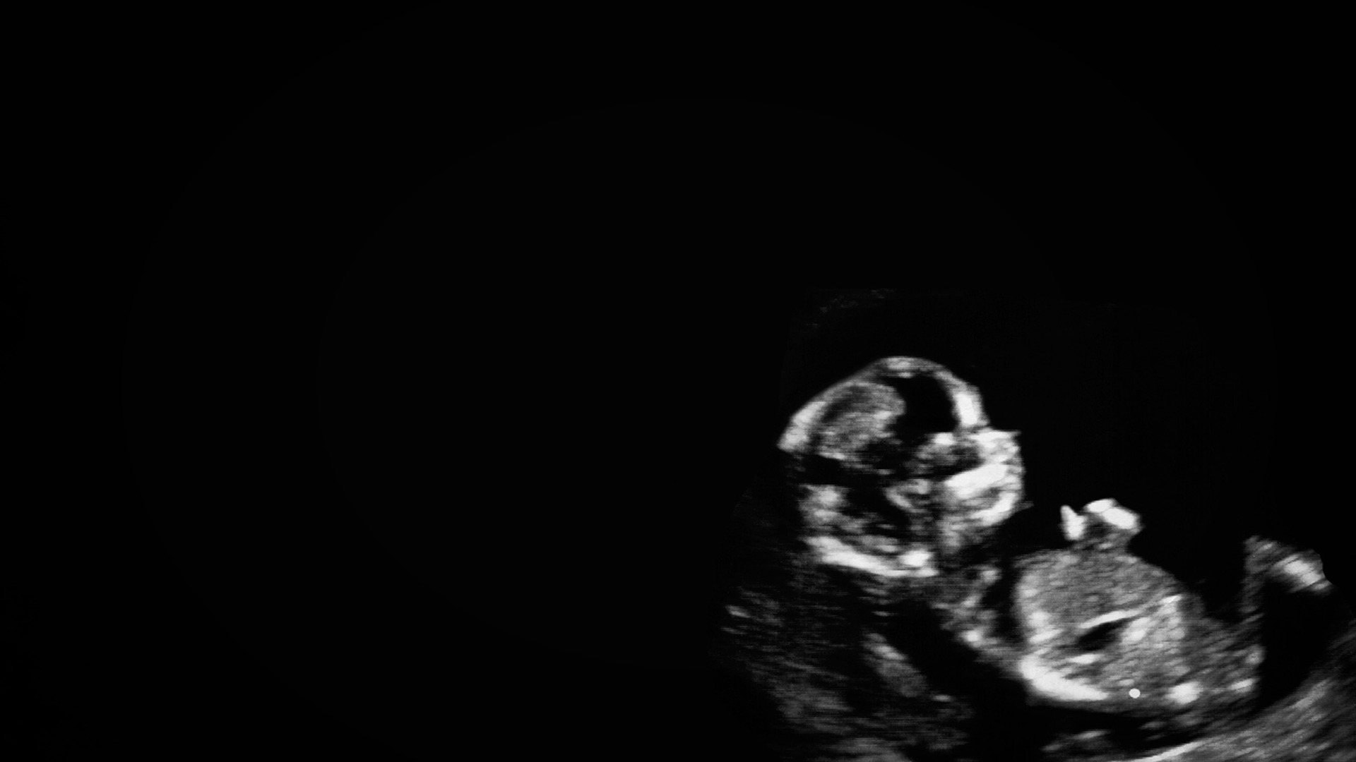
If abortion isn’t murder, why is it considered double-HOMICIDE when a pregnant woman is MURDERED?
Answer – Because we KNOW what’s
in the womb: a living PERSON,
not a “POTENTIAL life” that
comes alive at some point.

Slide 11
Whether the life in the womb is valuable is determined by who EXTERMINATES the life. Life is WORTHY if the mother wants to KEEP the child, or if a man murders a PREGNANT woman. Life is WORTHLESS if the mother does not WANT the child!

Slide 12
Can We Justify Abortion?
If we “CANNOT know” whether life begins at conception, whether a “fetus” is a living person, or whether there is a difference between a human being and a person, then we
CANNOT abort; we must give the
benefit of the doubt to LIFE.

