Slide 1
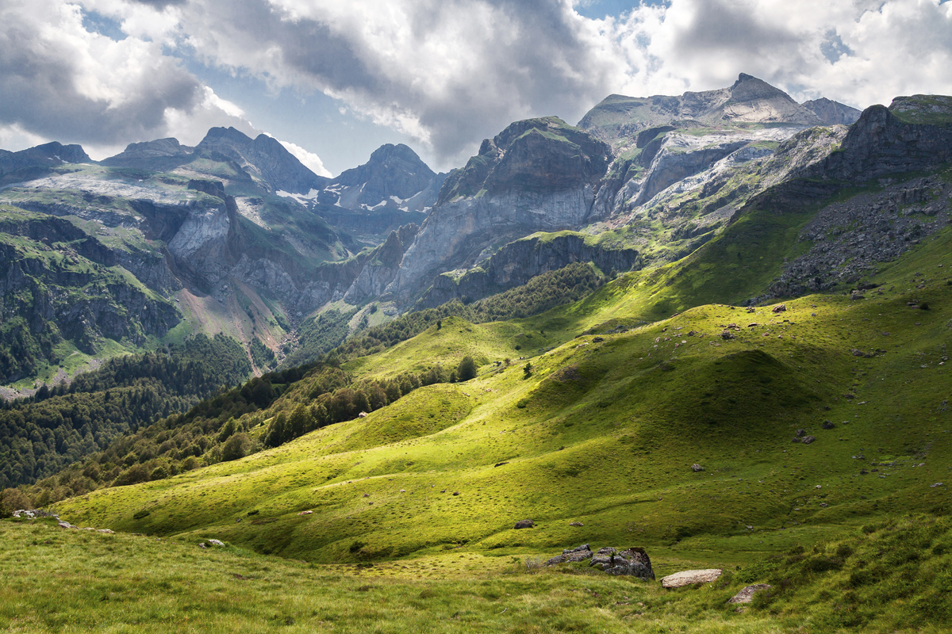
the power of god’s providence in our lives

Slide 2
Providence Makes a Difference
Our work in the Lord
Problems
Uncertainties
Prayer

