Slide 1
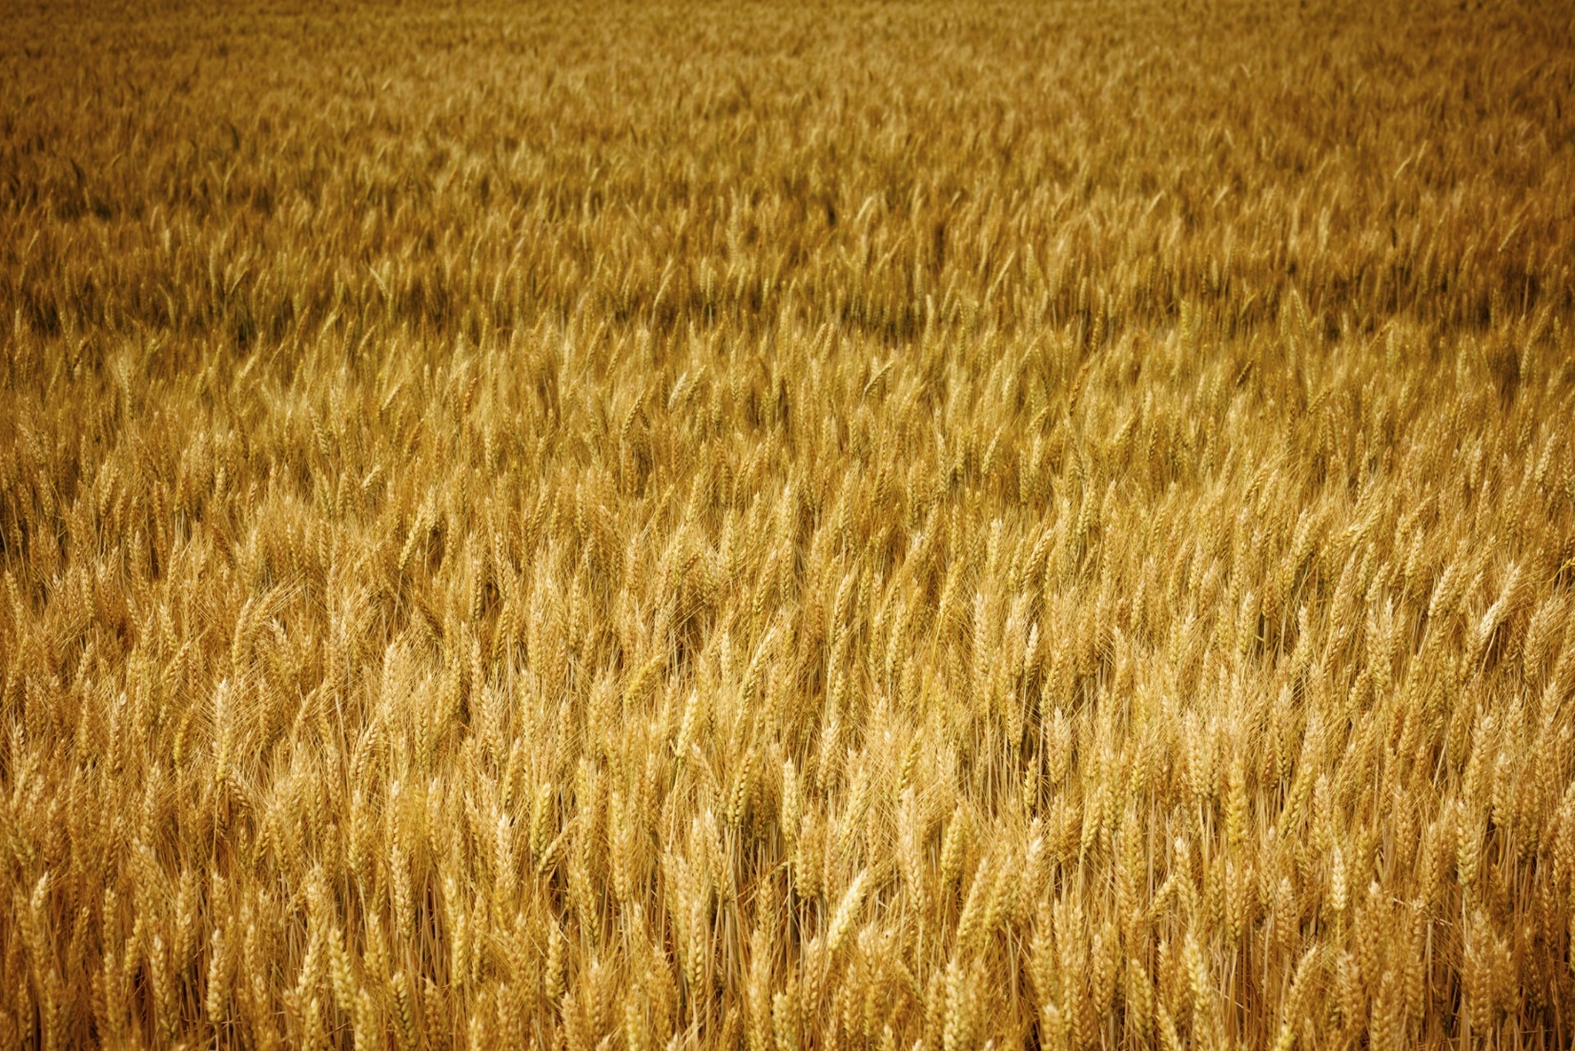
in due season we shall reap galatians 6:9

Slide 2
in due season we shall reap
Learn patience
See ourselves as farmers
Take the long view

