Slide 1
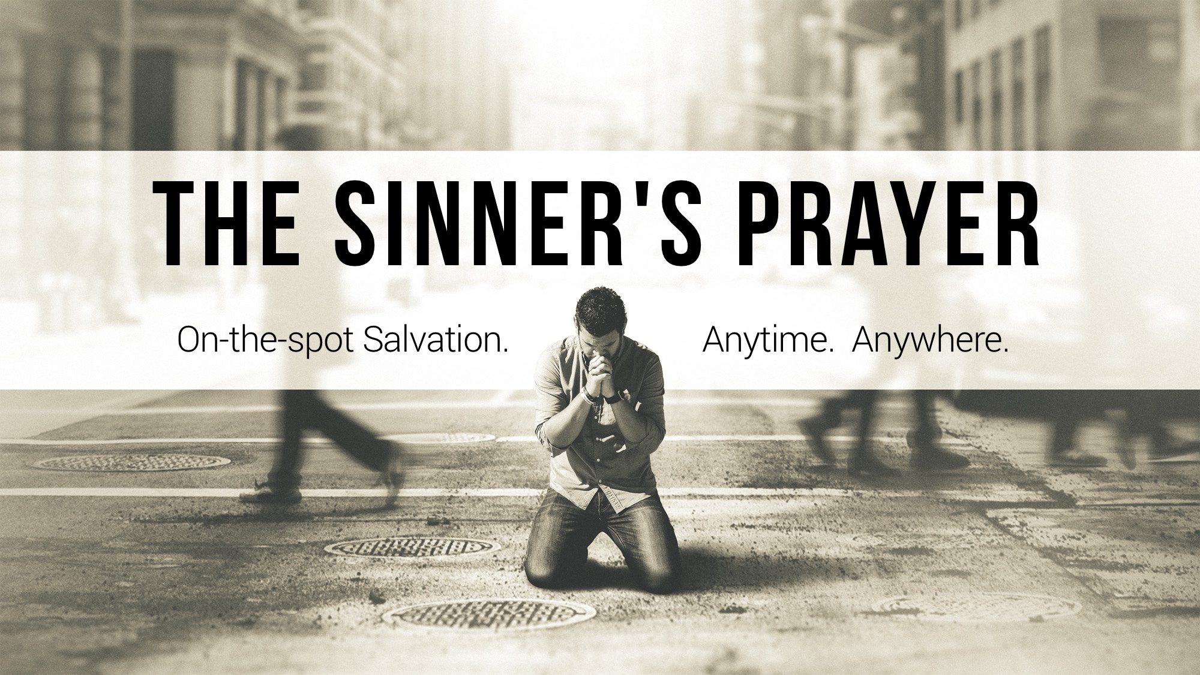

Slide 2

“Dear Lord Jesus, I know that I am a sinner deserving of eternal hell, and I ask for Your forgiveness. I believe You died for my sins and rose from the dead. I turn from my sins and invite You to come into my heart and life. I want to trust and follow You as my personal Lord and Savior. In Your Name. Amen.”

Slide 3
Undeniable Facts:
Biblically, no unsaved person was ever told to “PRAY this prayer to receive salvation”, or “Receive Jesus by ACCEPTING Him into your heart”.

Slide 4
The “Sinner’s Prayer” ORIGINATED in the mind of MEN, not the mind of GOD.

Slide 5
Does God Hear the Sinner’s Prayer?
While God is AWARE of all prayers, it does not mean He GRANTS the requests for forgiveness while setting aside established COMMANDS that pardon sins: Acts 10; 11.14

Slide 6
Passages Used to Support the Sinner's Prayer
John 1.11-13 – Receiving Jesus is receiving His WORD in OBEDIENCE: John 8.31; 12.48; Acts 2.41; James 1.22-25; cf. Gal. 3.26-27

Slide 7
Passages Used to Support the Sinner's Prayer
Luke 18.10-14 – Contextually, these were Jews in a covenant relationship with God; not sinners praying to become a CHRISTIAN!

Slide 8
Passages Used to Support the Sinner's Prayer
Rom. 10.9-10 – We are to have God’s word (what He has done for us) in our hearts and mouths so that we may DO it: cf. Deut. 30.11-14; Rom. 10.5-8

Slide 9
Passages Used to Support the Sinner's Prayer
To confess Jesus as Lord means to pledge ALLEGIANCE to His Lordship with a willingness to OBEY Him: Luke 6.46; Rom. 1.5; 6.17-18; 10.16; 16.25-26

Slide 10
Passages Used to Support the Sinner's Prayer
Rom. 10.13 – Calling on the Lord is to OBEY the Father’s will, which includes BAPTISM: cf. Matt. 7.21; Acts 2.21, 37-38; 9.1-18; 22.16; 1 Peter 3.21

Slide 11
Passages Used to Support the Sinner's Prayer
Rev. 3.14-22 – Contextually, this is written to lukewarm CHRISTIANS who needed to repent of their sins.

Slide 13
Sinner, do you need to call on Jesus’ name?
“And now why do you wait? Rise and be baptized and wash away your sins, calling on his name.” Acts 22.16

Slide 14
Christian, do you need to say the sinner’s prayer?
“If we confess our sins, he is faithful and just to forgive us our sins and to cleanse us from all unrighteousness.” 1 John 1.9

