Slide 1
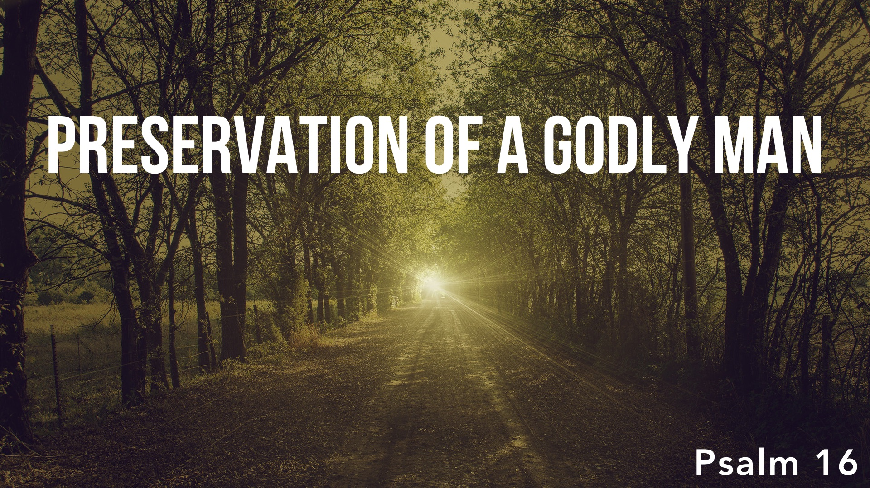

Slide 2
We Are Preserved by Trusting in God: 1
Through confidence in God, David found safety and joy: cf. cf. 1 Peter 1.4-5; Jude 24; 2 Tim. 4.18
God’s will for us is that we would take refuge in Him when we face hardships and troubles in this life: cf. Phil. 4.6-7; 1 Peter 5.7; 1 Sam. 1.15

Slide 3
We Are Preserved by Attaching Ourselves to God: 2-4
To place confidence in the living God is to disavowal allegiance to any other god/idol.
David’s humility: He had no source of spiritual blessings apart from God, and without God he was lost and without hope: cf. Eph. 2; John 15

Slide 4
We Are Preserved by Attaching Ourselves to God: 2-4
David found delight in his brethren with like precious faith – those who feared God and set themselves apart for God’s service: Psalm 119.63; 2 Cor. 6.14-7.1
David made the commitment that he would not participate in any idol worship; he would not even mention their name: cf. Exo. 23.13

Slide 5
We Are Preserved by Being Content with God’s Blessings: 5-6
David’s contentment was not in the things of this world, but in his commitment to God – that sustained and refreshed him! Psalm 73.25-26
God was the source of all David’s present and future blessings: 2 Peter 1.3; 1 Peter 1.3-4

Slide 6
We Are Preserved by Following God’s Wisdom: 7
David was directed by God’s word; his conscience was trained – studied, internalized – by God’s word to do the right thing: Psalm 1.2; 119.105, 11

Slide 7
We Are Preserved by Putting God First: 8
David consciously set the Lord before Him always by putting his treasure in heaven, setting his mind on the things above, and seeking first the kingdom of heaven in all things: cf. Psalm 15.5; Col. 1.23

Slide 8
We Are Preserved by Expecting God’s Promises: 9-11
Even in death, David rests in hope – he was looking forward to everlasting life; death was not the end: Rom. 8.24-25; Heb. 6.18; 10.23
Messianic prophecy – death could not stop Jesus, and won’t stop those who love Jesus: Acts 2.24-33; 13.26-41; 1 Thess. 4.13-17; 1 Cor. 15.16-19, 20-23

Slide 9
We Are Preserved by Expecting God’s Promises: 9-11
Even in death, God has made the path of life known: 2 Tim. 1.10; John 3.16; 14.19; 2 Thess. 2.16-17
In the end a better home awaited him – a heavenly one, in the presence of God for all eternity. Cf. v.1

