Slide 2
Why This Study? Consider the Following:
We need God’s authority for all that we do.
We need God’s authority for most of what we do.
We need God’s authority for some of what we do.
We need God’s authority for none of what we do.

Slide 4
The CHURCH of Christ: The one body of Christ is the totality of all forgiven sinners of all time in all places (Matt. 16.18; Eph. 1.22-23; Acts 2.41, 47; Eph. 5.23, 30; 1 Cor. 12.13; Heb. 12.23).
CHURCHES of Christ: The organized collectivity of forgiven sinners in any given geographical location that assemble, worship, and work together, and submit to Christ in all things (Rom. 16.16; 1 Cor. 1.2; Gal. 1.2; Col. 3.17).

Slide 5
Characteristics of a Local Church

Slide 6
The SEED Principle
God’s word is a seed (Luke 8.11) that is planted in the HEART for the purpose of producing fruit in one’s life – it will reproduce Christians and churches of Christ after the same characteristics of the original seed.

Slide 7
Descriptions of the Lord’s Church
No official name – biblical descriptions point OWNER-SHIP to whom the church belongs, giving GLORY only to Jesus.

Slide 8
Catholic
Methodist
Baptist
Christian
The Bible ONLY makes Christians and churches of Christ ONLY.

Slide 9
The Organization of the Churches of Christ
Each local church is autonomous and overseen by ELDERS (Acts 20.28). DEACONS serve the church under the oversight of the eldership. SAINTS represent the members of a local body: Phil 1.1

Slide 10
The WORK of the Churches of Christ
Is SPIRITUAL in nature.
EVANGELISM: Save the lost.
EDIFICATION: Keep the saved, saved.
BENEVOLENCE: Care for the needy saints.
WORSHIP: The saved praise God and encourage one another.

Slide 11
The HEART of the Churches of Christ
We can have the EXTERNALS right, but without TRANSFORMATION of the inward man – pure in heart, maintaining unity through godly attitudes and right doctrines, growing in grace and love toward one another – or if we fail to evangelize, we are not a church that SUBMITS to Christ in all things.

Slide 12
You Shall Know a Church by Their FRUIT
Paul taught the SAME God-ordained pattern in worship, doctrine, work and heart in every church, and that churches would be PERVERTED by following a false gospel: 1 Cor. 4.17; Gal. 1.6-8

Slide 13
You Shall Know a Church by Their FRUIT
Do some of the traits of the New Testament church make it a New Testament church?

Slide 14
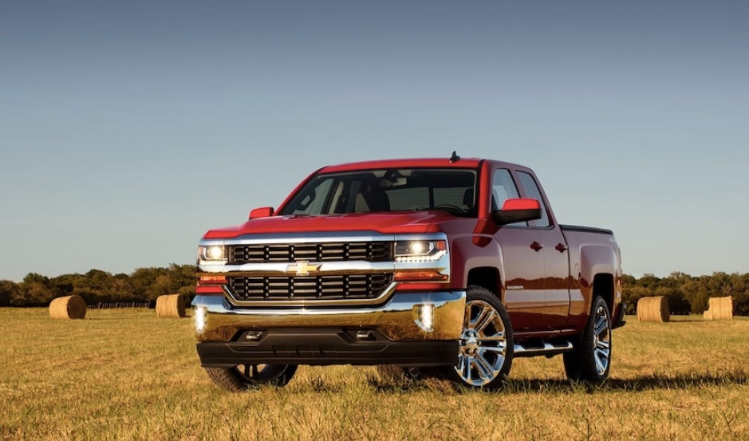
Does putting the Ford insignia on a truck make it a Ford?

Slide 15
You Shall Know a Church by Their FRUIT
Every PLANT - any doctrine, tradition, or religious practice - not planted by God will be UPROOTED: Matt. 15.13

Slide 16
You Shall Know a Church by Their FRUIT
A church belongs to Christ when it consists of all the IDENTIFYING marks found in the church we read about in the Bible.

