Slide 1
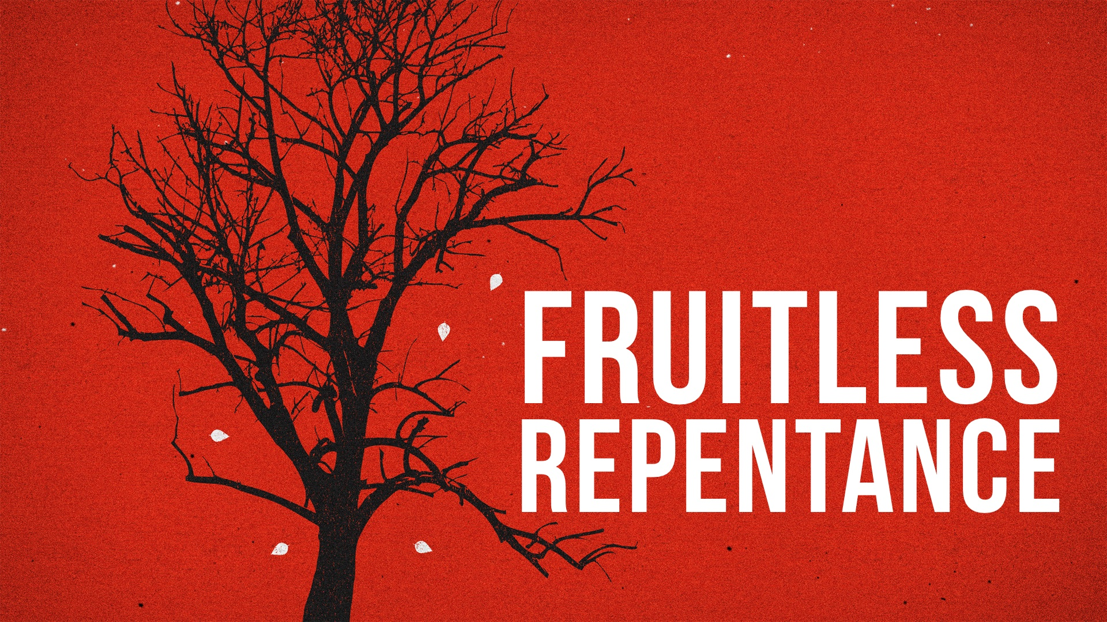

Slide 2
Repentance Follows GODLY SORROW
A DESIRE to repent grows out of sorrow for our sins (Psalm 51.4, 17; 2 Cor. 7.9-10)

Slide 3
Repentance Follows GODLY SORROW
A DESIRE to repent grows out of sorrow for our sins (Psalm 51.4, 17; 2 Cor. 7.9-10) – a CONVICTION by God’s word (Acts 2.37-38) and an acknowledgment of God’s GOODNESS (Rom. 2.4-6).

Slide 4
Repentance Embraces FRUIT BEARING
Since repentance leads to bearing fruit, we can KNOW when a sinner repents: 2 Cor. 7.10-11
Fruit must be borne that corresponds to a change of heart – a heart that has TURNED to God – otherwise there will be FRUITLESS repentance: Acts 26.20

Slide 5
Repentance Demands RIGHTEOUSNESS
It is COMPREHENSIVE: Gal. 2.20; Eph. 4.25-32; Col. 3.5-10, 12-14
It is not COMFORTABLE: Ezra 9-10
It can be COSTLY: Luke 14.33; 19.8-9; Acts 19.18-19; Lev. 6.1-7
It is genuine CONFIDENCE in God: Jonah 3.4-10; Luke 11.32; 1 Thess. 1.9-10; Acts 17.30-31; Heb. 11.6

