Slide 1
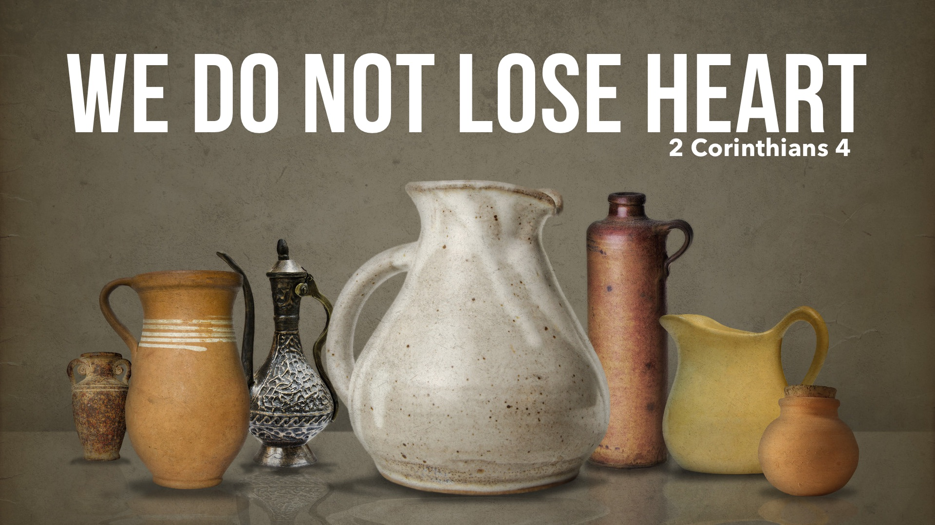

Slide 2
By God’s Mercy We Are CARRYING Beautiful Treasures
The gospel was entrusted to PERISHABLE vessels so that its imperishable beauty (1 Peter 1.23-25) is seen in the POWER of God.

Slide 3
By God’s Mercy We Are CONQUERING Hardships
When we PROCLAIM Christ: 5-7, 10-11
When we believe in His PROMISES: 13-14; cf. 5.7, 10
When we give Him the PRAISE: 15

Slide 4
By God’s Mercy We Are COURAGEOUS
When we put our suffering into PERSPECTIVE – that the weight of glory is beyond the weight of suffering – what seems to be an extreme burden is hardly a burden at all, and what seems to be an everlasting burden is only temporary. Therefore, we do not lose heart!

