Slide 1
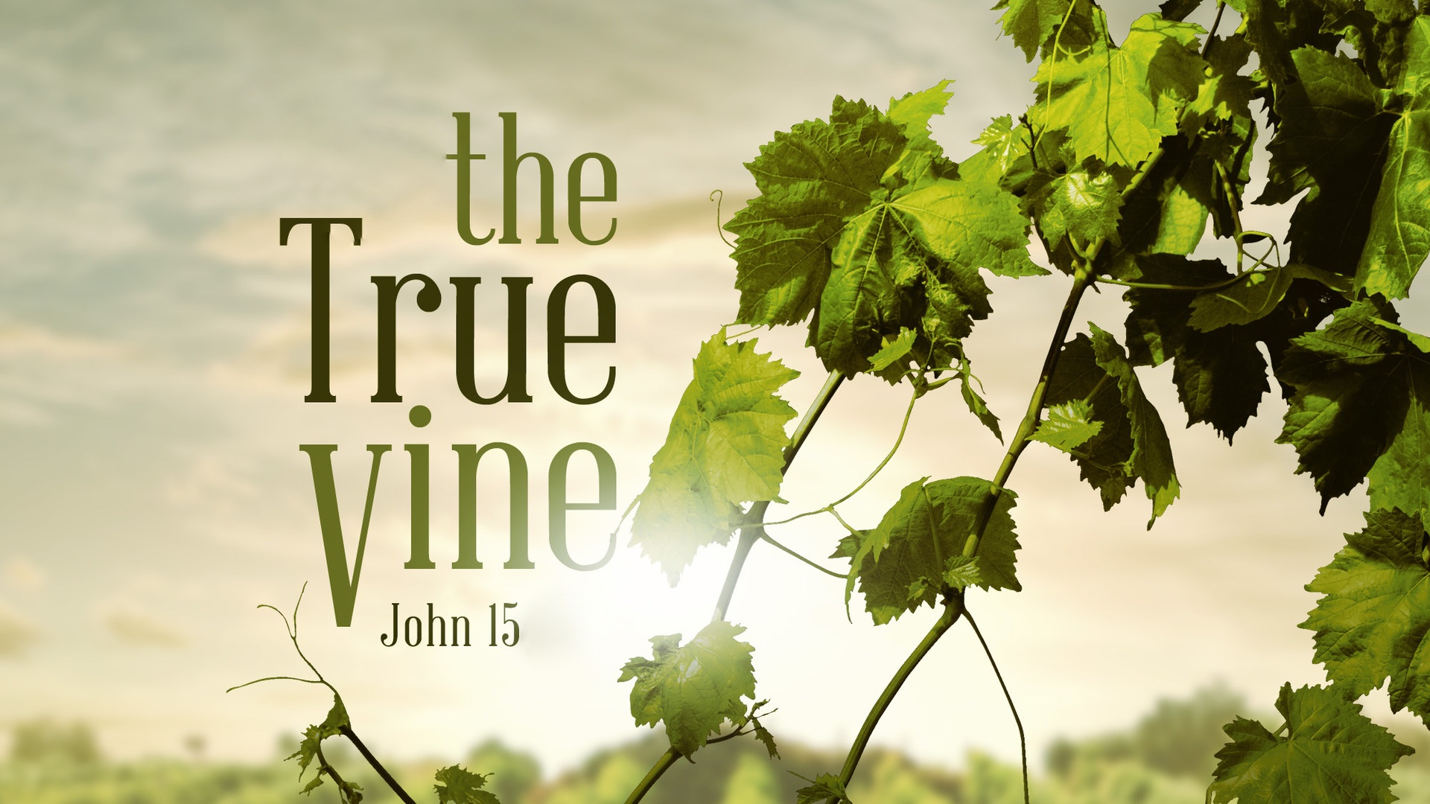

Slide 2
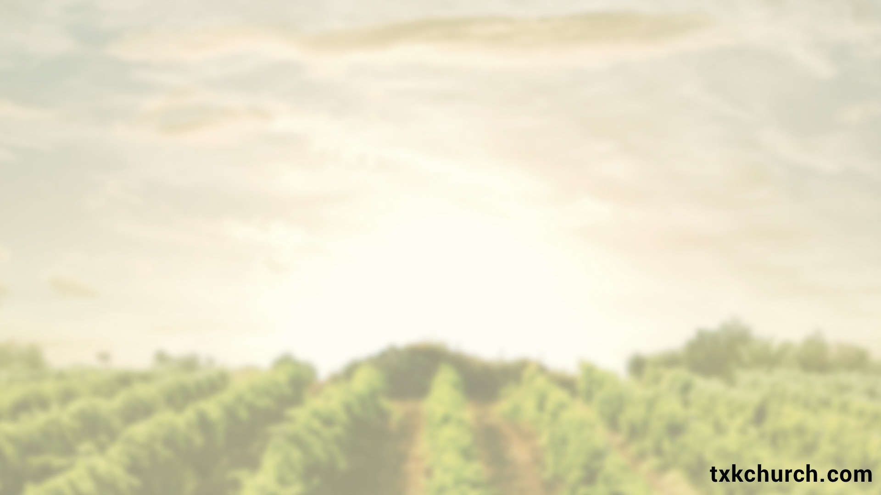
Abiding in the True Vine Involves PRUNING
Pruning is done through OBEDIENCE to God’s word:
John 14.23-24; 15.3, 7
As we follow His word, we will grow in maturity, wis-dom, purity, etc., and put to death any sin in our life because we are ADDING godly qualities to our faith:
Gal. 5.22-23; 2 Peter 1.5-11; cf. Heb. 12.5-6, 11; 1 Peter 1.6-9; James 1.2; Phil. 3.7-11; Luke 8.15

Slide 3
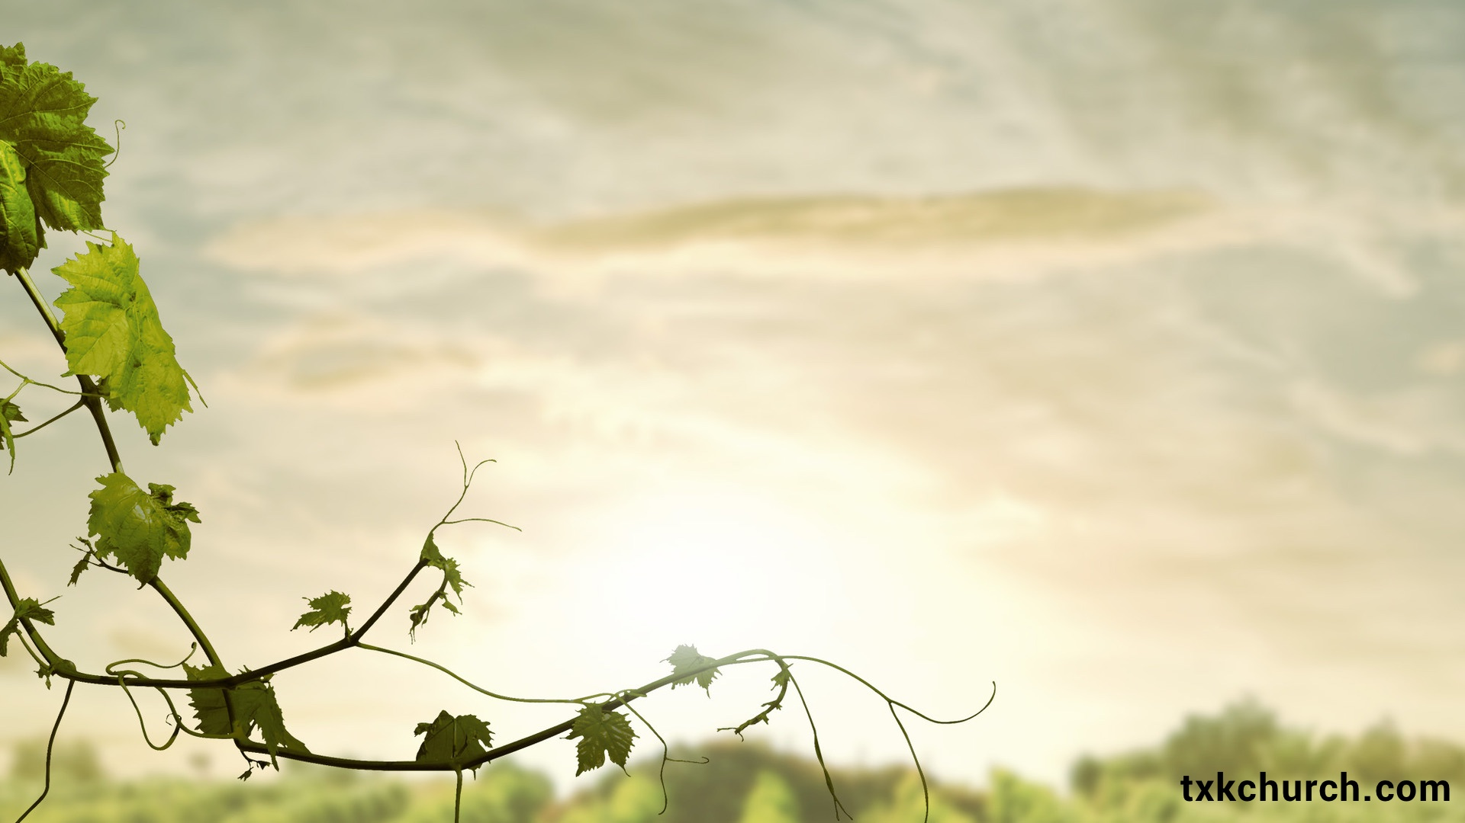
We determine whether the vinedresser cuts us off (for being FRUITLESS), or cuts on us (to ENSURE fruitfulness): Rom. 11.22

Slide 4
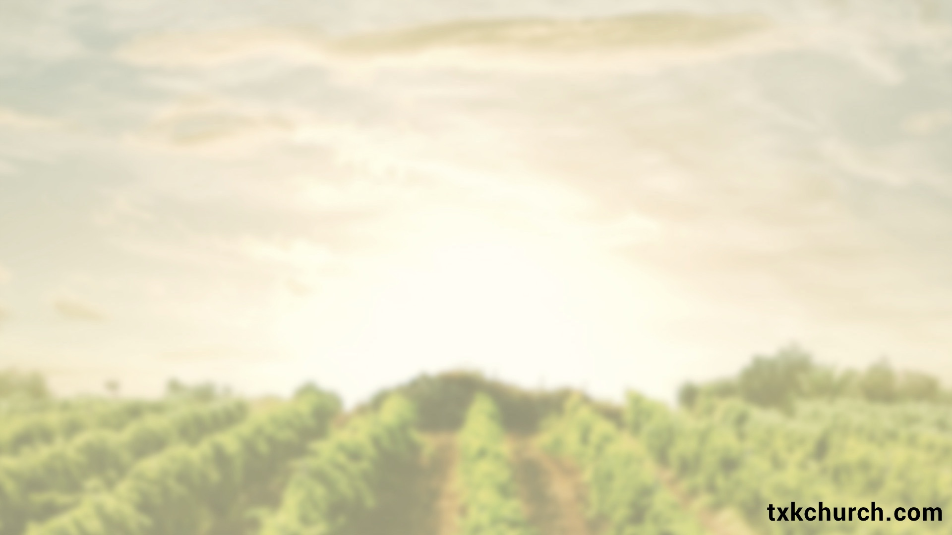
Abiding in the True Vine PROVIDES Life
We are fully DEPENDENT upon Jesus for spiritual life; for there is no life apart from Christ, the True Vine:
Acts 4.12; John 14.6; Phil. 4.13; Gal. 2.20

Slide 5
Abiding in the True Vine PRODUCES Fruit
We are to bear fruit by practicing good works that bring glory to God and points others to Him; PROVING that we are His disciples, under His INFLUENCE: 15.4-16; cf. John 13.34-35
By bearing fruit, we show the EXCELLENCY of His law, the POWER of His gospel, and that we are PARTAKERS of the divine nature. This brings glory to God! 2 Peter 1.3-4

Slide 6
Who we serve determines if we
will produce GOOD fruit (glory to God) or BAD fruit (glory to Satan).
Matt. 7.15-27; 12.33-37; Rom. 6.16-18, 21-22; Eph. 5.9; Col. 1.10

