Slide 1
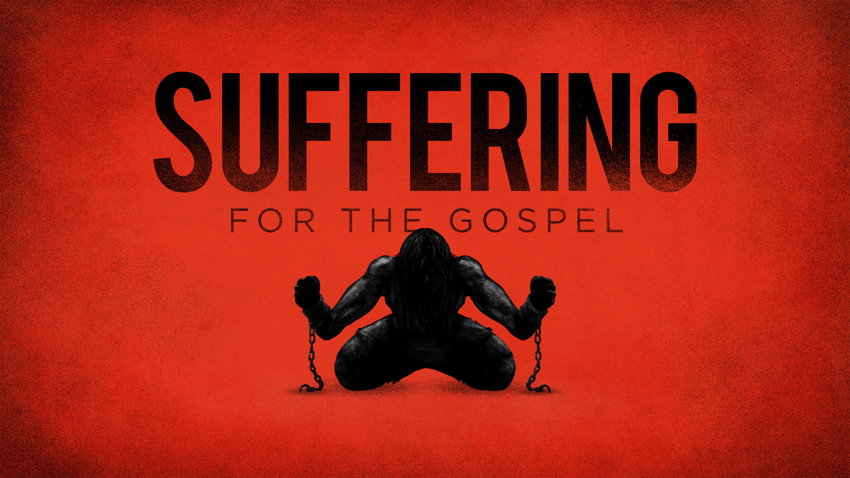

Slide 2
Remember!
When we are facing persecution, we must remember our SAVIOR!
When we are facing persecution, we must remember the hope of our SALVATION.

Slide 3
DIE to LIVE
If we have died with Christ, we can FACE suffering because we no longer view our lives as our OWN: Rom. 6.3-8; Col. 2.11-13; 3.1-3; Gal. 2.20

Slide 4
CLAIM Him to be CLAIMED
If we claim Christ, we will SHARE in His suffering, but be CROWNED with His glory: John 15.18-20, Rom. 8.17; Mark 13.13; Matt. 10.32-33; John 12.42-43; Rev. 2.13; 3.8; Rev. 2.10; 3.21; 2 Tim. 4.6-8; 1 Peter 4.13

Slide 5
TRUST the TRUSTWORTHY
If we are not faithful to Christ, He will remain faithful and keep His PROMISE to deny those who are faithless.

