Slide 2
We Should Not Be Surprised.
Jesus said the world would hate us.

Slide 3
John 15.18-21; Matthew 10.22
“If the world hates you, know that it has hated me before it hated you. If you were of the world, the world would love you as its own; but because you are not of the world, but I chose you out of the world, therefore the world hates you. Remember the word that I said to you: ‘A servant is not greater than his master.’ If they persecuted me, they will also persecute you. If they kept my word, they will also keep yours. But all these things they will do to you on account of my name, because they do not know him who sent me.”

Slide 4
John 16.1-3
“I have said all these things to you to keep you from falling away. They will put you out of the synagogues. Indeed, the hour is coming when whoever kills you will think he is offering service to God. And they will do these things because they have not known the Father, nor me.”

Slide 5
Luke 7.34; Matthew 10.24-25
“The Son of Man has come eating and drinking, and you say, ‘Look at him! A glutton and a drunkard, a friend of tax collectors and sinners!’”
“A disciple is not above his teacher, nor a servant above his master. It is enough for the disciple to be like his teacher, and the servant like his master. If they have called the master of the house Beelzebul, how much more will they malign those of his household.”

Slide 6
Acts 24.5, 14
“For we have found this man a plague, one who stirs up riots among all the Jews throughout the world and is a ringleader of the sect of the Nazarenes.”
“But this I confess to you, that according to the Way, which they call a sect, I worship the God of our fathers, believing everything laid down by the Law and written in the Prophets”

Slide 7
Acts 28.21-22
“And they said to him, “We have received no letters from Judea about you, and none of the brothers coming here has reported or spoken any evil about you. But we desire to hear from you what your views are, for with regard to this sect we know that everywhere it is spoken against.”

Slide 8
1 Peter 4.12-16
Beloved, do not be surprised at the fiery trial when it comes upon you to test you, as though something strange were happening to you. But rejoice insofar as you share Christ's sufferings, that you may also rejoice and be glad when his glory is revealed. If you are insulted for the name of Christ, you are blessed, because the Spirit of glory and of God rests upon you. But let none of you suffer as a murderer or a thief or an evildoer or as a meddler. Yet if anyone suffers as a Christian, let him not be ashamed, but let him glorify God in that name.

Slide 9
Matthew 5.10-12
“Blessed are those who are persecuted for righteousness' sake, for theirs is the kingdom of heaven. ‘Blessed are you when others revile you and persecute you and utter all kinds of evil against you falsely on my account. Rejoice and be glad, for your reward is great in heaven, for so they persecuted the prophets who were before you.’”

Slide 10
What to Expect as a Christian
When we stand for the truth, we will be spoken against, attacked, called names, falsely labeled, misrepresented, mistreated, and have false charges made against us!
Falsely labeling us a cult is intended to produce prejudice and scare people away from investigating if what we teach is the truth!
Remember, our Master was mistreated by unbelievers.

Slide 11
What is a Cult?

Slide 12
The American Heritage Dictionary
“A religion or religious sect generally considered to be extremist or false, with its followers often living in an unconventional manner under the guidance of an authoritarian, charismatic leader.”
(ahdictionary.com)

Slide 13
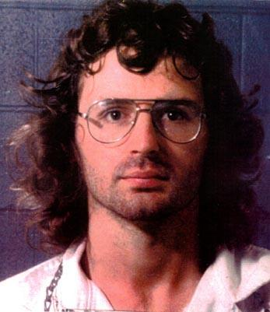
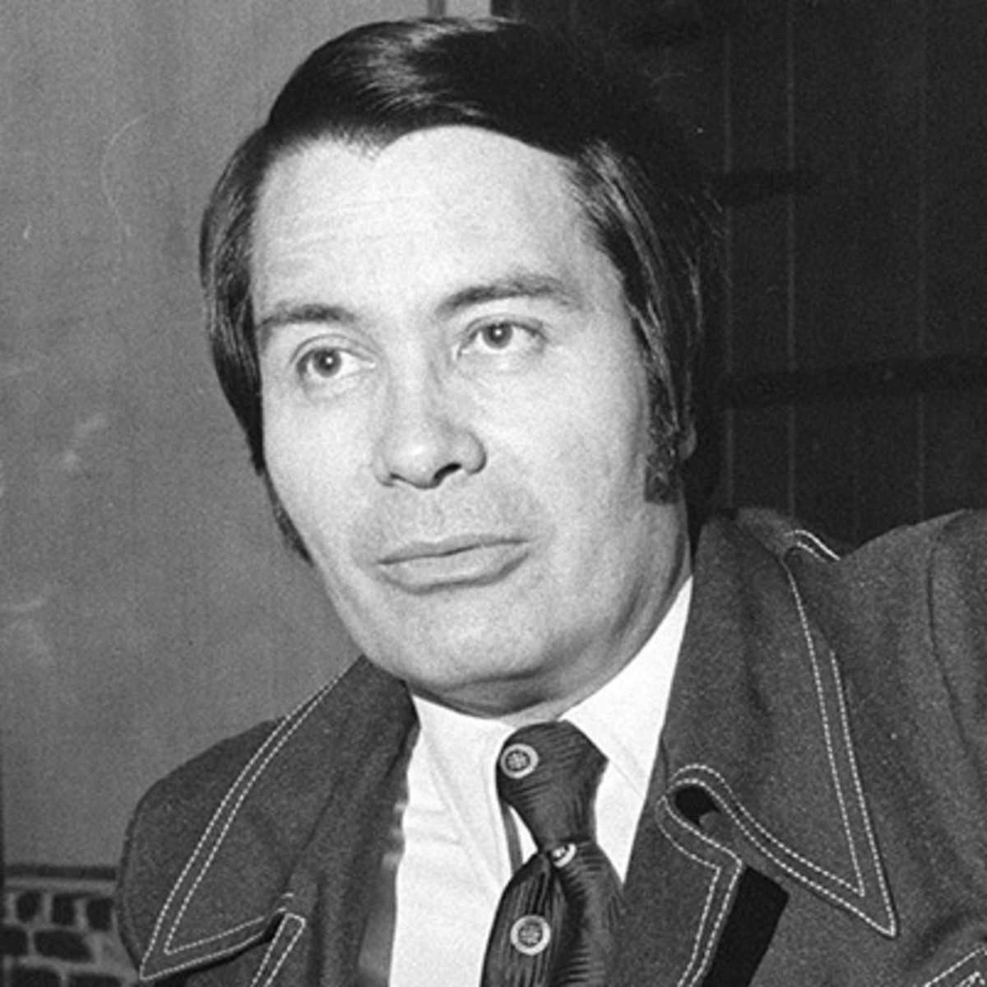
David Koresh
Branch Davidians
Waco, TX, 1993
James Jones (Jim Jones)
The People’s Temple
Georgetown, Guyana, 1978
“Jonestown”

Slide 14
Distinguishing Characteristics
Secretive in activities and rituals; secrecy is valued, sometimes on the pain of death. Unwilling for open investigation of teachings, practices, and business affairs from the outside; members are not to question anything, but trust the system.

Slide 15
Distinguishing Characteristics
Unconventional methods of study and interpretation; one is subject to hours of repetitive lectures, loss of sleep, control of diet – forms of brainwashing; members are taught to accept teachings even if not reasonable or rational; critical thinking is opposed and downplayed because questions that probe to seek for the truth, are viewed as rebellion to the leader or leadership.

Slide 16
Distinguishing Characteristics
A charismatic leader who initially developed beliefs and practices, who abuses his power by taking undue advantage of followers (sometimes even sexual exploitation of both genders) and who may claim special revelation from God - including insider end-world understanding and extra-biblical revelation.

Slide 17
Distinguishing Characteristics
Revelation only to the leaders makes the group dependent upon them for the truth. Leaders claim to be prophets, etc.; leaders are not to be questioned.
Members sometimes worship and honor the leaders. Even sometimes with inappropriate loyalty (crossing the line of sexual purity and personal ownership).

Slide 18
Distinguishing Characteristics
“Love bombing”: showing extreme love and devotion to an individual member and showering them with care and gifts with the hopes to create an emotional dependency.

Slide 19
Distinguishing Characteristics
Complete loyalty is demanded of the followers – where you live, who you date, which church to go to, your job, physical separation from your family (one must leave them to be a part of the group), etc.; intimidation, guilt, paranoia, and fear are used to control the membership; punishment may include isolating members from those on the outside (in fact, cults are deeply suspicious of the outside), physical punishment, death, and/or penalizing them for leaving.

Slide 20
Distinguishing Characteristics
Members will have a persecution complex (us against them mentality); this is maintained by paranoia. They are convinced that somebody out there is trying to get them.
Sometimes they have compounds that are located out in the middle of nowhere; isolation is encouraged; paranoia is maintained.

Slide 21
Distinguishing Characteristics
To be admitted and/or to advance in ranks, oaths may be required (sometimes on pain of death) in order to be accepted.
Those starting out at the bottom have very little idea about the true nature of the organization; they are only allowed to have more knowledge as they go up in the ranks (inner circles or degrees); there may be different doctrines for the different ranks. Leaders have power and rights; the common people do not, etc.

Slide 22
Why Are We Labeled a Cult?

Slide 23
Why Are We Labeled a Cult?
We reject faith only. James 2.24
We reject “God doesn’t care what you do as long as you believe in Him.” Matt. 7.21
We reject denominations because denominations are foreign to scripture! 1 Cor. 1.10ff; Eph. 4.1-6
We teach that obeying God is necessary for salvation. Luke 6.46; Heb. 5.9
We withdraw from brethren who have become unfaithful to God. Matt. 18.15-17; 1 Cor. 5; 2 Thess. 3.14-15; Titus 3.10

Slide 24
Why Are We Labeled a Cult?
We teach that we must submit to God’s moral standards and not the world’s. John 12.48; Eph. 5.11
We teach that there is no truth outside of the Bible and that the Bible is our sole authority in all religious matters and the only way for mankind to have unity is through the Scriptures. Additionally, we demand book, chapter, and verse. John 12.48; Col. 3.17; 1 Peter 4.11
We demand faithfulness to God because God demands faithfulness to Himself. Rev. 2.10

Slide 25
Why Are We Labeled a Cult?
Sometimes it is used by those in ignorance or hatred to keep people from investigating the truth. Acts 17.11
When one can’t answer arguments in a rational way, they start name calling or discrediting the source.
Sometimes we are lumped in with groups like ICOC, which is a cult.
“We told people what to do, when to do it and how to do it. We controlled every area of their lives…” (“Why I Left” by Gustavo Sassano, formerly the ICOC’s top leader in Argentina)

Slide 26
To the denominational world, the doctrines we hold to are extreme and unorthodox (contrary to what is usual, traditional, or accepted). We are different and therefore, “we must be a cult”. Matt. 15.1-14

Slide 27
The Lord’s Church Is Not a Cult

Slide 28
The Lord’s Church Is Not a Cult
The Lord’s church does not possess secret truth revealed only to them; we are open for investigation.
Cult’s claim to have extra, special revelation from God. However, we are not receiving revelation anymore: Jude 3; 2 Peter 1.3-4
All cult teachings must be blindly accepted. Questions that probe to seek the truth, are viewed as rebellion to the leadership.
We have no closed teachings: Anything said or done in our worship assembly, Bible studies, and activities is open for careful investigation. We do not hide any teachings whatsoever.
Test us: John 8.31-32; 18.20; Acts 17.11; 1 Thess. 5.21; 1 John 4.1

Slide 29
The Lord’s Church Is Not a Cult
The Lord’s church submits to Christ alone.
No so-called modern prophets or apostles (unlike some cults).
There is no human leader or organization or board of the Church upon the earth; only Jesus: Eph. 1.22; 5.23-24; Col. 3.17
Our Leader never exploited power: John 6.15; 13.1-20; Matt. 4.1-11; Phil. 2.5-11
We do have leaders in the church, only because God desires that: Eph. 4.11-12

Slide 30
The Lord’s Church Is Not a Cult
Their scope of authority is limited and localized: Acts 14.23; 1 Peter 5.1-3
They must meet specific biblical qualifications: 1 Tim. 3.1-7; Titus 1.5-9; 1 Peter 5.2
There is no “one-man eldership” authorized; there must be a plurality to make sure there is not an abuse of power, among other reasons. Additionally, there are no ranks within the eldership, they are equal in authority.
Preachers, like everyone else, are under the elders. Heb. 13.17
They are appointed by the church; they do not take the power themselves. There are checks and balances in place to keep the elders in their place (1 Tim. 5.19; they can become unqualified and the church may remove them from office).

Slide 31
The Lord’s Church Is Not a Cult
The Lord’s church does not make merchandise of its members.
Forced giving: Cults frequently demand their adherents to forfeit money and/or their personal property to the cult leader.
In the N. T. we find that Christians voluntarily sold possessions in time of great need to help needy saints (not the leadership): Acts 2.45; 4.35; 11.29; 1 Cor. 16.2
Churches did not make constant appeals for funds because of the vision of some leader.

Slide 32
The Lord’s Church Is Not a Cult
The Lord’s church is all the saved.
Jesus is the Savior of His church: Matt. 16.18; Eph. 5.23
There is only one church [body]: Col. 1.18, 24; Eph. 4.4
One is added to the body/church when saved: Acts 2.38, 41, 47; 1 Cor. 12.13
The church revealed in the N.T. is not a cult, sect, or denomination. It is the one body. The apostles taught the same thing.

Slide 33
The Lord’s Church Is Not a Cult
The Lord’s church does not fit the cult characteristics.
We teach respect for the laws of the land (contrary to cults): Rom. 13.1ff; 1 Tim. 2.1-3; 1 Peter 2.13-17
We teach to obey employers: Eph. 6.5-9
We (and the eldership) do not control members’ life (except, we must demand loyalty to Christ).
We do not use intimidation, sleep deprivation, and paranoia to teach, but love, patience, and gentleness.
We have no manual, but the Bible.

Slide 34
When we serve Jesus, we will have enemies of the cross (Phil. 3.17-19). Will you serve Jesus, regardless of what others label you as?

