Slide 2
The Eye Is the LAMP of the Body
Our eyes can be a stumbling block to our spiritual HEALTH: Luke 11.33-36; 1 John 2.16
What we VIEW with our eyes can affect our minds; where we FIX our eyes affects our whole life.
If we KEEP our eyes from sin, we will keep our whole body from sin! Luke 8.14

Slide 3
Are We Entertained by Sin?
Some entertainment glorifies sin: lying, revenge, ungodly lifestyles such as cohabitation, fornication, adultery and homosexuality, nudity, criminal activity, sex, drugs, immodesty, dirty dancing, drunkenness, etc.

Slide 4
What Is Our Motivation for Watching Sin?
Is it our way of enjoying the things of this world and the lives we use to live before becoming a disciple of Jesus?
Why are we entertained by the sins that will send us to hell if we were to actually engage in them?
Why are we entertained by the sins that Christ died for?

Slide 5
What Does the Bible Say?
We are to avoid things that are not “FITTING” for saints: Eph. 4.29-32; 5.1-21
We are to EXPOSE sin: Eph. 5.11-12
We are to ABSTAIN from every form of evil: 1 Thess. 5.22
We are to be PURE in heart: Matt. 5.8; Phil. 4.8; Col. 3.1-3; 1 Cor. 15.33

Slide 6
What Does the Bible Say?
BUT we can WATCH things God hates?
How can we say we do not love sin if we LOVE to watch it?
It is sin whether we PARTICIPATE in it or just enjoy watching it! cf. Rom. 1.32

Slide 7
“Television is an invention that PERMITS you to be entertained in your living room by people you would NOT have in your home…”
David Frost

Slide 8
The Solution to the PROBLEM
Turn the TRASH off! Rom. 12.9
Make a COMMITMENT: Psalm 101.3; 119.37; Gal. 5.23
Don’t make EXCUSES! “I can handle it.” “I’m mature enough to watch this.”

Slide 9
The Solution to the PROBLEM
REVIEW movies:
Kidsinmind.com
pluggedin.com
commonsensemedia.org

Slide 10
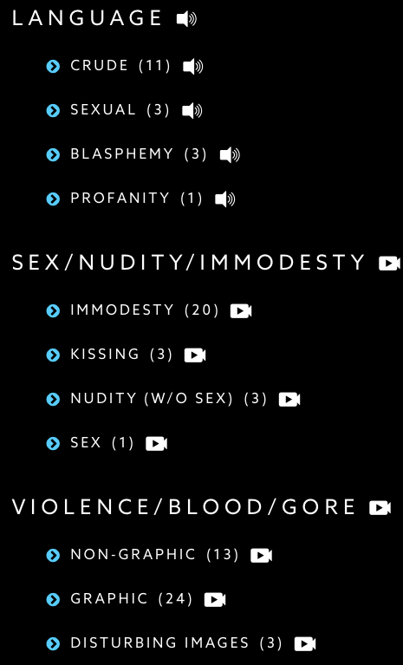
The Solution to the PROBLEM

Slide 11
The Solution to the PROBLEM
QUESTION everything watched or read:
Is this something that God hates?
Is this fitting for saints?
What if the Lord returned as I am watching?
Does this entertainment glorify God? 1 Cor. 10.31
Will this affect my influence as a Christian?
Is this a good and wise use of my time as a Christian?
Does this entertainment draw me away from Christ?
Does this entertainment allow me to set my mind on things above? Col. 3.1-2

Slide 12
We cannot have a pure mind when we fill it with that which is IMPURE.

