Slide 1
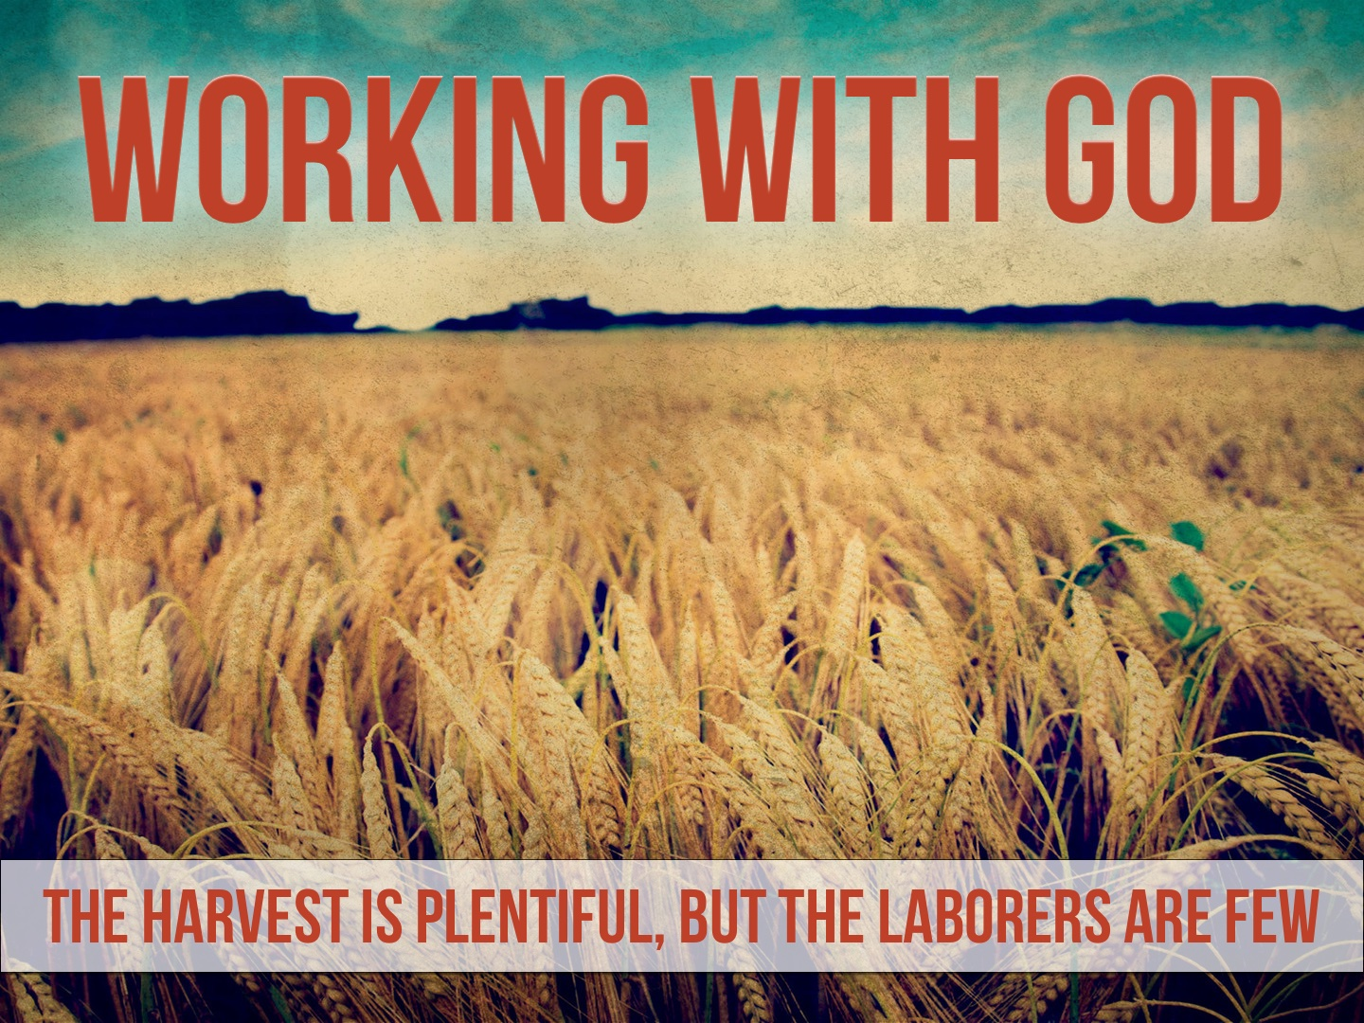

Slide 2
We Are Laborers Together with God
If we have obeyed the gospel, we have entered into the work of the Lord: Matt. 28.18-20
God has graciously made us a vital part of His work: Rom. 10.13-17; 1 Cor. 1.21; Acts, etc.
God demonstrated His trust in us by entrusting us with the gospel: 1 Tim. 1.11; 6.20; 2 Tim. 1.14

Slide 3
We Are Expected to Labor
God desires that we will be eager to join Him in His work of saving men: Titus 2.11-14; Eph. 2.10
There is no one but us to do this great work: Eph. 2.10; 2 Tim. 2.19-21; 1 Tim. 3.15; Rom. 10.13-14; Matt. 28.18-20; Mark 16.15-16
Laborers are needed in the harvest field. There is much work to do: Matt. 9.35-38

Slide 4
Our Labor Impacts the Results
A direct correlation exists between our labor and people being saved: Rom. 10.14
How did the apostles and disciples accomplish so much? Acts 2.46; 5.42; 20.20.
We must realize our responsibility. If we fail to do our part, there can be no increase: 1 Cor. 3.6; 15.58; Rev. 13.14

