Slide 4
1.94 billion monthly active users
1.28 billion daily active users
29.7% of users are age 25 to 34
5 new profiles are created every second
Source: zephoria.com
Notes:
Source: https://zephoria.com/top-15-valuable-facebook-statistics/

Slide 5
300 million photos are uploaded per day
20 minutes average time per visit
4.75 billion pieces of content shared daily
Source: zephoria.com
Notes:
Source: https://zephoria.com/top-15-valuable-facebook-statistics/

Slide 6
510k comments are posted
293k statuses are updated
136k photos are uploaded
every 60 seconds
Source: zephoria.com
Notes:
Source: https://zephoria.com/top-15-valuable-facebook-statistics/

Slide 7
Twitter
319 million active users
500 million tweets a day
Source: zephoria.com | omnicoreagency.com
Notes:
Source: https://zephoria.com/top-15-valuable-facebook-statistics/

Slide 8
snapchat:
166 million daily active users
Snaps per day: 3 billion
9,000 snaps sent per second
10 billion videos a day
793 years to watch every snap made in a single day
Sources: mediakix.com | expandedramblings.com
Notes:
Sources:
http://www.businessinsider.com/snapchat-photos-sent-per-second-2015-5
http://www.digitaltrends.com/social-media/snapchat-10-billion/

Slide 9
Oxford Dictionaries 2013 Word of the Year, “selfie”
Source: oxforddictionaires.com
Notes:
http://blog.oxforddictionaries.com/2014/06/social-media-changing-language/

Slide 10
3.25 billion hours watched each month
estimated 300-400 hours of video uploaded every 60 secs
almost 5 billion videos are watched daily
average mobile viewing session lasts more than 40 mins
Source: expandedramblings.com | fortunelords.com
Notes:
http://blog.oxforddictionaries.com/2014/06/social-media-changing-language/

Slide 11
What Good Can We Do With Social Media?
Keep up with family, friends, and brethren from all around the world.
Provides free and clean entertainment.
Our “web presence” to promote the gospel within the community/world.
Notes:
Source: https://zephoria.com/top-15-valuable-facebook-statistics/

Slide 13
What Evil Can We Do With Social Media?
Divide people
Spread lies and bitterness
Advance false doctrines
Pornography
Profanity
Immodesty
All kinds of immorality
Notes:
Source: https://zephoria.com/top-15-valuable-facebook-statistics/

Slide 14
Watch what you POST on

Slide 15
Watch What You Post on Facebook
Do not BROADCAST sin to the world: Matt. 5.14-16; 12.36-37; Eph. 4.29-32; 5.3-5; Rom. 12.1-2; 1 Peter 4.3-5; 1 Tim. 4.12; 1 Peter 2.12; Titus 2.7-8; Matt. 18.6
Corrupt words, complaining, angry thoughts (venting), gossip, arguments, immodesty, inappropriate images, etc.
Notes:
Source: https://zephoria.com/top-15-valuable-facebook-statistics/

Slide 16
Watch What You Post on Facebook
THINK before you post:
Is it TRUTHFUL?
Is it NECESSARY?
Is it KIND?
Is it APPROPRIATE?
If it's a sin OFFLINE, it's a sin ONLINE!
Notes:
Source: https://zephoria.com/top-15-valuable-facebook-statistics/

Slide 17
Watch what you SHARE/LIKE on

Slide 18
Watch What You Share/Like on Facebook
Are we guilty of sharing / liking SIN?
“Memes” sometimes include immodesty, profanity, immorality, gossip, blasting people, inappropriate images, etc.
A meme consists of an image and funny caption.
Notes:
Source: https://zephoria.com/top-15-valuable-facebook-statistics/

Slide 19
Notes:
Source: https://zephoria.com/top-15-valuable-facebook-statistics/

Slide 20
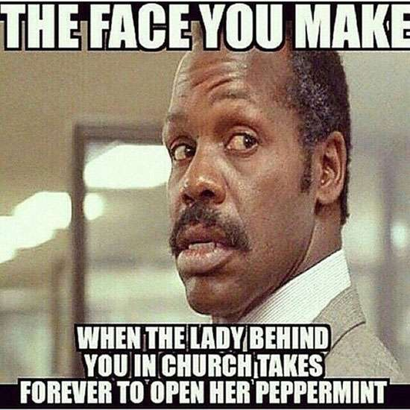
Notes:
Source: https://zephoria.com/top-15-valuable-facebook-statistics/

Slide 21
Notes:
Source: https://zephoria.com/top-15-valuable-facebook-statistics/

Slide 22
Watch What You Share/Like on Facebook
Are we guilty of sharing / liking SIN?
“Memes” sometimes include immodesty, profanity, immorality, gossip, blasting people, inappropriate images, etc.
A meme consists of an image and funny caption.
Are we spreading lies? Slander? Are the facts TRUTHFUL?
Notes:
Source: https://zephoria.com/top-15-valuable-facebook-statistics/

Slide 23
FAKE
Source: World News Daily Report
Notes:
http://worldnewsdailyreport.com/red-sea-archaeologists-discover-remains-of-egyptian-army-from-the-biblical-exodus/

Slide 24
Watch What You Share/Like on Facebook
Pay attention to the source.
When we share an image/video we share the caption, the page it originated from and the comments.
Notes:
Source: https://zephoria.com/top-15-valuable-facebook-statistics/

Slide 25
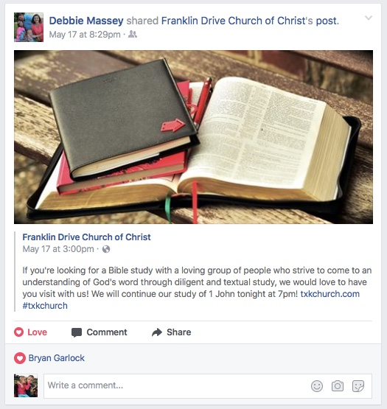
Notes:
Source: https://zephoria.com/top-15-valuable-facebook-statistics/

Slide 26
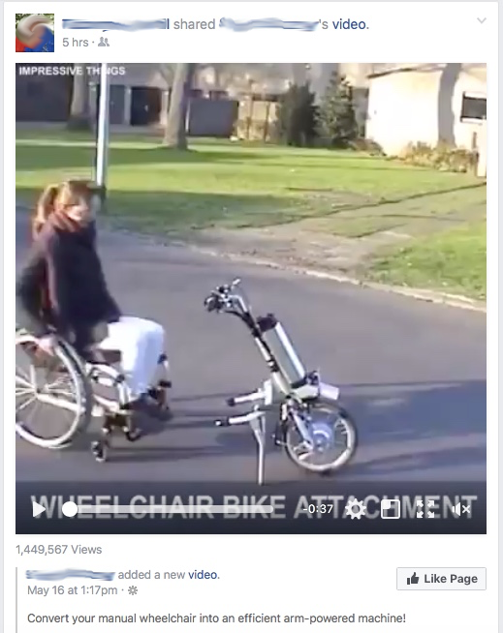
Notes:
Source: https://zephoria.com/top-15-valuable-facebook-statistics/

Slide 27
Watch what you DO on

Slide 28
Watch What You Do on Facebook
Online TEMPTATIONS await you!
the people you BEFRIEND: 1 Cor. 15.33
the things you SEE: Matt. 6.22-23; Psalm 101.3
Do not settle family / friend ISSUES online: Matt. 18.15-17
Notes:
Source: https://zephoria.com/top-15-valuable-facebook-statistics/

Slide 29
Watch your TIME spent on

Slide 30
How Much Time Do We Spend on Social Media?
2013: 14 times a day
2015: 1 hour and 40 minutes browsing time
2015: 50 mins Facebook, Instagram, and Messenger
2017: Adults check 30 times a day
2017: Millennials check 150 times a day
Average time spent per Facebook visit is 20 minutes
Average snapchatters snapchat 18 times a day
Average time spent snapchatting is 30 mins
Sources: socialmediaweek.org | zephoria.com | nbcnews.com | telegraph.co.uk | expandedramblings.com
Notes:
http://www.digitaltrends.com/mobile/informate-report-social-media-smartphone-use/
http://www.marketingcharts.com/online/social-networking-eats-up-3-hours-per-day-for-the-average-american-user-26049/
http://www.cnn.com/2015/11/03/health/teens-tweens-media-screen-use-report/

Slide 31
How Much Time Do We Spend on Facebook?
Newsfeed: updates on family and friends, etc.
Talking to people
Watching videos
“Click bait”
Notes:
http://www.digitaltrends.com/mobile/informate-report-social-media-smartphone-use/
http://www.marketingcharts.com/online/social-networking-eats-up-3-hours-per-day-for-the-average-american-user-26049/
http://www.cnn.com/2015/11/03/health/teens-tweens-media-screen-use-report/

Slide 34
What Are We Doing With Our Time?
What if we checked our Bible 30 times a day?
What if we prayed 30 times a day?
What if we invited 30 people to a Bible study?
“Walk in wisdom toward outsiders, making the best use of the time.” Col. 4.5
Notes:
http://www.digitaltrends.com/mobile/informate-report-social-media-smartphone-use/
http://www.marketingcharts.com/online/social-networking-eats-up-3-hours-per-day-for-the-average-american-user-26049/
http://www.cnn.com/2015/11/03/health/teens-tweens-media-screen-use-report/

Slide 36
What we post, like, or share REFLECTS good or bad on Christ and the church.

