Slide 1
LESSONS FROM

Slide 2
JONAH ESCAPED: CH1
JONAH REPENTED: CH2
JONAH OBEYED: CH3
JONAH BECAME ANGRY: CH4
LESSONS FROM

Slide 3
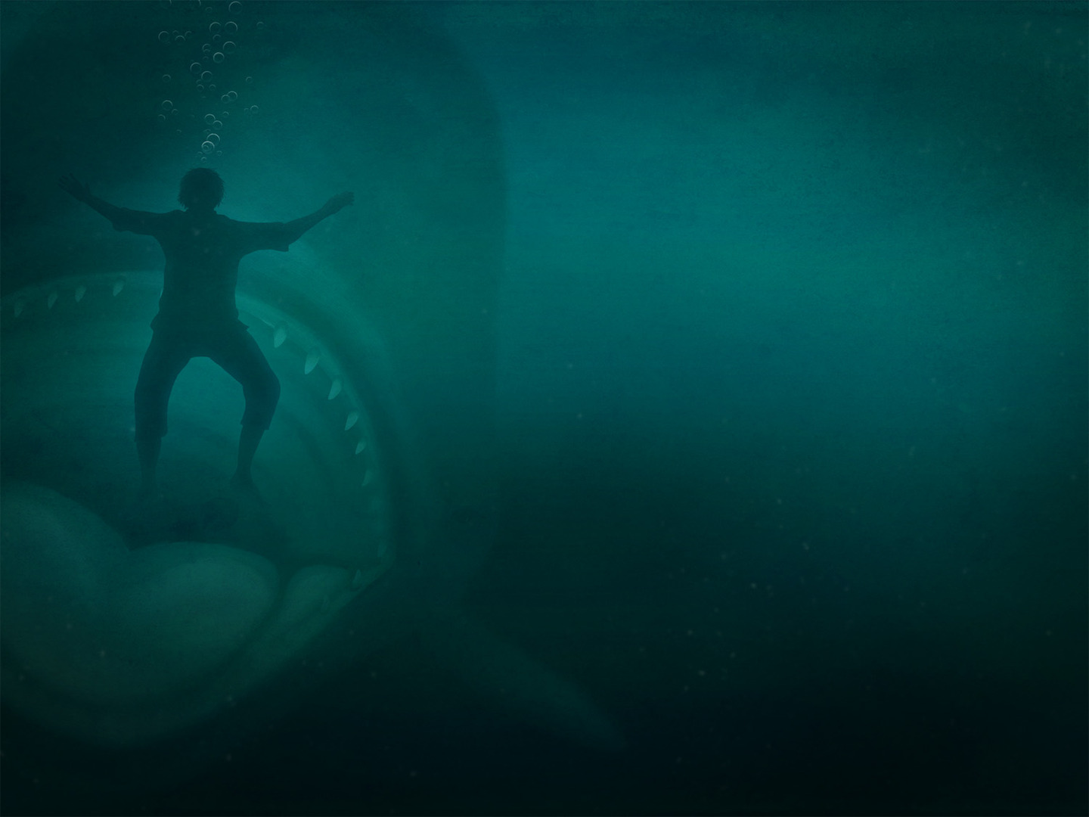
How Much Do We Love Our Enemies?
“If you cared for this plant which you did not create, may I not care for a whole city of people whom I have created?”
If Jonah could have regard for the plant, surely God could have regard for those who repented: Jer. 18.7-8; Ezek. 33.11; 2 Peter 3.9

