Slide 2
Barnabas Was Spiritually Mature
He was full of the Holy Spirit: Acts 6.3; 11.24
He was full of faith: Acts 11.24

Slide 3
Barnabas Set Many Godly Examples
An example in giving: Acts 4.36-37
An example in reliability: Acts 11.22-23, 30; 13.2
An example in promoting unity: Acts 9.26-28; 11.19-23; 15.1-2; 37-39
An example of repentance: Gal. 2.11-14; 1 Cor. 9.6

Slide 4
Barnabas Taught Others
He evangelized: Acts 13.5-12, 43
He taught with boldness: Acts 13.46; 14.3
He taught with persistence: Acts 13.50-51; 14.1
He defended the truth: Acts 15.1-2
He grounded new saints: Acts 11.22-26; 13.1; 15.30-35

Slide 5
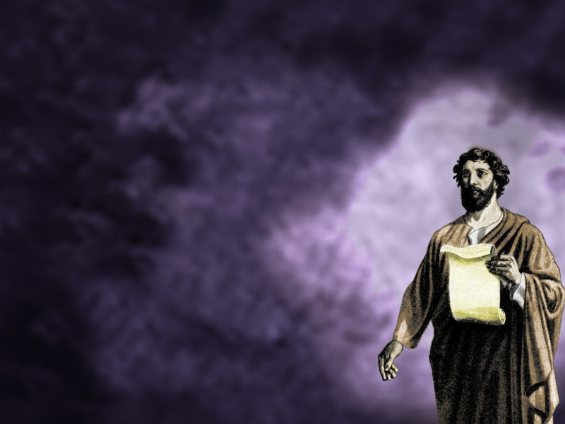
Let us strive to be like Barnabas!

