Slide 1
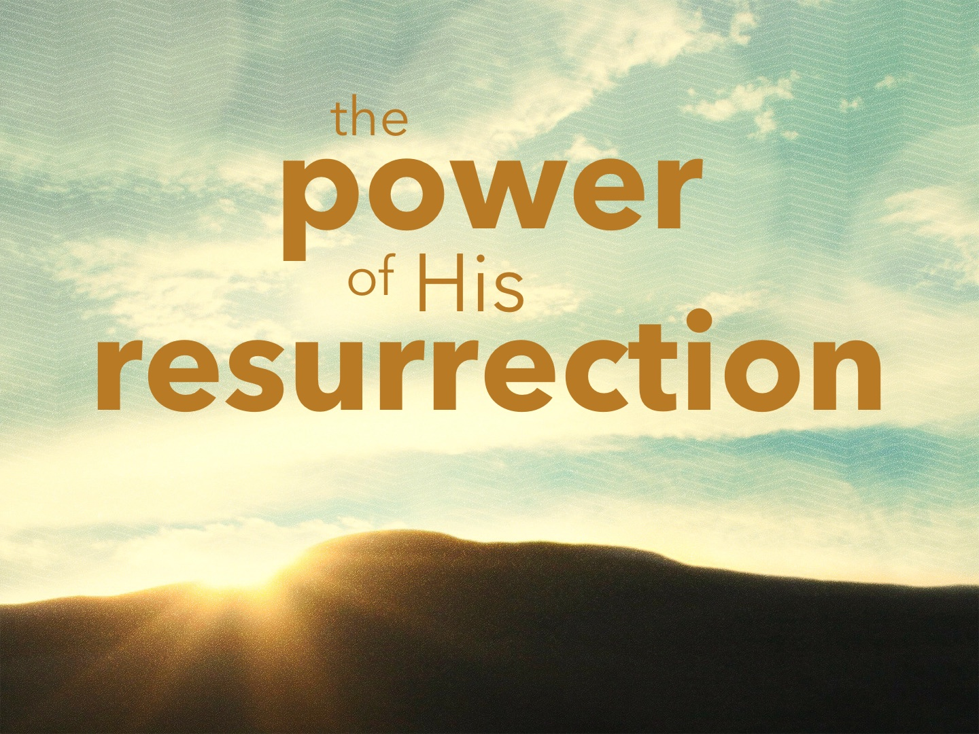

Slide 2
The Resurrection Displayed God’s POWER
Christ’s death, burial and resurrection is the basis for the Christian’s FAITH: 1 Cor. 15.3-4, 12-19
No resurrection – “Christianity” is a WASTE of time.
His words might have some moral influence, but there would be no POWER behind them: Rom. 1.16
Acts 2.24; Rom. 1.4; 2 Cor. 13.4; Phil. 3.10

Slide 3
The Power Is Seen in Our SALVATION
Romans 4.24-25; 5.10
Christ’s DBR is the basis for the Christian’s DBR: Rom. 6.3-11
Baptism and forgiveness are CONDITIONED upon the resurrection: 1 Peter 1.3, 21-23; 3.21; Eph. 1.18-23; 2.1-10; Col. 2.11-13; 1 Cor. 15.17

Slide 4
The Power Is Seen in Overcoming SIN
Romans chapters 6-8
The new life is experienced after BAPTISM: Rom. 6.4; Eph. 4.24; 2 Cor. 5.17
The same power of God that raised up Jesus is at work in US: Eph. 3.20; Phil. 1.6; 2.13; 1 Thess. 2.13; 1 John 2.14

Slide 5
The Power Is Seen in Overcoming SIN
Romans chapters 6-8
We have the power to overcome SATAN: 2 Peter 1.3; James 4.7
As we "overcome" we are being "CONFORMED" Col. 3.1-4, 5-9, 12-17
By the resurrection, Christ proclaimed victory, we too can have VICTORY: 1 John 5.1-5; 4.4

Slide 6
The Power Is Seen in Our RESURRECTION
1 Corinthians 15.20, 23
We have the HOPE and PROMISE of the redemption of our bodies to look forward to: Rom. 8.23; 1 Cor. 6.14; Phil. 3.10, 21

