Slide 1
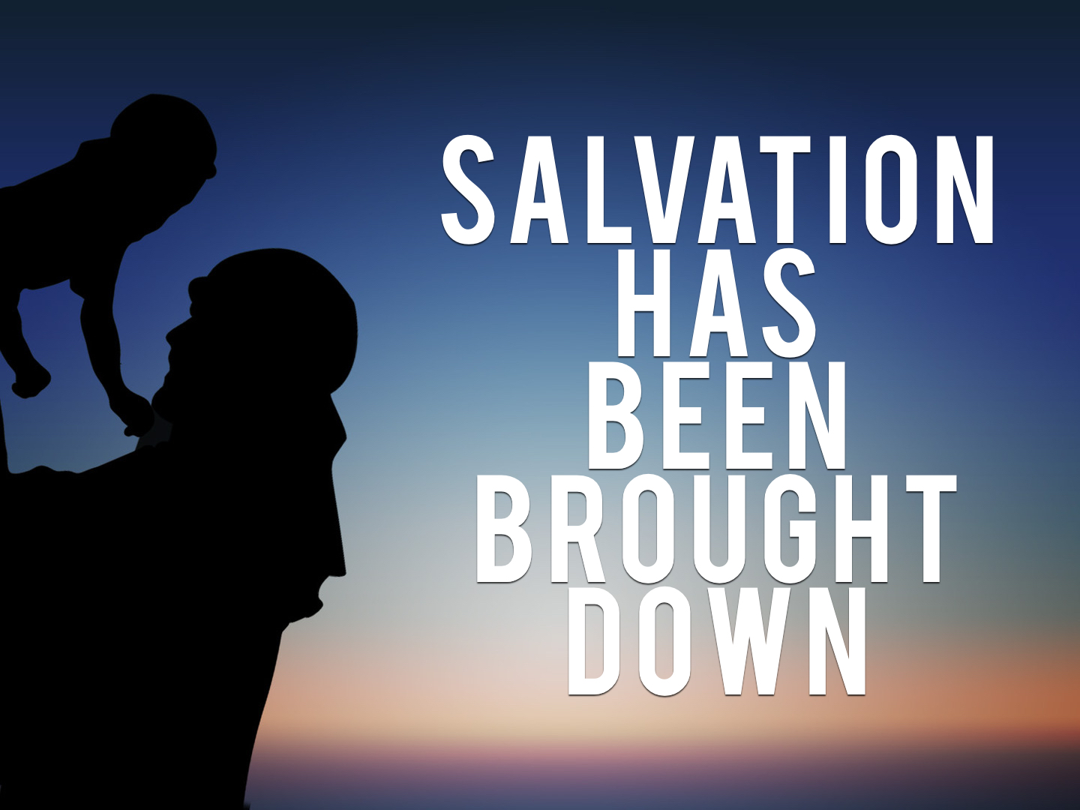

Slide 2
Simeon and Anna
Luke 2.25-28: Just, devout, patient
Luke 2.36-38: Servant, trusting, proclaimer

Slide 3
The Prophet’s Prophecy
Salvation prepared for all people [sinners]: Matt. 1.21; Luke 2.10-11; 4.18-19; 5.31-32; 19.10; 1 Tim. 1.15; 1 John 4.14; cf. Rom. 3.23

Slide 4
The Prophet’s Prophecy
Appointed for the fall and rise of many in Israel: Isaiah 8.14-15; Hosea 14.9; Acts 4.10-12; 1 Cor. 1.23; 1 Peter 2.6-8

Slide 5
The Prophet’s Prophecy
A sign that is to be opposed; spoken against: Psalm 22.6-8; Matt. 2.1-12, 16-23; 11.19; 13.53-58; Mark 3.20-22; Acts 28.22; Jude 15

Slide 6
The Prophet’s Prophecy
A sword that pierced through Mary’s soul: cf. John 19.25
A revealer of hearts: Heb. 4.12

Slide 7
The Prophet’s Prophecy
Simeon saw salvation brought down.
Simeon saw fulfillment of prophecy.
Simeon saw the death of Christ.

Slide 8

For the sinner:
Believe: Acts 16.31
Repent: Acts 2.38
Confess faith: 1 Tim. 6.12
Be immersed: Acts 22.16
For the saint:
Remain faithful: Rev. 2.10
Repent: Col. 3.5
Confess faults: 1 John 1.9

