Slide 2
A Need
The Skills and Abilities
Naysayers, Ridicule and Resistance
Support Each Other
God Helps
A Determination
The Results

Slide 3
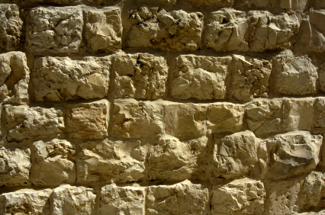
A Mind To Work
John 9:4 "We must work the works of Him who sent Me as long as it is day; night is coming when no one can work.

Slide 4
A New Year Approaching
A Desire To Glorify God
A New Preacher
Fresh Preaching
New Ideas
Enthusiasm

Slide 5
A Need
The Skills and Abilities
Naysayers, Ridicule and Resistance
Support Each Other
God Helps
A Determination
The Results

