Slide 1
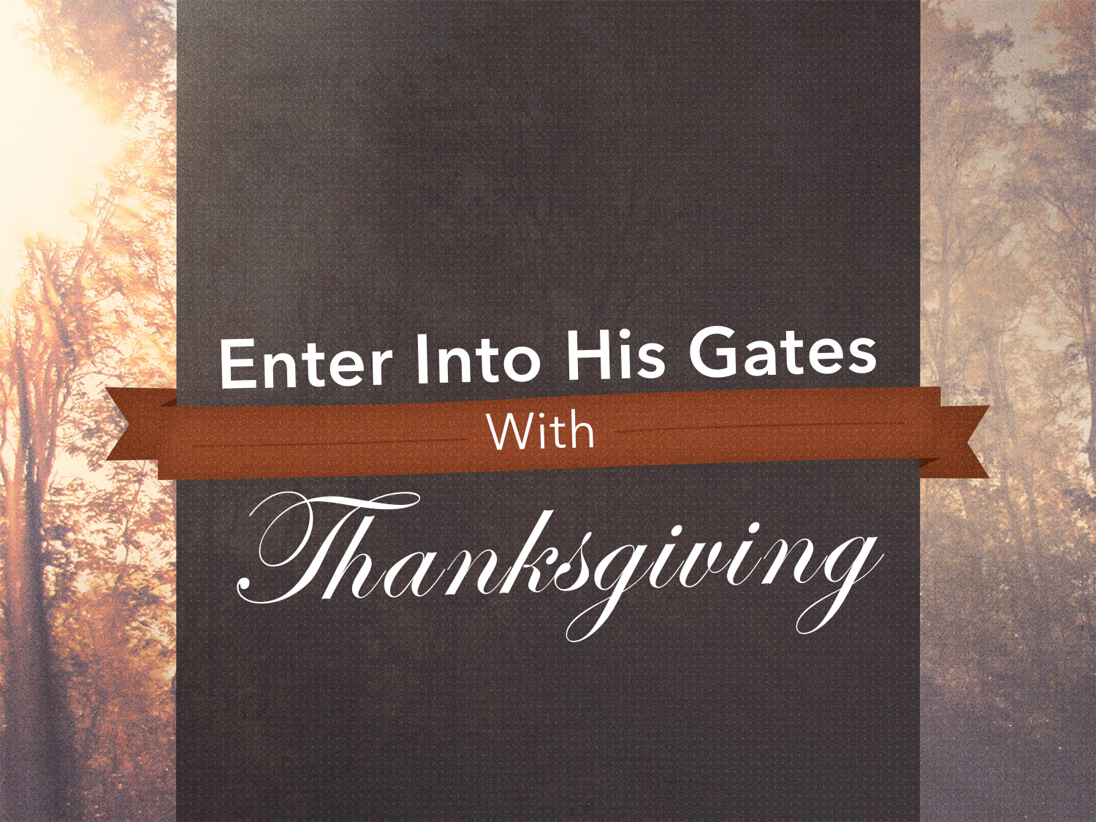

Slide 2
do not be anxious about anything, but in everything by prayer and supplication with thanksgiving let your requests be made known to God.
Philippians 4.6

Slide 3
Continue steadfastly in prayer, being watchful in it with thanksgiving.
Colossians 4.2

Slide 4
giving thanks always and for everything to God the Father in the name of our Lord Jesus Christ
Ephesians 5.20

Slide 5
Give Thanks Always
Psalm 34.1: “I will bless the Lord at all times; his praise shall continually be in my mouth.”
Thanksgiving ought to come before and after God’s blessings: 2 Chron. 20.20-21; Luke 17.11-19

Slide 6
Give Thanks for Everything
Things physical
Things spiritual
Things good & bad: 1 Thess. 5.16-18
All things work together for good: Rom. 8.28, 35-39; cf. Acts 16.25; Col. 4.18; Phil. 1.12-14; 2.14

Slide 7
Give Thanks for Everything
We should ENLARGE upon our blessings rather than EXAGGERATE our troubles!

Slide 8
Give Thanks to God the Father
Because He is the giver of all good gifts…
“Every good gift and every perfect gift is from above, coming down from the Father…” James 1.17

Slide 9
Give Thanks to God the Father
Because He is the source of all blessings…
The God who made the world and everything in it, being Lord of heaven and earth, does not live in temples made by man, nor is he served by human hands, as though he needed anything, since he himself gives to all mankind life and breath and everything. Acts 17.24-25

Slide 10
Give Thanks to God the Father
Because He is our Father…
See what kind of love the Father has given to us, that we should be called children of God; and so we are… 1 John 3.1

Slide 11
Give Thanks in the Name of Our Lord Jesus Christ
And whatever you do, in word or deed, do everything in the name of the Lord Jesus, giving thanks to God the Father through him.
Colossians 3.17

Slide 12
Why does Paul command this?

Slide 13
Ingratitude Toward God is the Height of Ungodliness
Surely the righteous shall give thanks to your name; the upright shall dwell in your presence.
Psalm 140.13 cf. Rom. 1.20-21

Slide 14
The Christian’s Life Ought to Overflow With Thanksgiving
…rooted and built up in him, strengthened in the faith as you were taught, and overflowing with thankfulness.
Colossians 2.7 cf. 3.15

Slide 15
A Thankful Life Is a Prayerful Life.
Through him then let us continually offer up a sacrifice of praise to God, that is, the fruit of lips that acknowledge his name.
Hebrews 13.15

Slide 16

For the sinner:
Hear the gospel: Matt. 17.5
Believe the gospel: Acts 16.31
Repent: Acts 2.38
Confess faith: 1 Tim. 6.12
Be immersed: Acts 22.16
For the saint:
Remain faithful: Rev. 2.10
Be thankful: Eph. 5.20
Repent: Col. 3.5
Confess faults: 1 John 1.9

